Slide 2
EUI – INNOVATIVE ACTIONS
EUI Transfer Study Video Guide
Based on EUI Transfer Study Guidance and Template for Transfer Partners
Adele Bucella and Klemen Strmšnik, EUI Transfer Experts
September 2025

Slide 3

This webinar aims to give inspiration to Transfer Partners producing Transfer Studies

Slide 4
What will we cover in this webinar?
Introduce the Guidance & Template
Present three main Transfer Study chapters:
PART 1 – City Context and Vision
PART 2 – Local Transfer Journey
PART 3 – Next Steps towards Transfer
Provide some tips and examples for improved clarity and quality

Slide 5
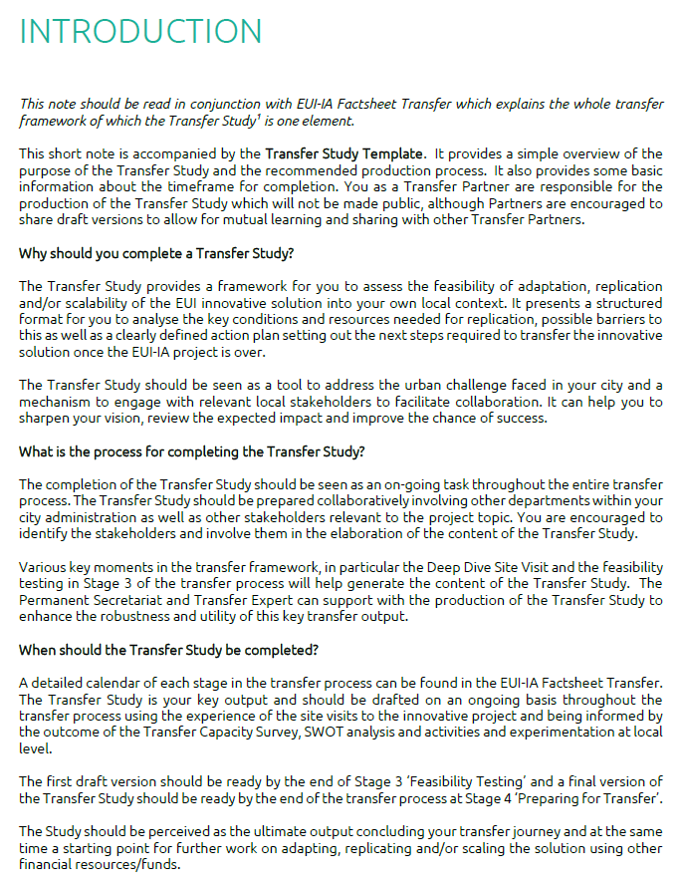
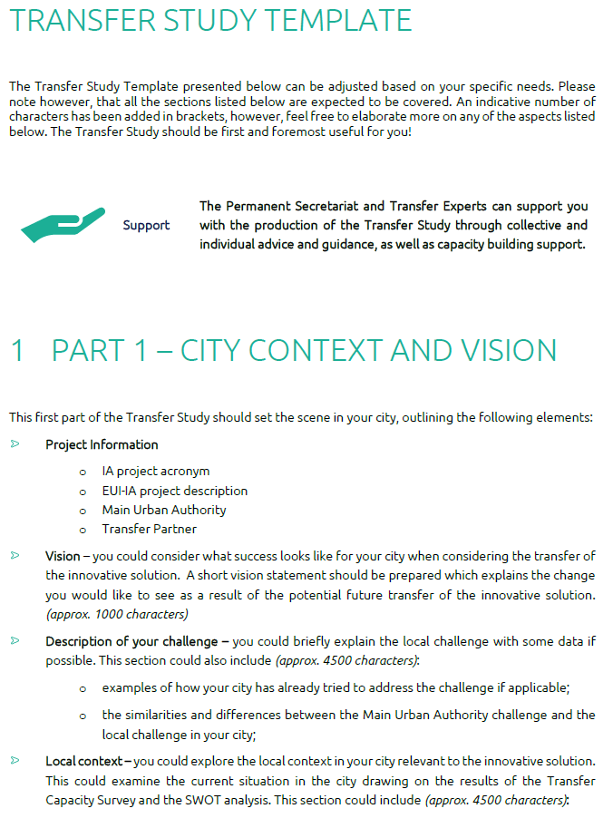
Transfer Study Guidance and Template design

Slide 6
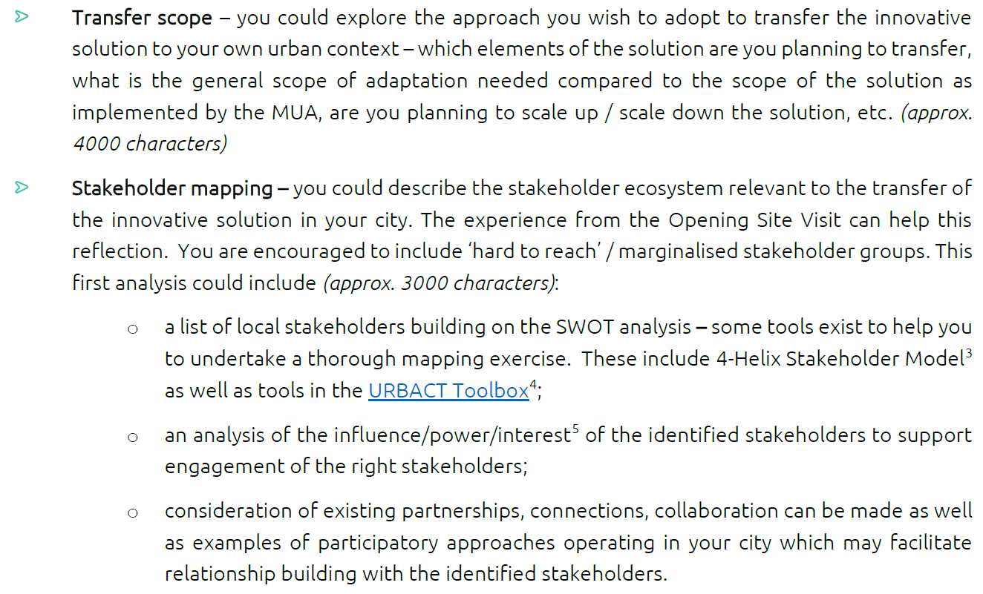
Transfer Study Guidance and Template design

Slide 7
Part 1

Slide 8
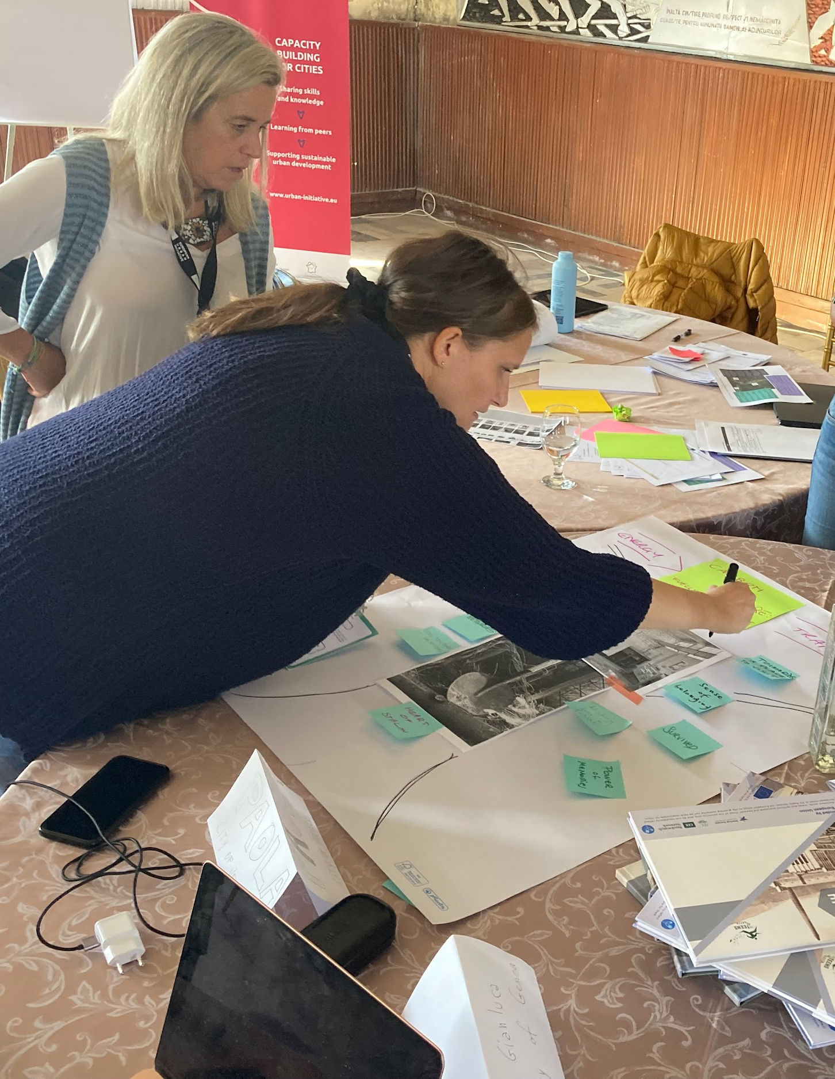

City Context
and Vision
Setting a strong vision statement
Describing the challenge and local context
Presenting the scope of the transfer
Stakeholder mapping
Providing the risk analysis

Slide 9

A strong Vision Statement…
To transform our city into a thriving, biodiverse urban ecosystem where nature and community flourish together — by engaging citizens, redesigning spaces, and fostering a culture of stewardship that ensures resilient green environments for future generations.
… is short and punchy!
… imagines success.
… describes expected change through the transfer process.
… is reinforced with visualisation!
Building a greener, fairer future where no one is left behind — renewing our homes and neighbourhoods to be affordable, sustainable, and full of opportunity for generations to come.

Slide 10
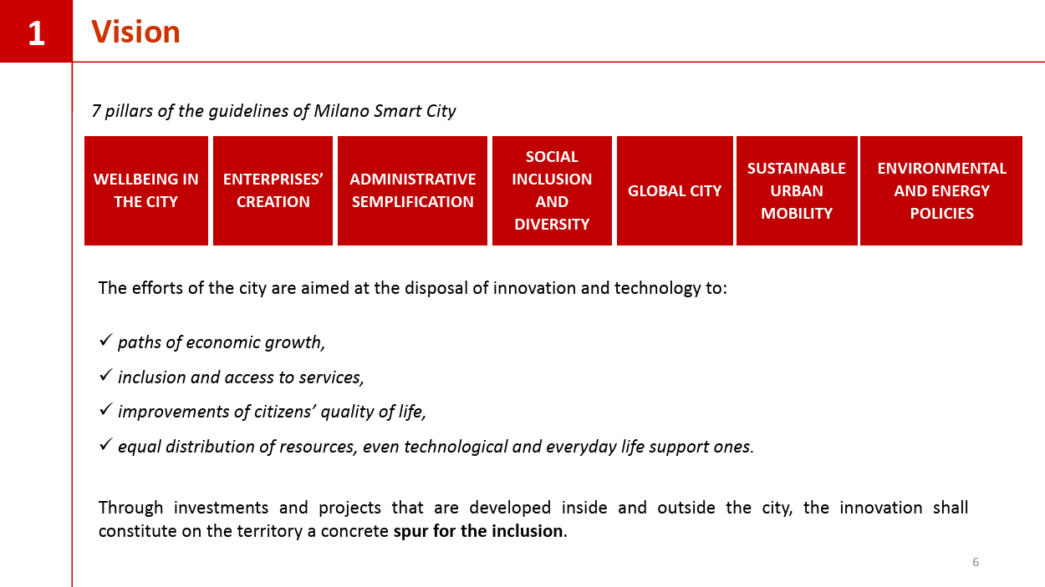
Sharing the Vision Statement using graphics
Example 1 – Milan strategy for Smart City: Technologies enabling economic boost and social inclusion

Slide 11
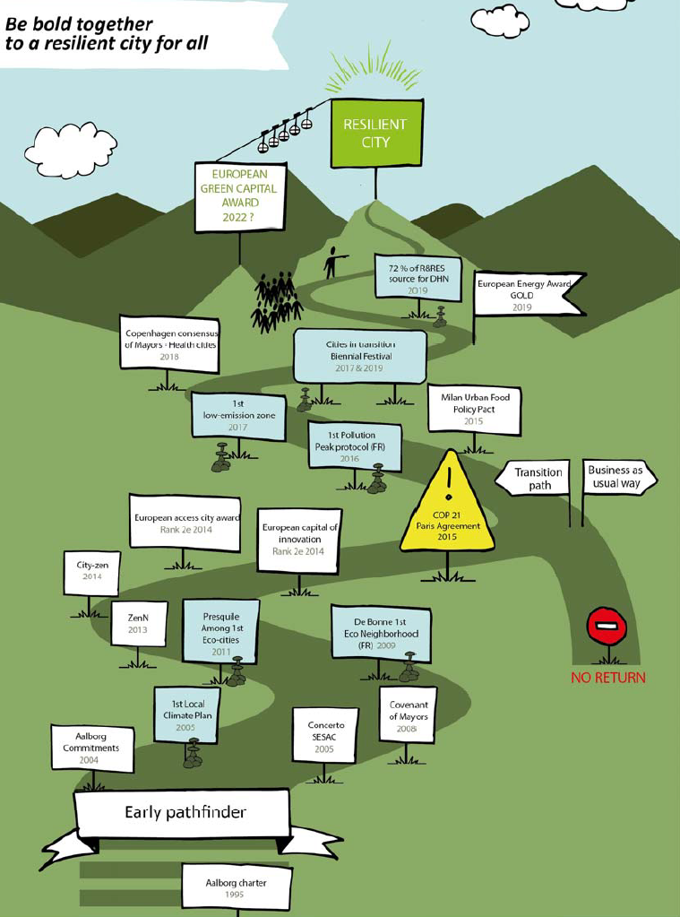
Sharing the Vision Statement using graphics
Example 2 – Grenoble - Cities in transition: Paving the way for resilient cities

Slide 12
Describing your Challenge and Local Context
YOUR CHALLENGE
Explain the challenge
Use data and examples of previous attempts (if applicable)
Similarities & differences between the Main Urban Authority challenge and the local challenge in your city
YOUR LOCAL CONTEXT
Explain the local context in your city relevant to the innovative solution
Examine the current situation - drawing on the results of the Transfer Capacity Survey and the SWOT analysis.

Slide 13
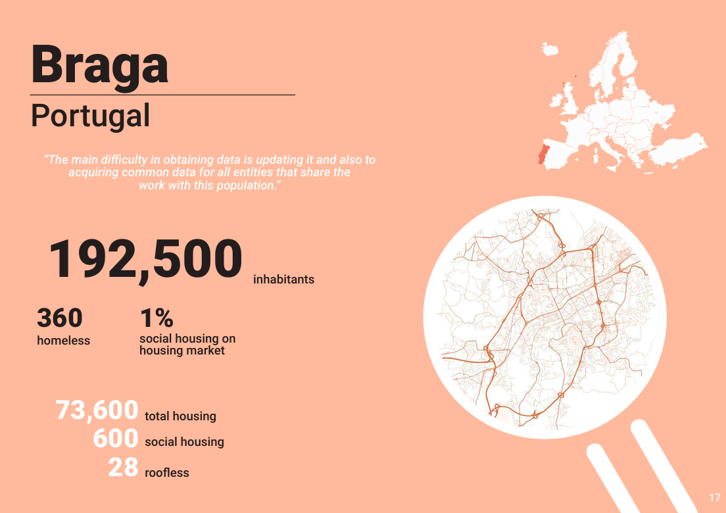
Describing your Challenge and Local Context
Example 1 –– URBACT ROOF project Partner Profiles

Slide 14
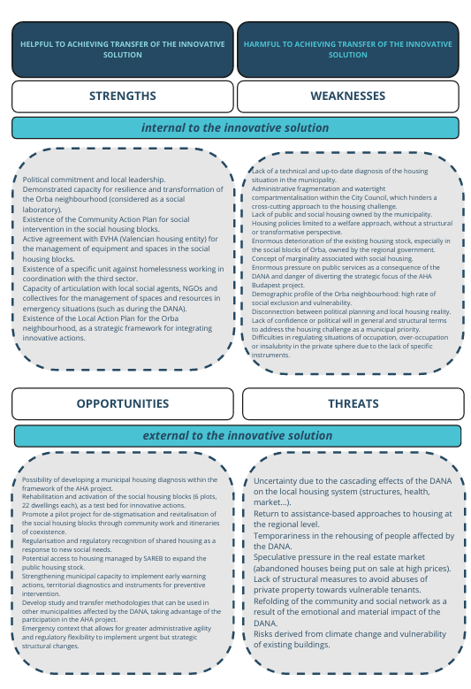
Describing your Challenge and Local Context
Example 2 – EUI-IA AHA Budapest example of a Transfer Partner SWOT analysis

Slide 15
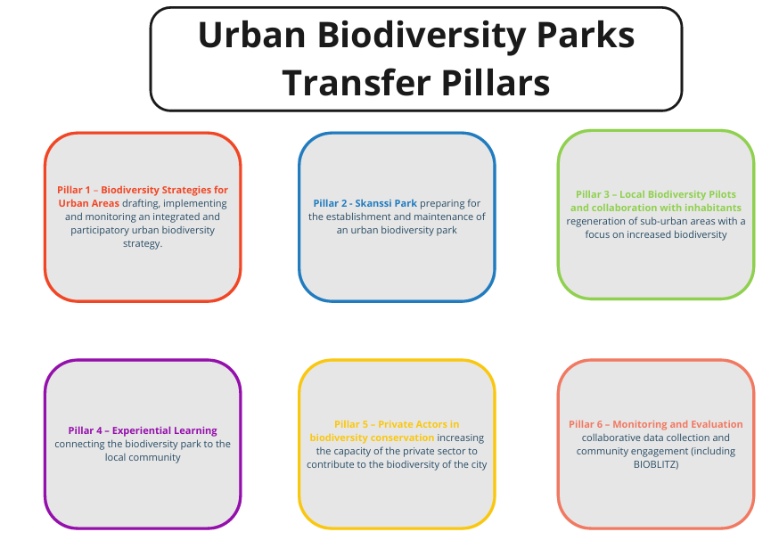
Presenting the Scope of Transfer
Example – EUI-IA Urban Biodiversity Parks example of transfer pillars

Slide 16
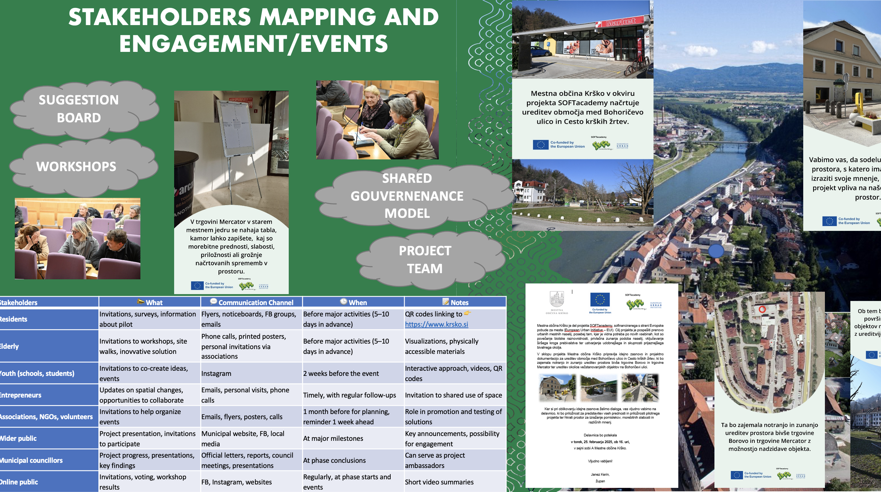
Stakeholder Mapping
Example – EUI-IA Project SOFTacademy, Transfer Partner Krško, Slovenia

Slide 17
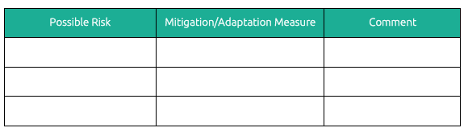
Risk Analysis
Table proposed in the Transfer Study Guidance

Slide 18
Part 2

Slide 19
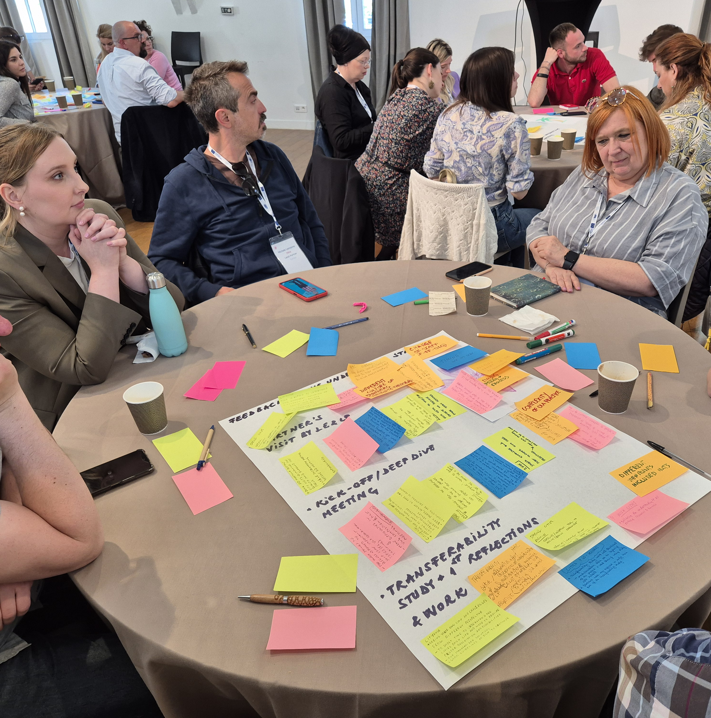
Local Transfer Journey
Roadmap Implementation
Feasibility Testing
Communicating the transfer
Lessons from transnational exchange

Slide 20
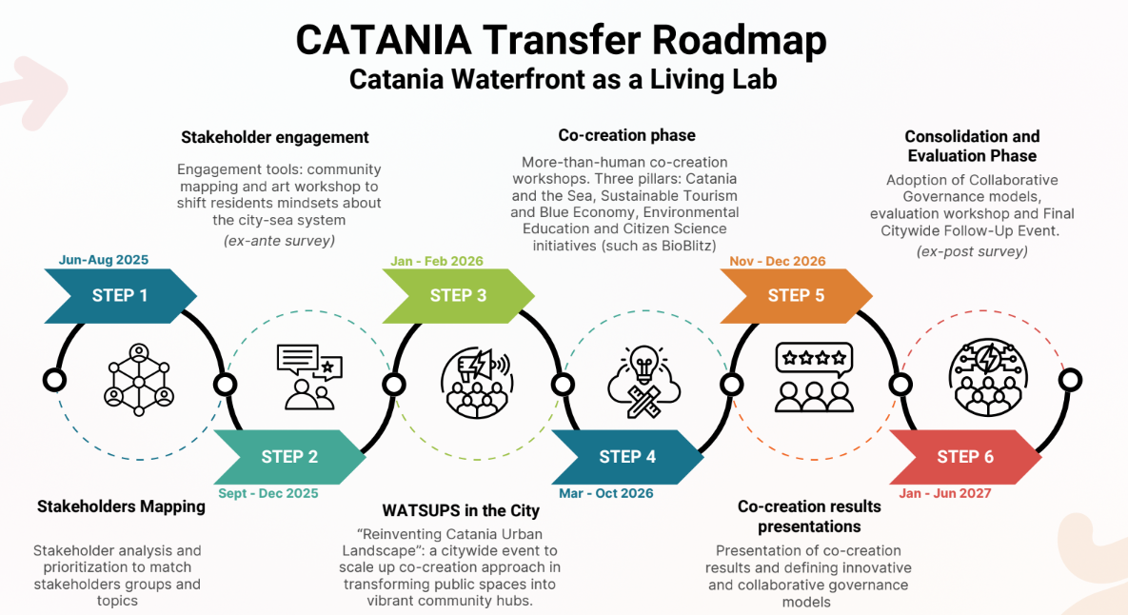
Roadmap Implementation
Example from
EUI-IA Watsups project, Transfer Partner Catania

Slide 21
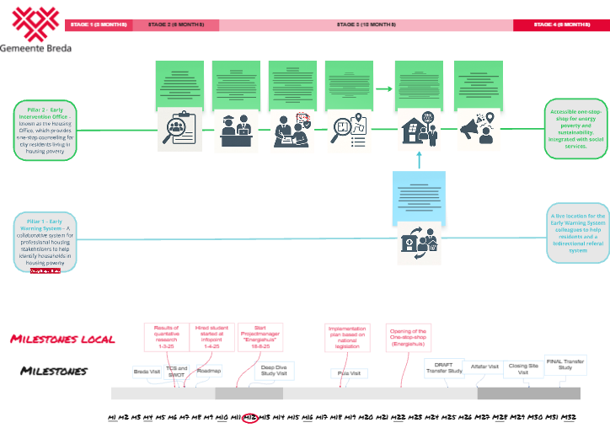
Roadmap Implementation
Examples from EUI-IA AHA Budapest project Transfer Partner Breda, Netherlands

Slide 22
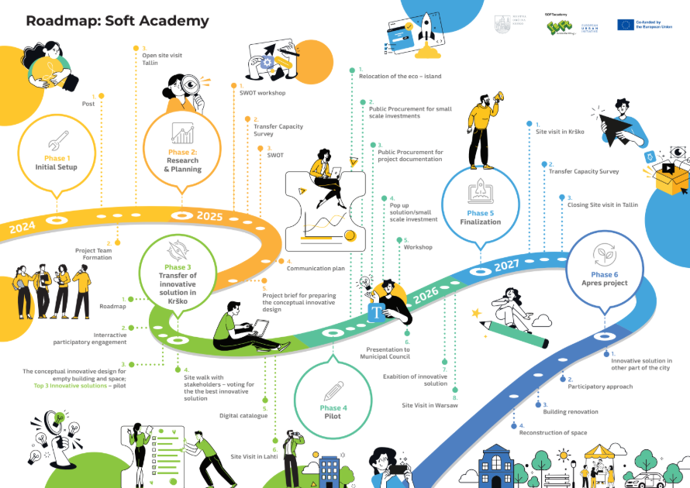
Roadmap Implementation
Examples from EUI-IA SOFTacademy, Transfer Partner Krško, Slovenia

Slide 23
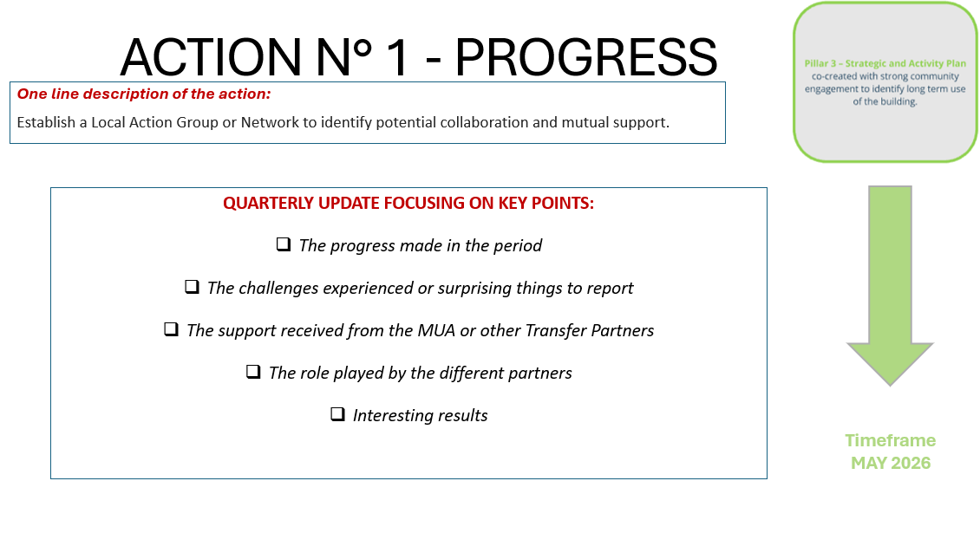
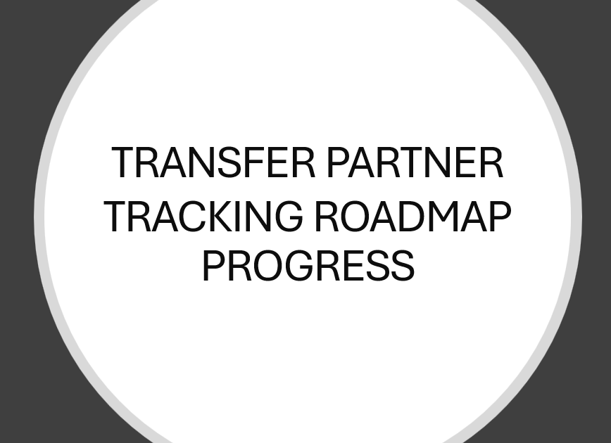
Feasibility Testing
Example 1: Roadmap and Pilot Action tracking tool various EUI-IA projects

Slide 24
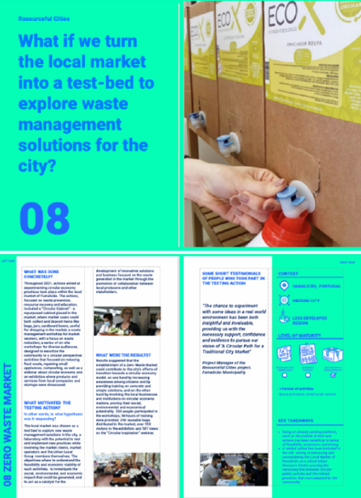
Feasibility Testing
Example 2: Presenting results of a pilot action (Resourceful Cities URBACT Network)

Slide 25
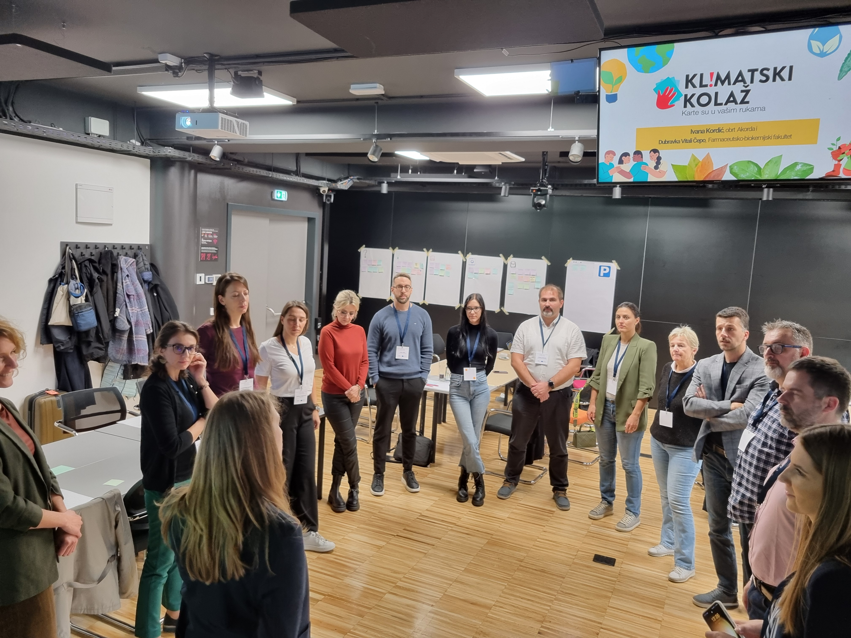
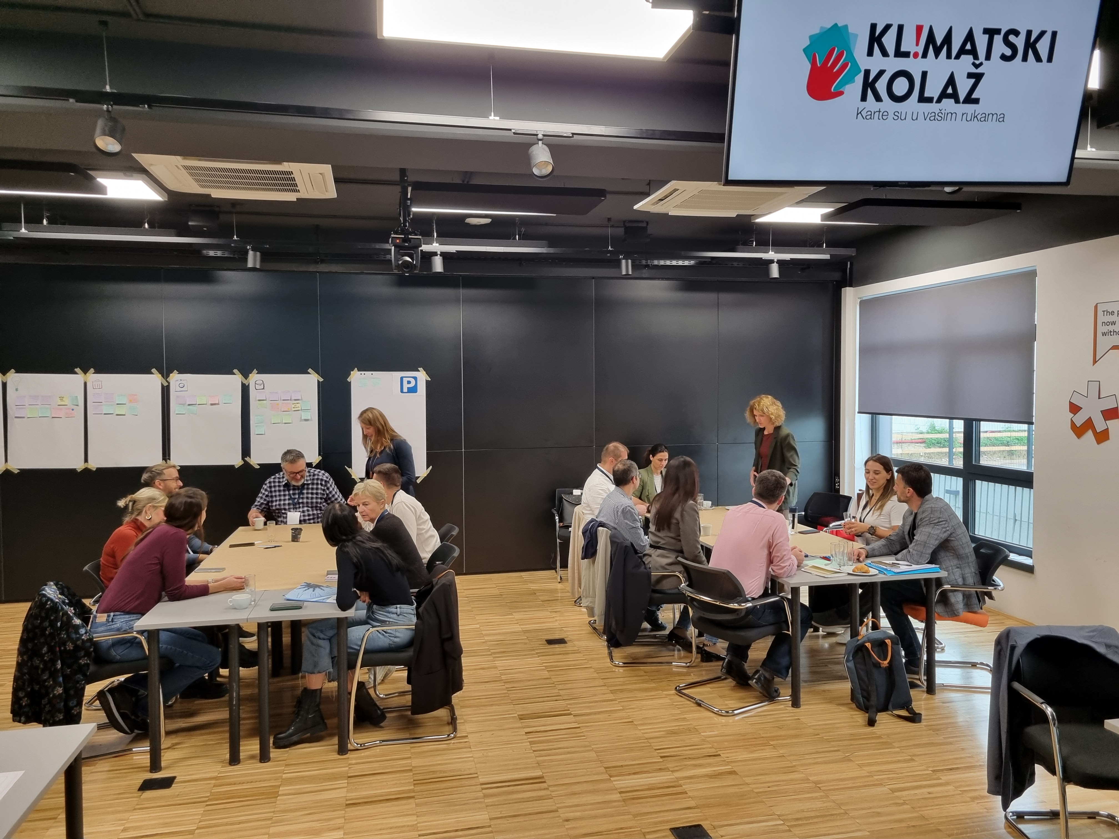
Communicating the transfer
Example: Pictures from your stakeholder engagement workshops and events

Slide 26
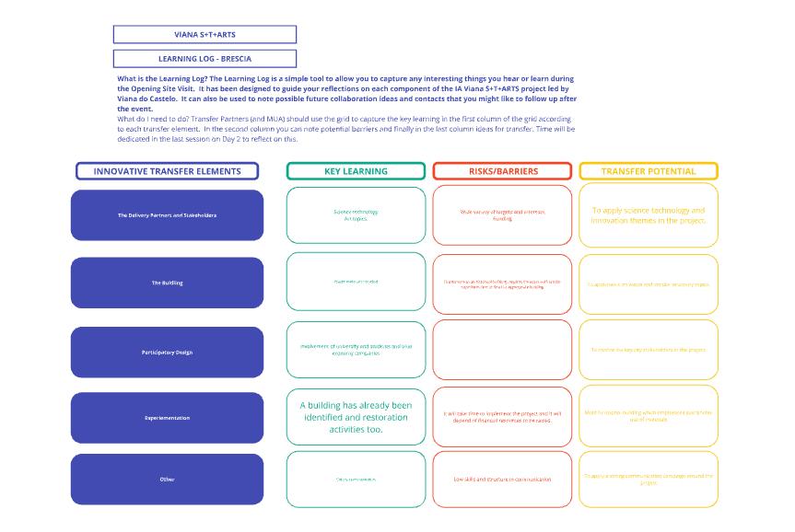
Lessons
from
Transnational
Exchange
Example 1: Learning log
EUI-IA Viana STARTS, Transfer Partner Brescia, Italy

Slide 27
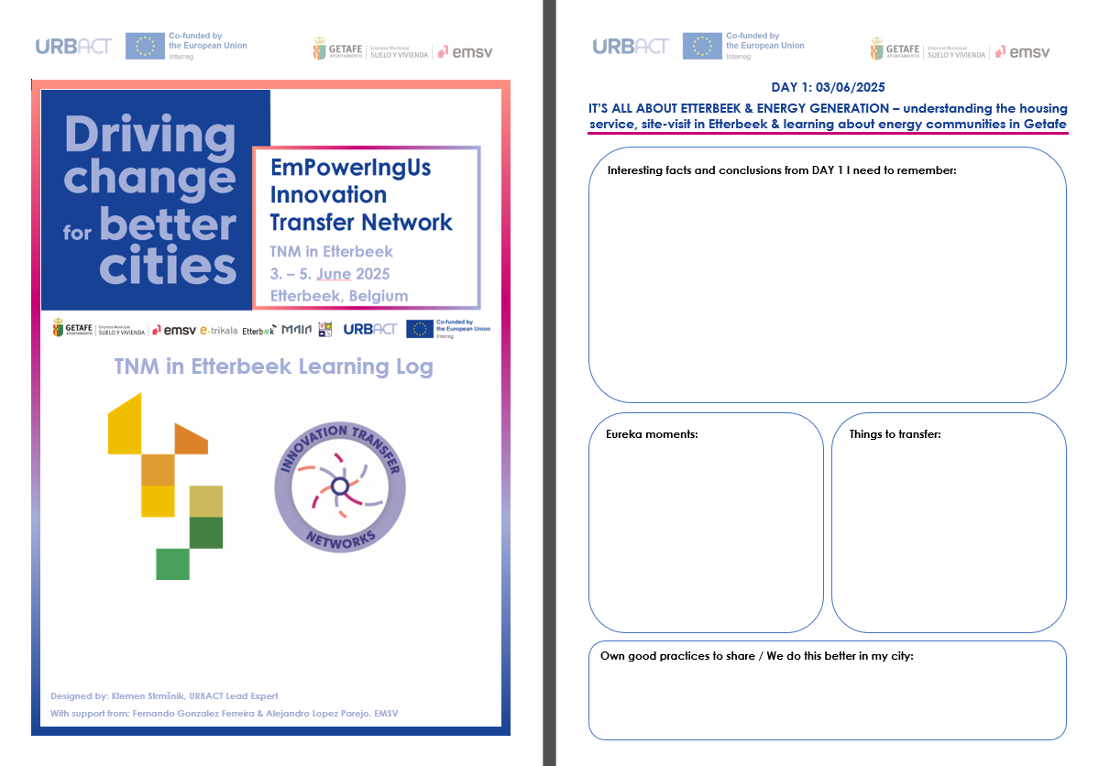
Lessons
from Transnational Exchange
Example 2:
Learning log
URBACT
EmPowerIngUs project

Slide 28
Part 3

Slide 29
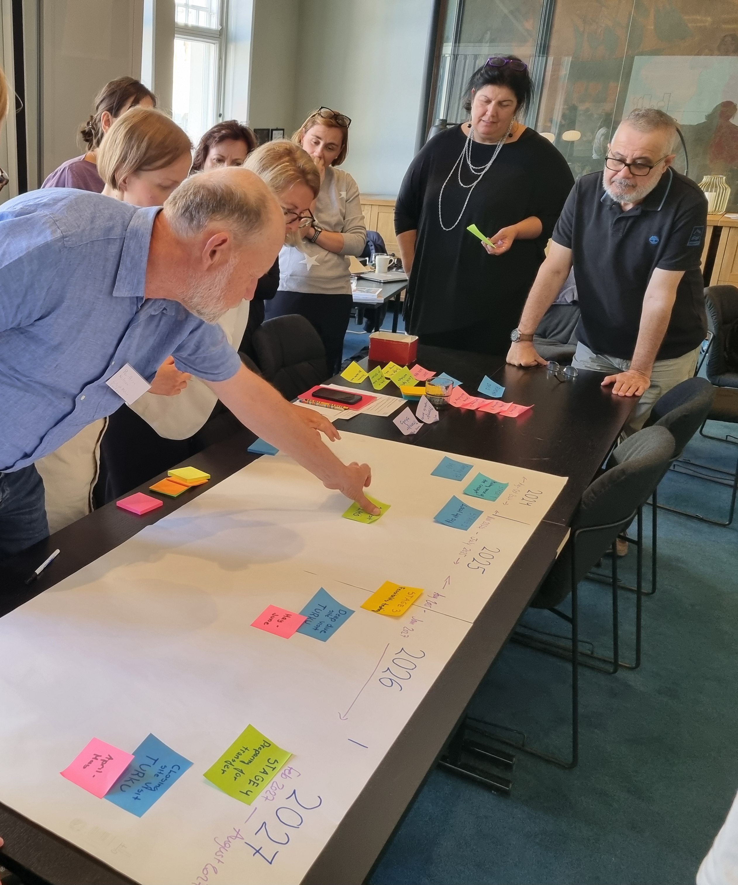
Next Steps
Towards Transfer
Transfer Action Plan
Funding and Resourcing
Presenting Transfer Capacity Survey results

Slide 30
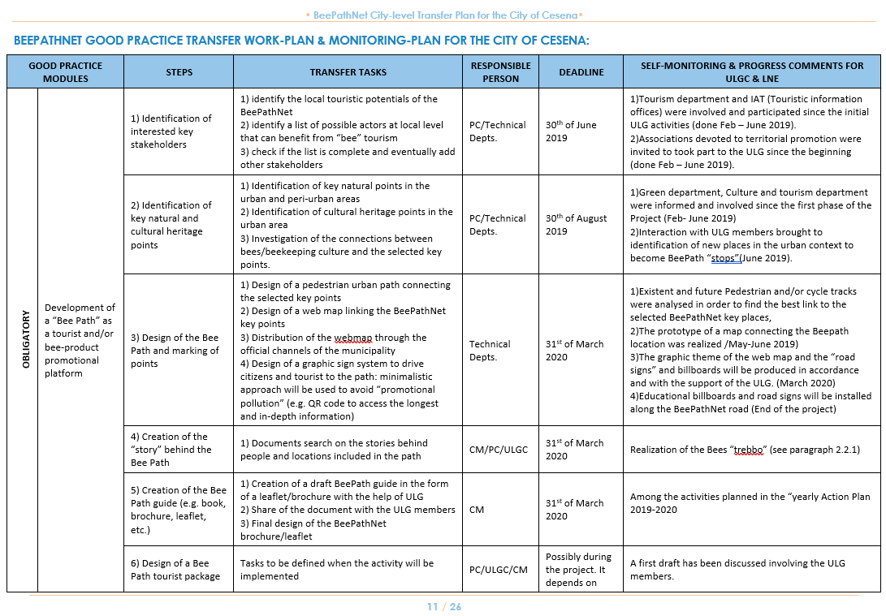
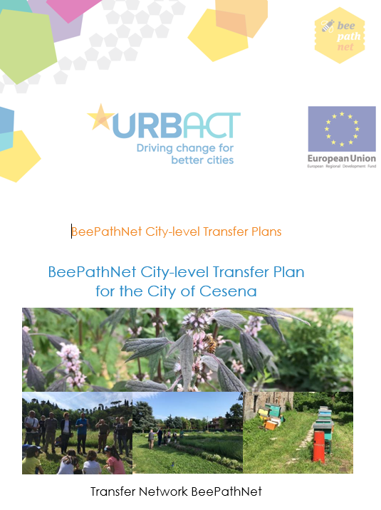
Transfer Action Plan
Example 1: BeePathNet, URBACT project

Slide 31

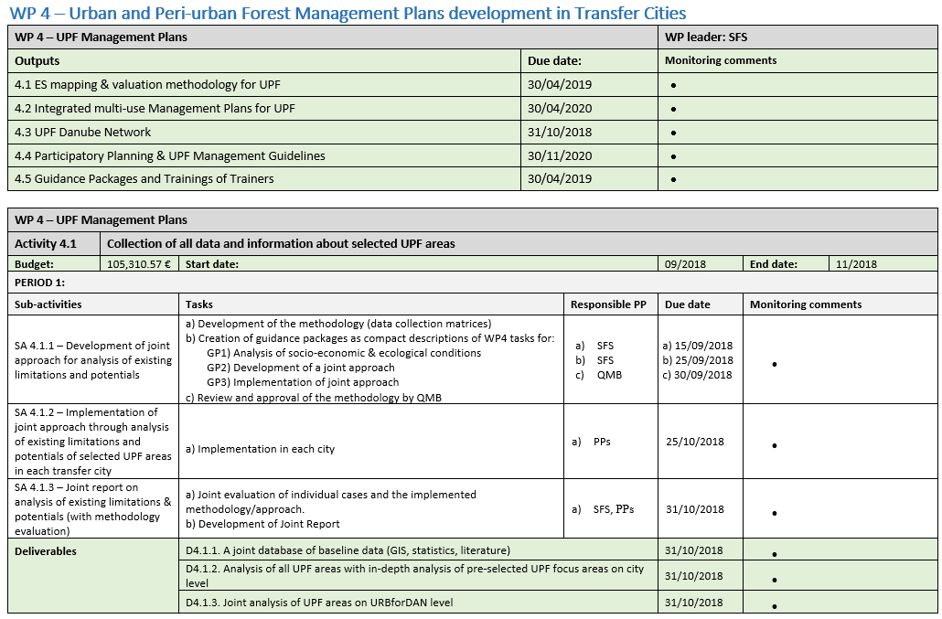
Transfer Action Plan
Example 2: URBforDAN, Interreg Danube project

Slide 32
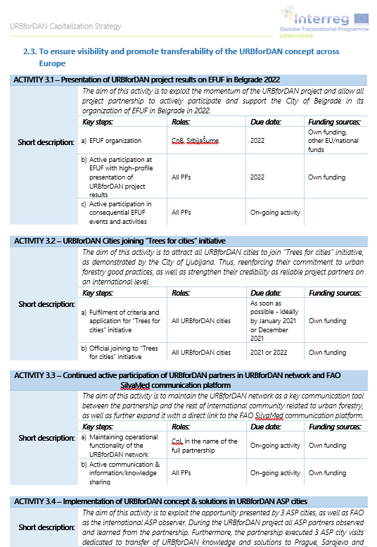
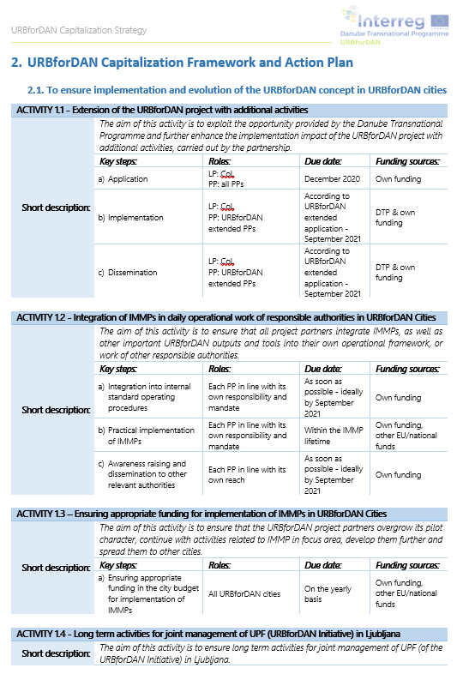
Transfer Action Plan
Example 3: URBforDAN, Interreg Danube project

Slide 33
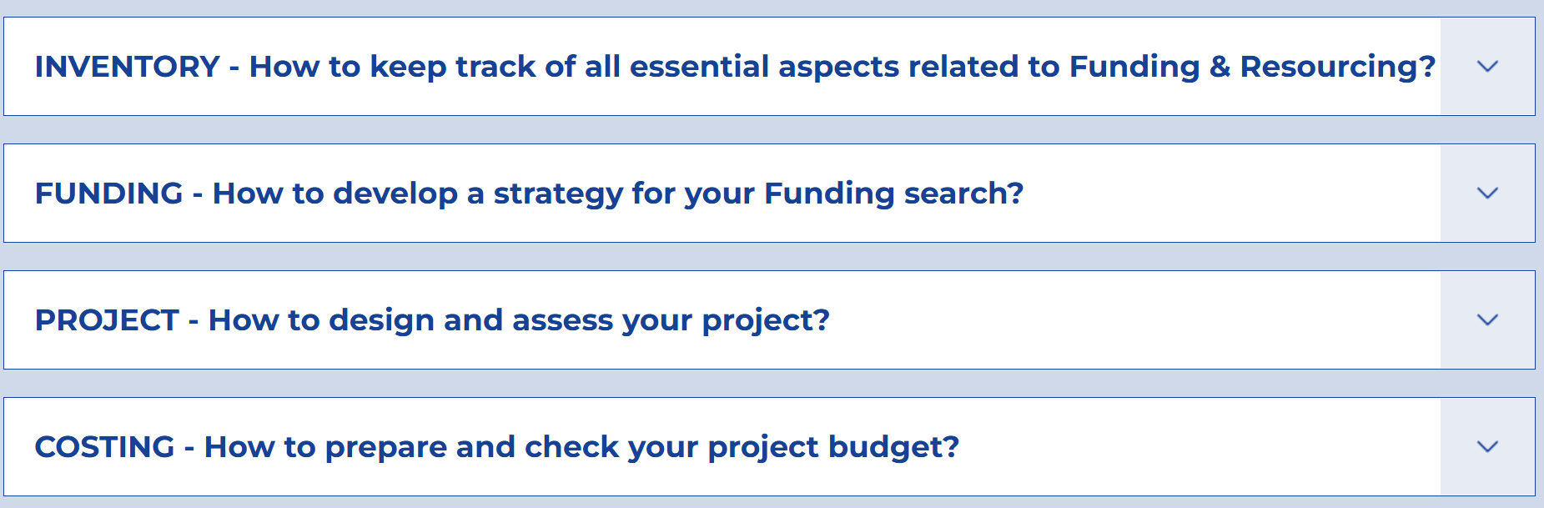
Funding and Resourcing
Example 1: URBACT Toolbox – Resourcing section

Slide 34
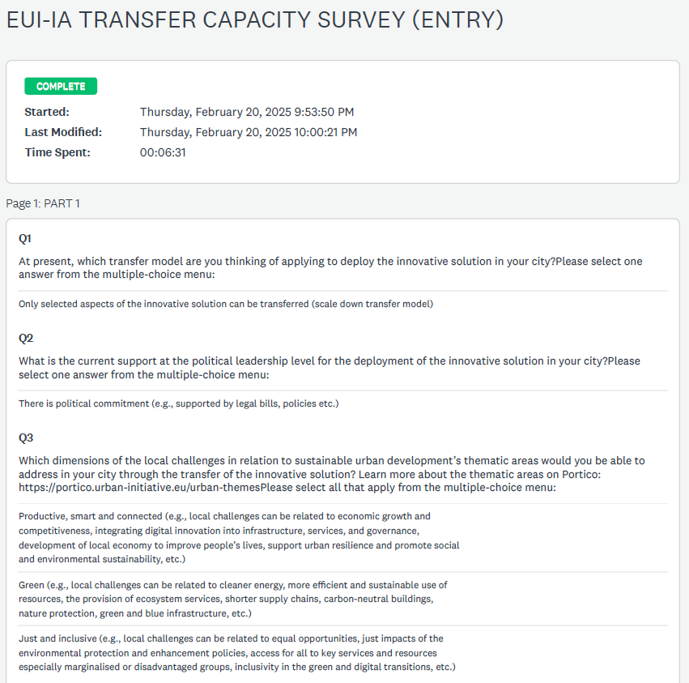
Presenting Transfer Capacity Survey results

Slide 35

Consult the EUI-IA Transfer Study Guidance in full to discover the Study Template All the examples presented in this webinar can be found on the EUI SharePoint space dedicated to Transfer Partners

Slide 36
Thank you!
&
Good luck with your Transfer Studies!

