Slide 2
EUI PEER REVIEW N° 6
04-05 DECEMBER 2024 BASSO PIAVE
Welcome to Day 2
Moderator: Adele Bucella, EUI Expert

Slide 3
Study Visit Debrief Time!

Slide 4
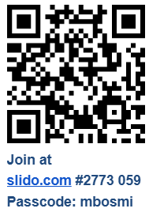
Debriefing of the study visits

Slide 5
LUNCH

Slide 6
Breakout Room
Peer Review Session
Guiding Question N° 3

Slide 7
Room Allocation
Basso Piave
Move to:
Room 1
(follow Eurico and Martina)
Pilsen
Move to:
Room 2
(follow Sally and Levente)
Vukovar
Move to:
Room 3
(follow Eddy and Martijn)

Slide 8
CUR Reflections
(completed by 16.20)

Slide 9

CUR Share the Learning in Plenary
All back into the Plenary Room at 16.20
CUR be ready to report back on the main actions to take forward to the whole group

Slide 10
CUR Report Back

Slide 11
Interactive Wrap Up Session

Slide 12
EUI PEER REVIEW N° 6
04-05 DECEMBER 2024 BASSO PIAVE
Interactive Wrap Up Session
Moderator: Eddy Adams, EUI Expert

Slide 13
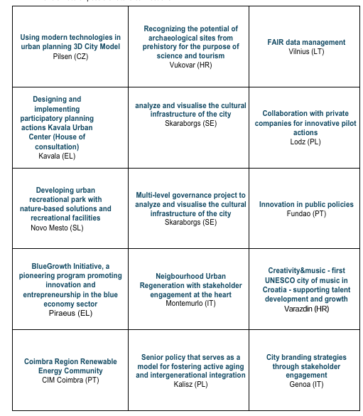
Matchmaking Bingo
INSTRUCTIONS
TAKE 5 MINUTES TO READ THE GOOD PRACTICES PRESENTED BY THE CITIES IN THE ROOM…then, when instructed:
Find the person representing the city(ies) you are interested in
Talk to the people about the Good Practice cases
Make a note of possible future connections
Be ready to tell us about your connections
Notes:
Reflect and use the post its to come close and populate the three boards
This lasts for 5’-6’, depending on the energy in the room
Closing words by moderator

Slide 14
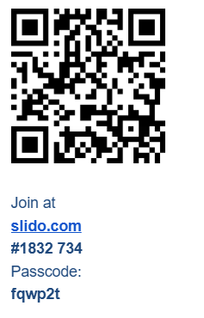
Feedback on Peer Review
Notes:
Reflect and use the post its to come close and populate the three boards
This lasts for 5’-6’, depending on the energy in the room
Closing words by moderator

Slide 15
And now what…?
Other capacity building opportunities with EUI
Notes:
Thank you, Romain and Anne, for these lovely welcoming words. If you felt inspired or intrigued, I have good news for you: we will hear more about the Hauts-de-France multi-level governance model in innovation later today – so stay tuned!

Slide 16

The EUI capacity building trio
6 Peer Reviews up to end of 2024, many more to come in 2025
46 approved C2C Exchanges
Call continuously open
2025: Portugal, Poland, Latvia in preparation

Slide 17
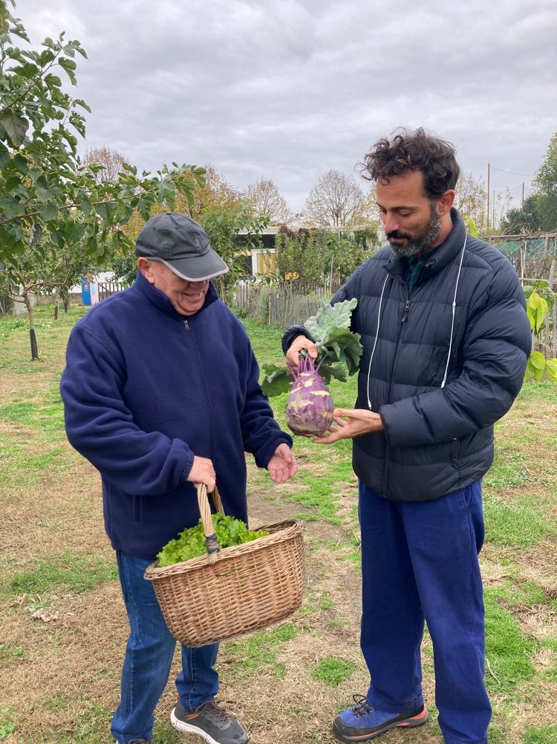
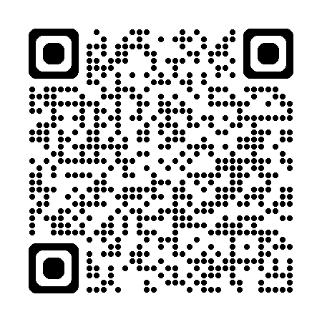
City-to-City Exchanges in 2024: call open continuously
Apply when you need/want! HERE
Evaluations conducted on a rolling basis.
We are here to help!
Book a 30-min online meeting with us at this link
Not sure who has the solution to the challenge you are facing? Join Portico, try the Urban Matchmaker

Slide 18
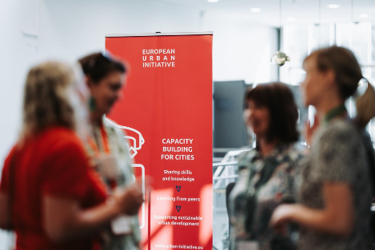

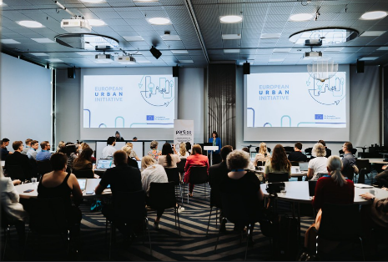

Events in 2024: focus on national ones
29-30 May 2024
Finland, Tampere,
“Leveraging Innovation Ecosystems for Sustainable Cities”
27-28 Nov 2024,
Prague, Czechia
Delivering high-quality ITIs in Czechia
12-13 November 2024
Limerick, Ireland,
Integrating NEB values in SUDs
3-4 Dec 2024
Goteborg, Sweden
Governance and Green goals for SUDs

Slide 19
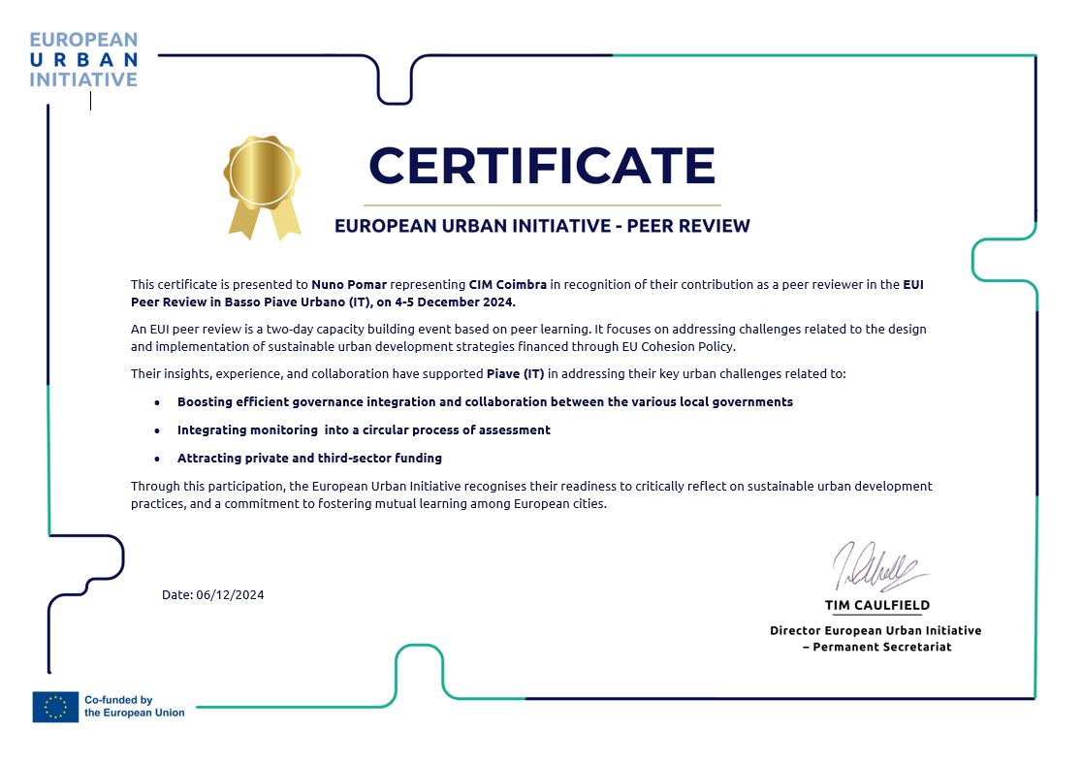
Celebrating our peer reviewers
Notes:
Reflect and use the post its to come close and populate the three boards
This lasts for 5’-6’, depending on the energy in the room
Closing words by moderator

Slide 20
Thank you!

Slide 21
Question 3
Contact us for any questions on EUI capacity building
at capacitybuilding@urban-initiative.eu
Thank you!

