Slide 1
Resilience in Antwerp EUI-URBACT conference – 20/11/2024 Brussels
Birgit Soetewey – Team CRO

Slide 2
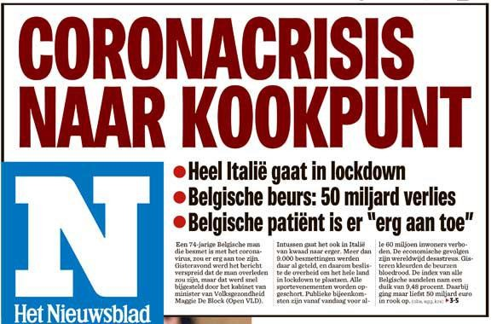
Chaotic times?

Slide 3
Chaotic times?

Slide 4
Chaotic times?

Slide 5
Chaotic times?

Slide 6
Chaotic times?

Slide 7
Chaotic times?

Slide 8
Chaotic times?

Slide 9
The answer? Resilience!
Source: Google Trends

Slide 10
Resilient Europe – URBACT 2016
URBACT = thematic networks with aim to promote transnational knowledge sharing.
RESILIENT EUROPE (September 2015 – June 2018)
Objectives:
creation of European network of cities to stimulate dialogue and deeper understanding of resilience;
involving wider social network by using transition management methodology in the design of local integrated action plans;
sharing knowledge on resilience and drawing up a toolbox of good practices to inspire action and accelerate transition to urban resilience.
Partners
Rotterdam (coordination), Glasgow, Vejle, Burgass, Tessaloniki, Malmö, Antwerp, Rome and Bristol.
Support from URBACT expert
Urban case study city of Antwerp: the method of transition management will be used to work on the water task in the Sint-Andries district.
Since, project > 6 years ago + internal changes + further insights on resilience → broader perspective!

Slide 11
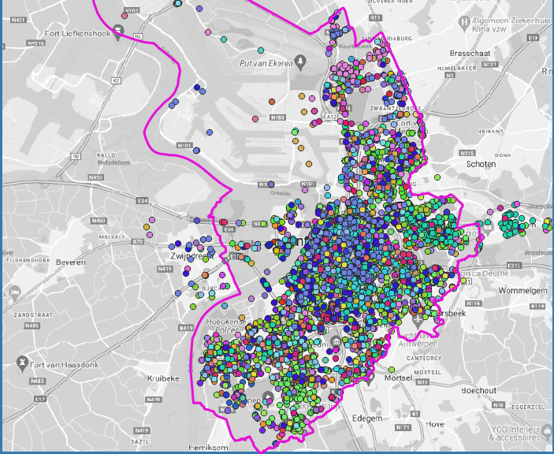
Resilience in Antwerp: flooding
Flood-related interventions fire department 2012-2021

Slide 12
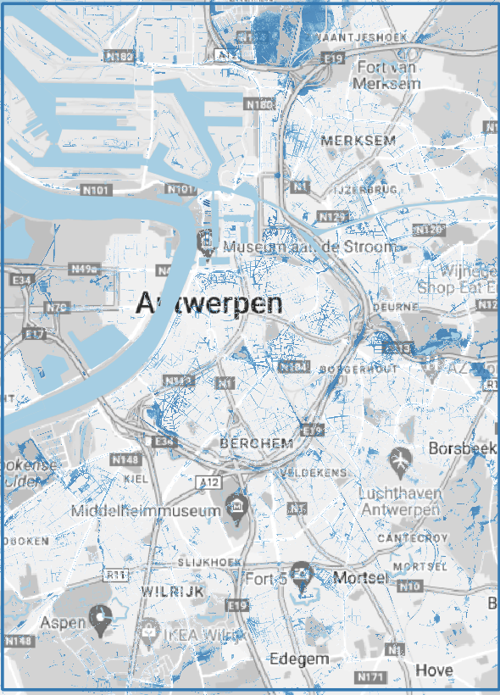
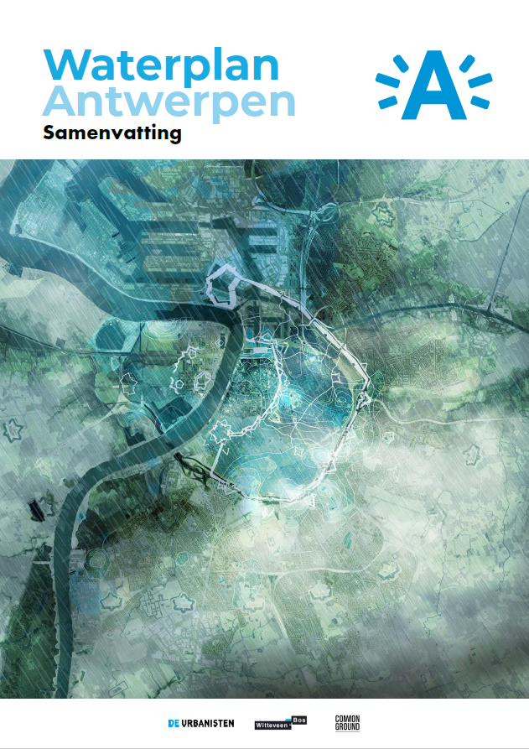
Resilience in Antwerp: flooding
Flooding map, T100, future climate scenario

Slide 13
Resilience in Antwerp: flooding and climate
Multi-layered approach
PREVENTION
Urban planning
Design buildings
PROTECTION
Capacity of streets, the city as a sponge
PREPAREDNESS
Supporting fire department by engaging self-reliance of citizens

Slide 14
A few examples: prevention and protection
Green roofs to hold water (and cool the building)
Give space to water

Slide 15
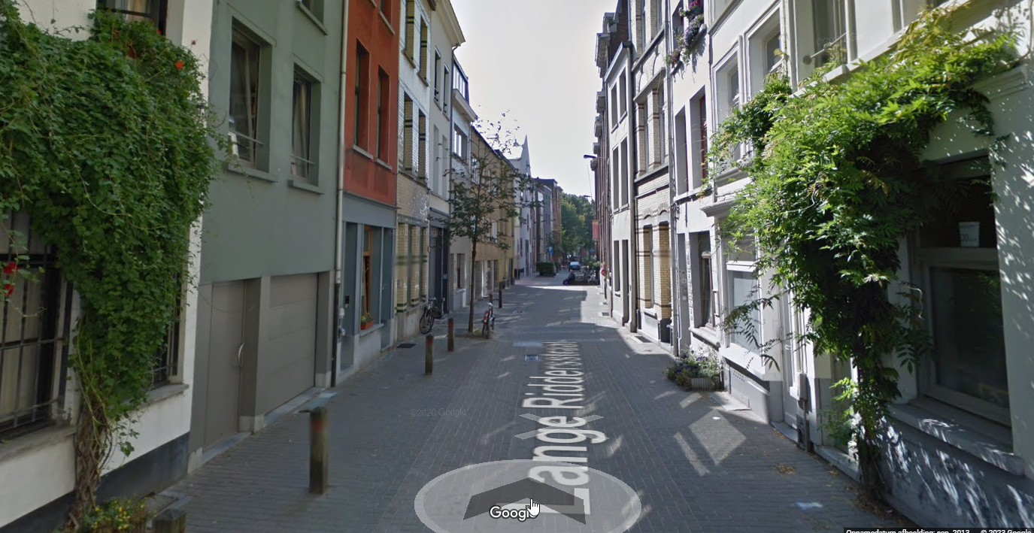
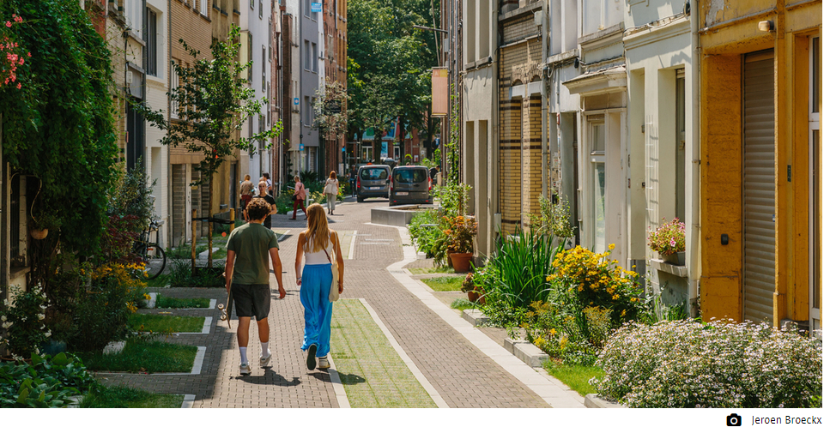
A few examples: prevention and protection
“Garden” streets

Slide 16
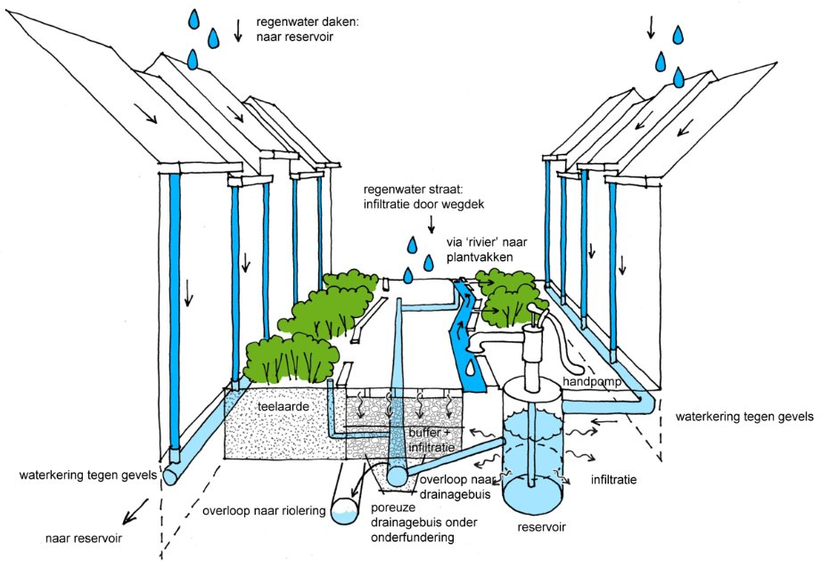
A few examples: prevention and protection
“Garden” streets

Slide 17
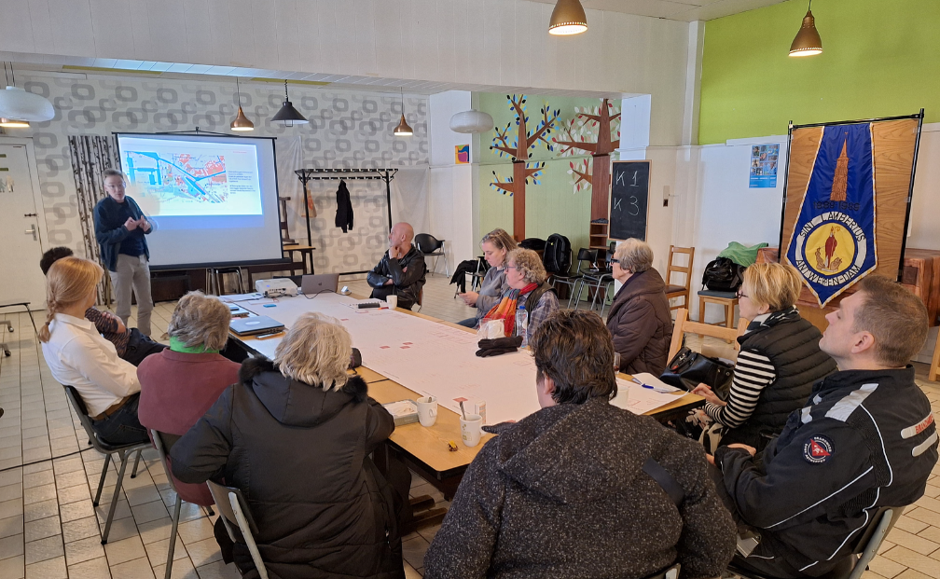
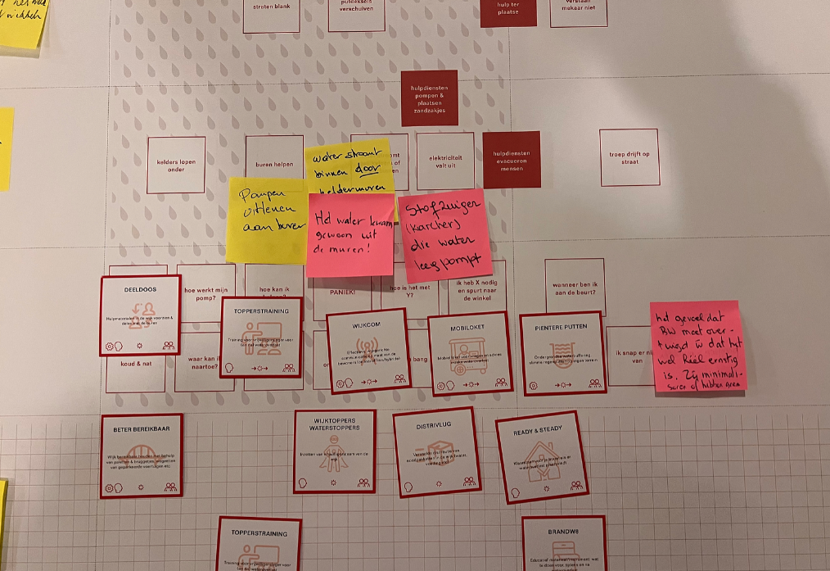
And preparedness?
How do you make your citizens more self-reliant?
New approach
Innovation process
Exploring
Ideas?
Experimenting
Evaluation and upscaling

Slide 18
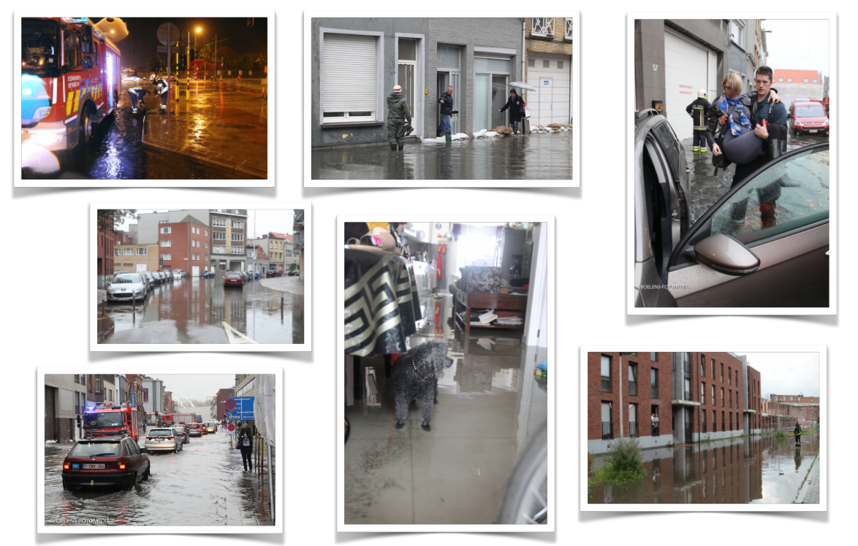
Preparedness in “Den Dam”

Slide 19
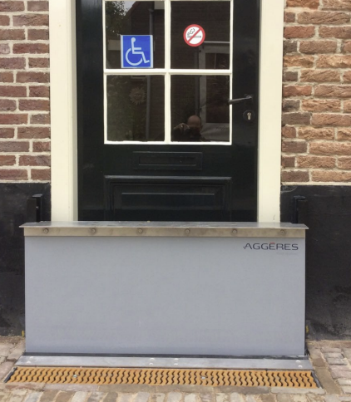
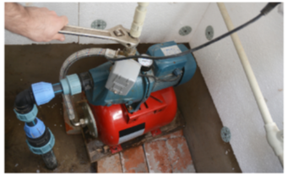
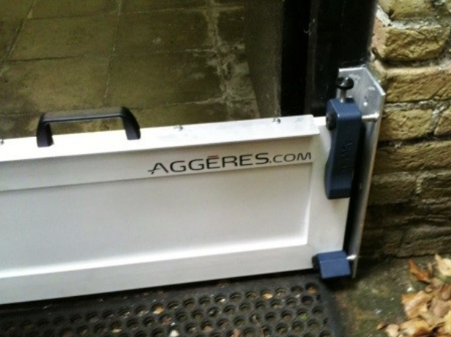
Experiments
“Technical solutions”
INNOVATIVE PUMPS IN BASEMENT
AUTOMATIC DOOR PROTECTION
“HOUSE DOCTER”

Slide 20
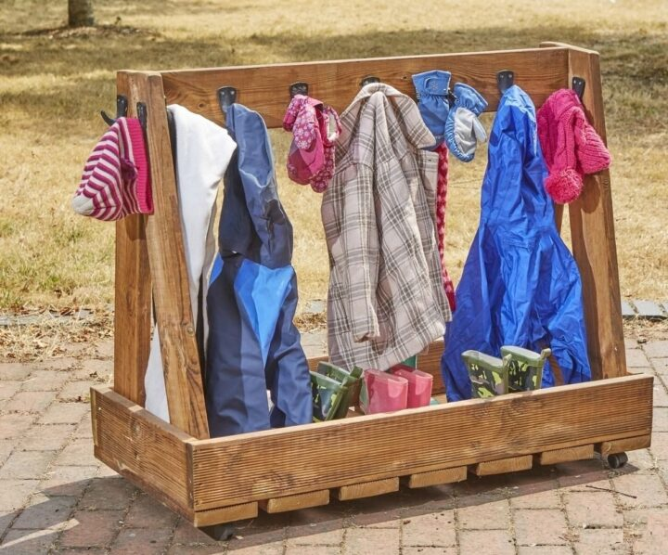
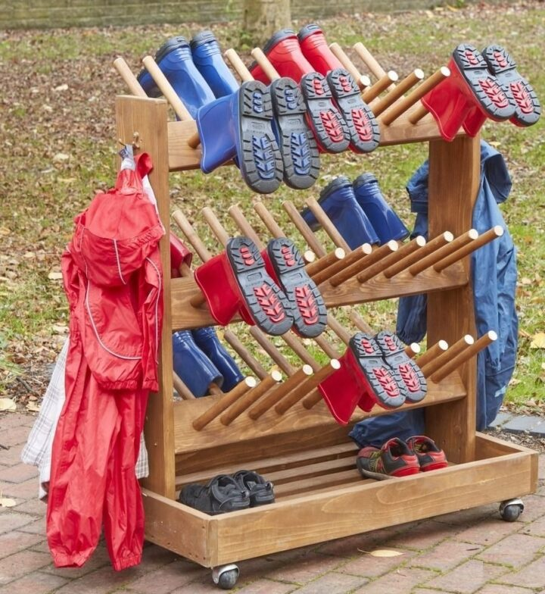
Experiments
Knowledge and awareness
MINI-MUSEUM
“ARMY” of RAIN BOOTS

Slide 21
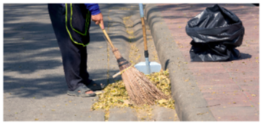
Experiments
Communication during flooding
“WIJKTOPPERS”
BE-ALERT
BRANDW8

Slide 22
What is resilience?
Anticipation
What can we do now to minimize the impact during the event?
Coping
How will we react to the event?
Adaptation
How can we learn from previous or other events and adapt to a better prepared city and community?

Slide 23
Questions?
bart.bruelemans@antwerpen.be (CRO)
rebecca.beeckman@antwerpen.be (resilience in climate and environment)
birgit.soetewey@antwerpen.be (projects: COVID, Ukranian refugees)

