Slide 1
Online Information Session
Call for Peer Reviews
22 October 2024, 10:30 – 12:00

Slide 2
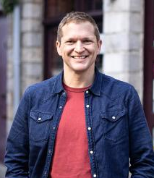
MC for today’s event
Wannes Haemers
Partnership & Communication Officer,
EUI Permanent Secretariat
Notes:
Thank you, Romain and Anne, for these lovely welcoming words. If you felt inspired or intrigued, I have good news for you: we will hear more about the Hauts-de-France multi-level governance model in innovation later today – so stay tuned!

Slide 3

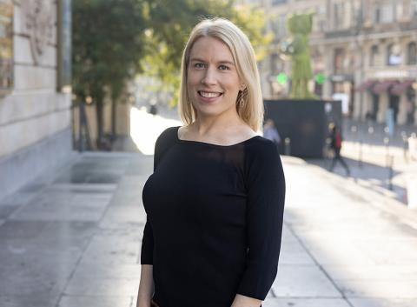
10:30
Welcome & Meet the Team
10:40
Context for EUI Peer Reviews
Carlotta Cesco Gaspere
Policy Officer, DG REGIO, European Commission
Today’s agenda
10:50
Peer Review call – main features & eligibility
Eilish O’Loughlin
Head of Capacity Building, EUI Permanent Secretariat
11:10
Breakout rooms in national languages
11:45
Return to plenary – how to apply & applicant support
12:00
End
Notes:
Thank you Marion, thank you Eilish for giving us an overview & framework of multi-level governance. Now for the concrete stuff: as you can see on the slides, we will do a first round of workshops, lead by the cases of Bilbao, and Empower, a project led by the cities of Schaerbeek, Ixelles, Bruxelles and the Innoviris network. We’ll then break for coffee, where we will also do some matchmaking. At 11:20, we will start our second round of workshops, with Vaasa and the Hauts-de-France Region. Our last session will be about sharing some opportunities to turn mission impossible (City/Region collaboration) into business as usual. We will then close with a networking lunch from 12:30 to 14:00 to which you are of course all cordially invited.

Slide 4
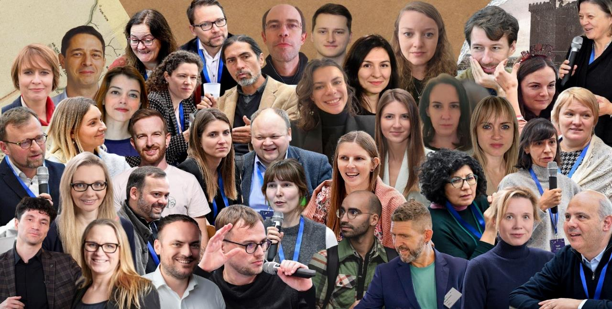
Urban Contact Points
Meet the network

Slide 5


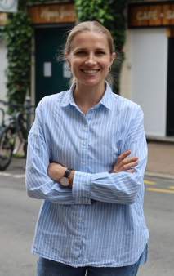
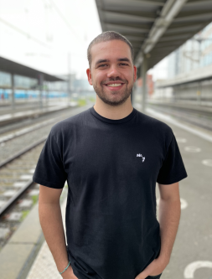


EUI PS - Capacity Building Unit
Meet the team
Raluca Toma
Sandra Valiunaite
Zoé Fournand
Eilish O’Loughlin
Eleonora Giorgi
Paul Janson
Magda Baidan

Slide 6
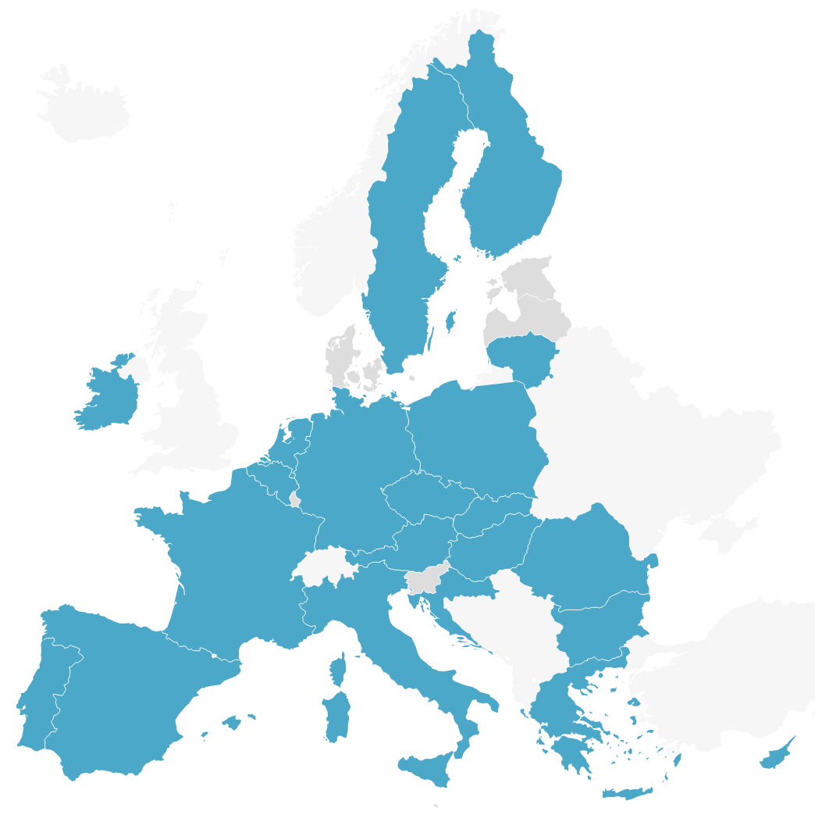
Who is in the room?
Let us know where you come from
in the chat box!

Slide 7
Context for EUI Peer Reviews
Carlotta Cesco Gaspere
Policy Officer, DG REGIO, European Commission
Notes:
Thank you, Romain and Anne, for these lovely welcoming words. If you felt inspired or intrigued, I have good news for you: we will hear more about the Hauts-de-France multi-level governance model in innovation later today – so stay tuned!

Slide 8
Sustainable Urban Development of Cohesion Policy 2021-2027
22 October 2024
Carlotta Cesco Gaspere, DG REGIO.03

Slide 9
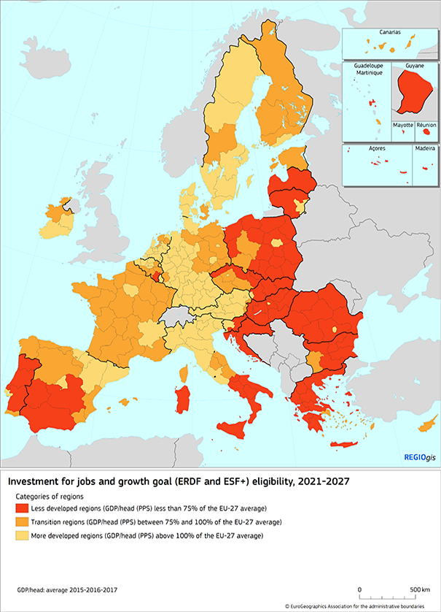
Cohesion Policy benefits all types of Territories
Cohesion Policy contributes to strengthening economic, social and territorial cohesion in the European Union.
It aims to correct imbalances between countries and regions, and delivers on the Union's political priorities, especially the green and digital transition.
Cohesion policy 2021-2027 EUR 378 billion:
1) Investment for jobs and growth, funded by:
European Regional Development Fund (ERDF)
European Social Fund+ (ESF+)
Cohesion Fund (CF)
Just Transition Fund (JTF)
2) Interreg: European Territorial Cooperation goal (ERDF)
3) Commission managed EU instruments and technical assistance
Notes:
Cohesion Policy plays a central role in reinforcing the European economic, social and territorial cohesion and correcting imbalances between territories, in this way bringing Europe closer to its citizens. Actually it connects local development needs and potentials with European and global objectives to trigger economic, social and territorial development in all regions. Cohesion Policy aims to ensure that public investment decisions are taken as close as possible to the citizens and that European actions are taken in the light of the possibilities and specificities at national, regional and local levels.

Slide 10





COHESION POLICY 2021-2027 FRAMEWORK - BASIS FOR INVESTMENTS AT NATIONAL, REGIONAL AND LOCAL LEVEL
THE 5 POLICY OBJECTIVES
1- A smarter Europe
2- A greener, low-carbon Europe
3- A more connected Europe
4- A more social and inclusive Europe
5- A Europe closer to citizens –by fostering sustainable and integrated development of all types of territories
5.1 fostering the integrated and inclusive social, economic and environmental development, culture, natural heritage, sustainable tourism, and security in urban areas
5.2 fostering the integrated and inclusive social, economic and environmental development, culture, natural heritage, sustainable tourism, and security in areas other than urban

Slide 11

POLICY OBJECTIVE 5 – INTEGRATED TERRITORIAL DEVELOPMENT
Minimum Requirements
A “cross-cutting territorial policy objective” to address the diverse and interlinked territorial and local (sub-regional) needs and challenges – thematic flexibility
Entails a “specific method” fostering integrated territorial development, that requires territorial development strategies, that are place-based, integrated and with the involvement of relevant partners in the preparation and implementation of the strategy .
Must be achieved via territorial tools - CLLD, ITI, or other territorial tool (national)
Notes:
Introducing a new policy objective “Europe closer to citizens” means reinforcing urban and territorial dimension of the Cohesion Policy that enables full thematic flexibility and a number of requirements aiming at facilitating and reinforcing place-based approaches and multi-level governance arrangements.
The PO5 supports tailor-made investment strategies at the territorial level, in cities and local communities, to address their diverse challenges, and tap into their development potentials. It offers local authorities or territorial bodies opportunities to build their policy mix to the challenges they are facing.

Slide 12
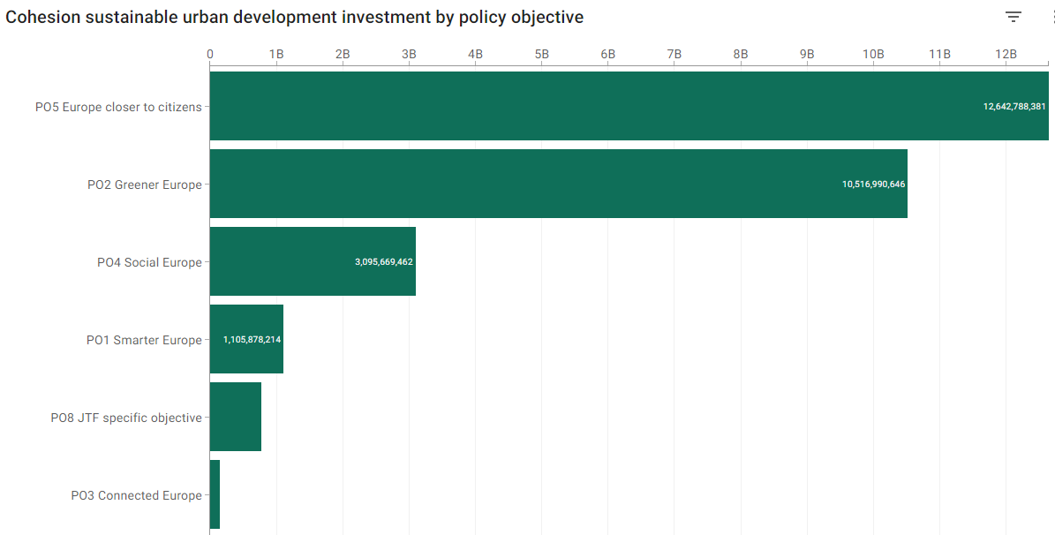
Sustainable Urban Development (SUD) in 2021-2027
Highest share of SUD with EUR 12.6 billion (almost 45% of total amount) is allocated under novel policy objective (PO) 5 ‘Europe closer to citizens’ privileging place-based territorial approaches
SUD is found in all policy objectives – PO2 ‘Greener Europe’ is second biggest contributor to SUD with share of EUR 10.5 billion (more than 37% of total amount) while also PO4 Social Europe contribution of EUR 3.1 billion (close to 11%) is not insignificant, confirming centrality of green transition and addressing social inequalities for urban development
Notes:
Through territorial instruments (ITI, CLLD and other territorial tools), funding can also be provided to sustainable urban development directly from other specific objectives under POs 1-4.
They can provide linkages already at specific objective level, which ensures that sustainable urban development strategies demonstrate their contribution to EU and global agendas. Support to territorial instruments under PO1 and PO2 complies with thematic concentration, or with the thematic enabling conditions linked to specific objectives of PO1-4. The second biggest contributor to sustainable urban development is PO2, with a significant drop to the next biggest, PO4.

Slide 13
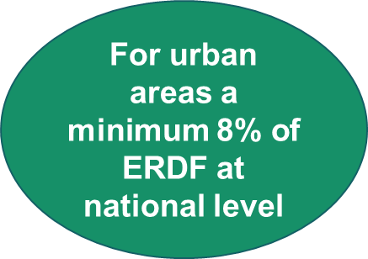
POLICY OBJECTIVE 5 – INTEGRATED TERRITORIAL APPROACH
Specific objective 5.1 fostering the integrated and inclusive social, economic and environmental development, culture, natural heritage, sustainable tourism, and security in urban areas
Strategies in the urban context
Functional Urban Areas
-
Urban-rural Linkages
special attention to the green and digital transitions
Notes:
The urban dimension of Cohesion Policy recognises the role of cities in the harmonious and polycentric development of Europe and its regions,
During the 2014-2020 programming period, cohesion policy has made SUD compulsory > 5% of European Regional Development Fund, ERDF, must be earmarked for SUD in each Member State) and the strategic dimension of the integrated approach has been affirmed. These key characteristics of SUD will be maintained in the current programming period 2021- 2027, when the minimum percentage of ERDF to be earmarked for SUD now increased to 8% (in fact reaching 12%). Strategies in urban areas are being promoted through an integrated and place-based approach to territorial development, where integration means multi-sectoral policy, multi-level and multi-stakeholder governance, and multi-territorial and community-led strategy. Territorial authorities In charge of developing and implementing these strategies are the so called art.11 urban authorities (from the art of the Regulation 1058/2021).

Slide 14
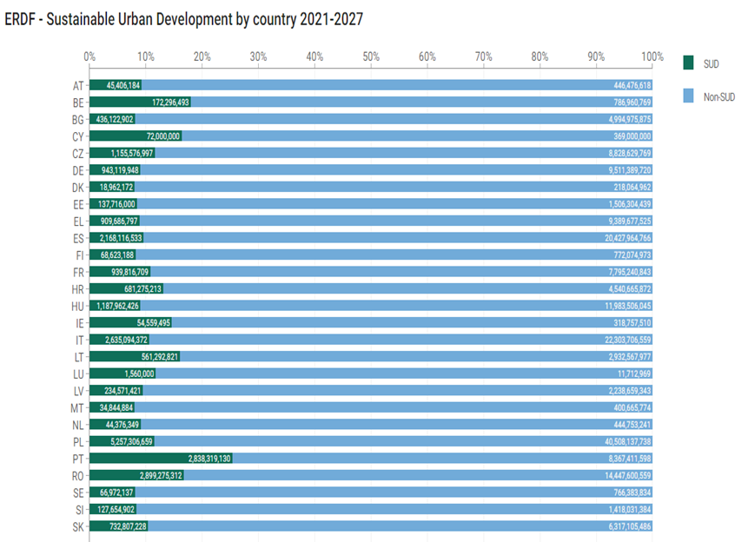
Sustainable Urban Development (SUD) in 2021-2027
Commitments in national and regional programmes fulfil or exceed the 8% target set for sustainable urban development support
EUR 24 billion (almost 12% of Member States ERDF allocation)

Slide 15
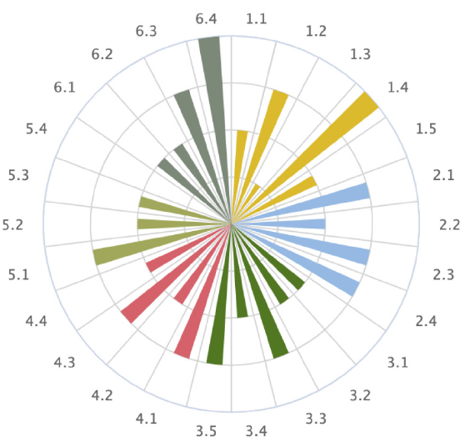

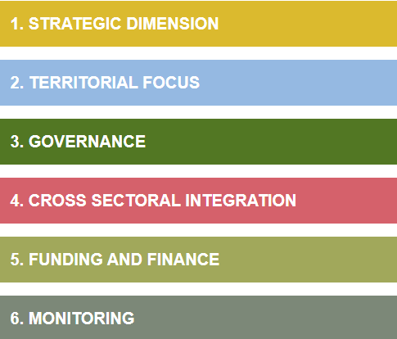
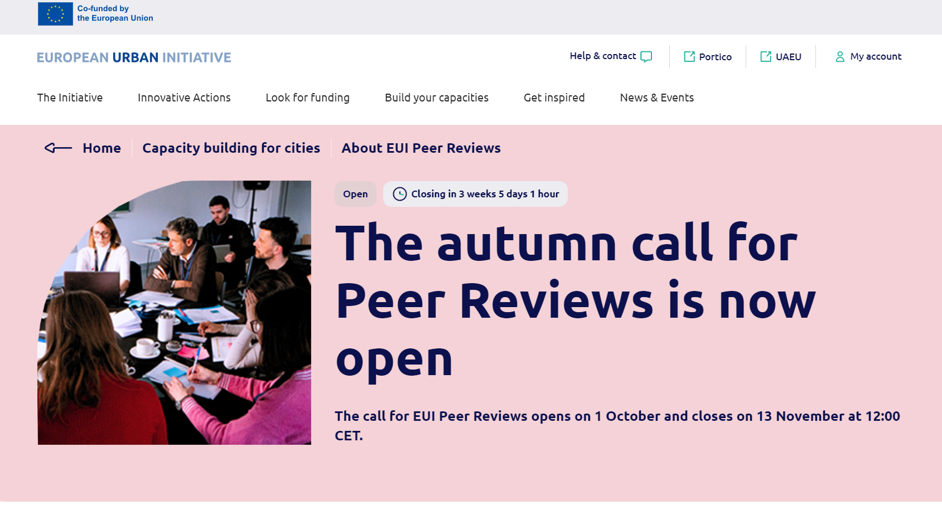
JRC TOOLKIT FOR SUSTAINABLE URBAN DEVELOPMENT (SUD) STRATEGIES
The Handbook of SUD strategies provides methodological support to cities to apply the integrated approach to their strategies.
It identifies main challenges and provides for resources, inspirational examples and recommendations to tackle them.
The self-assessment tool for SUD strategies - SAT4SUD can be voluntarily used by cities to assess the strength and weaknesses of their strategy and learn how to improve it.
The peer-review methodology serves to design interactive workshops where cities can meet in a safe environment to share their challenges on SUD strategies and provide feedbacks to each other.
Notes:
In order to help urban authorities design and implement SUD strategies, many tools and initiatives have been developed by DG REGIO and JRC. The Handbook contains recommendations intended to complement official regulations, without being prescriptive. In fact, it is conceived as a policy learning tool, flexible and adaptable to the needs arising from different territorial and administrative contexts. The Handbook addresses SUD strategies as bridges between cohesion policy on the one hand (with its rationale, rules and actors) and local territorial governance systems (with their rationale, rules and actors) on the other.

Slide 16
Thank you for your attention

Slide 17
Peer Reviews: Main features, eligibility & Call timeline
Eilish O’Loughlin
Head of Capacity Building,
EUI Permanent Secretariat
Notes:
Thank you, Romain and Anne, for these lovely welcoming words. If you felt inspired or intrigued, I have good news for you: we will hear more about the Hauts-de-France multi-level governance model in innovation later today – so stay tuned!

Slide 18


EUI Capacity Building in Short
  One target
  EU cities working on Sustainable Urban Development (SUD)
  Two objectives
  Build cities’ capacities in integrated, participative approaches
  Improve design & implementation of SUD policies & practices
  Three activities
  City-to-City Exchanges
  Peer Reviews
  Capacity Building Events
Notes:
C2C
61 applications to date
43 approved exchanges
Permanently open call
Events
Survey to MA soon launching
EU / Cluster events - 2023: RO, SI, FR
National events:
2023: HR, HU, SI;
2024: FI, IE, SE, CZ
2025 : EL, PL, LV, PT, RO, DK

Slide 19
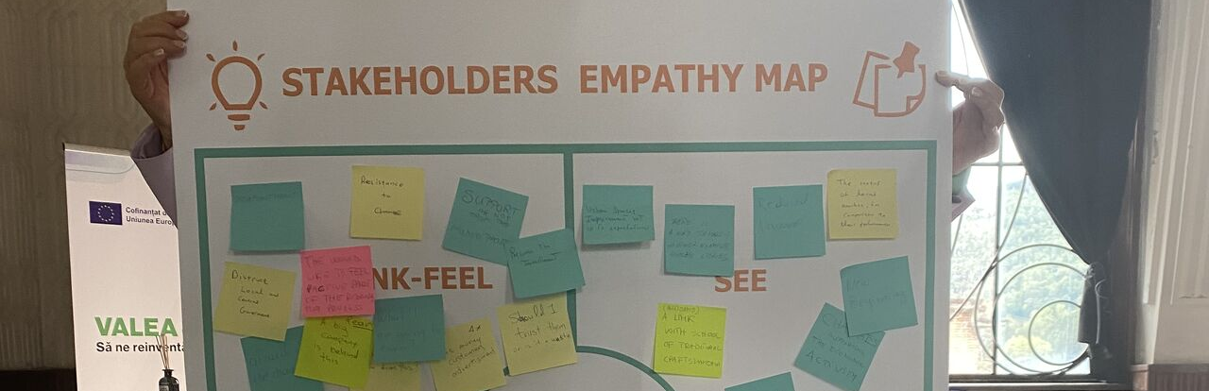
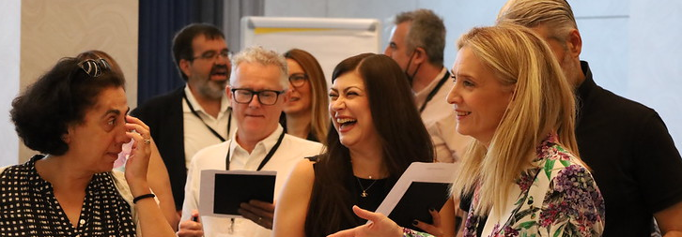
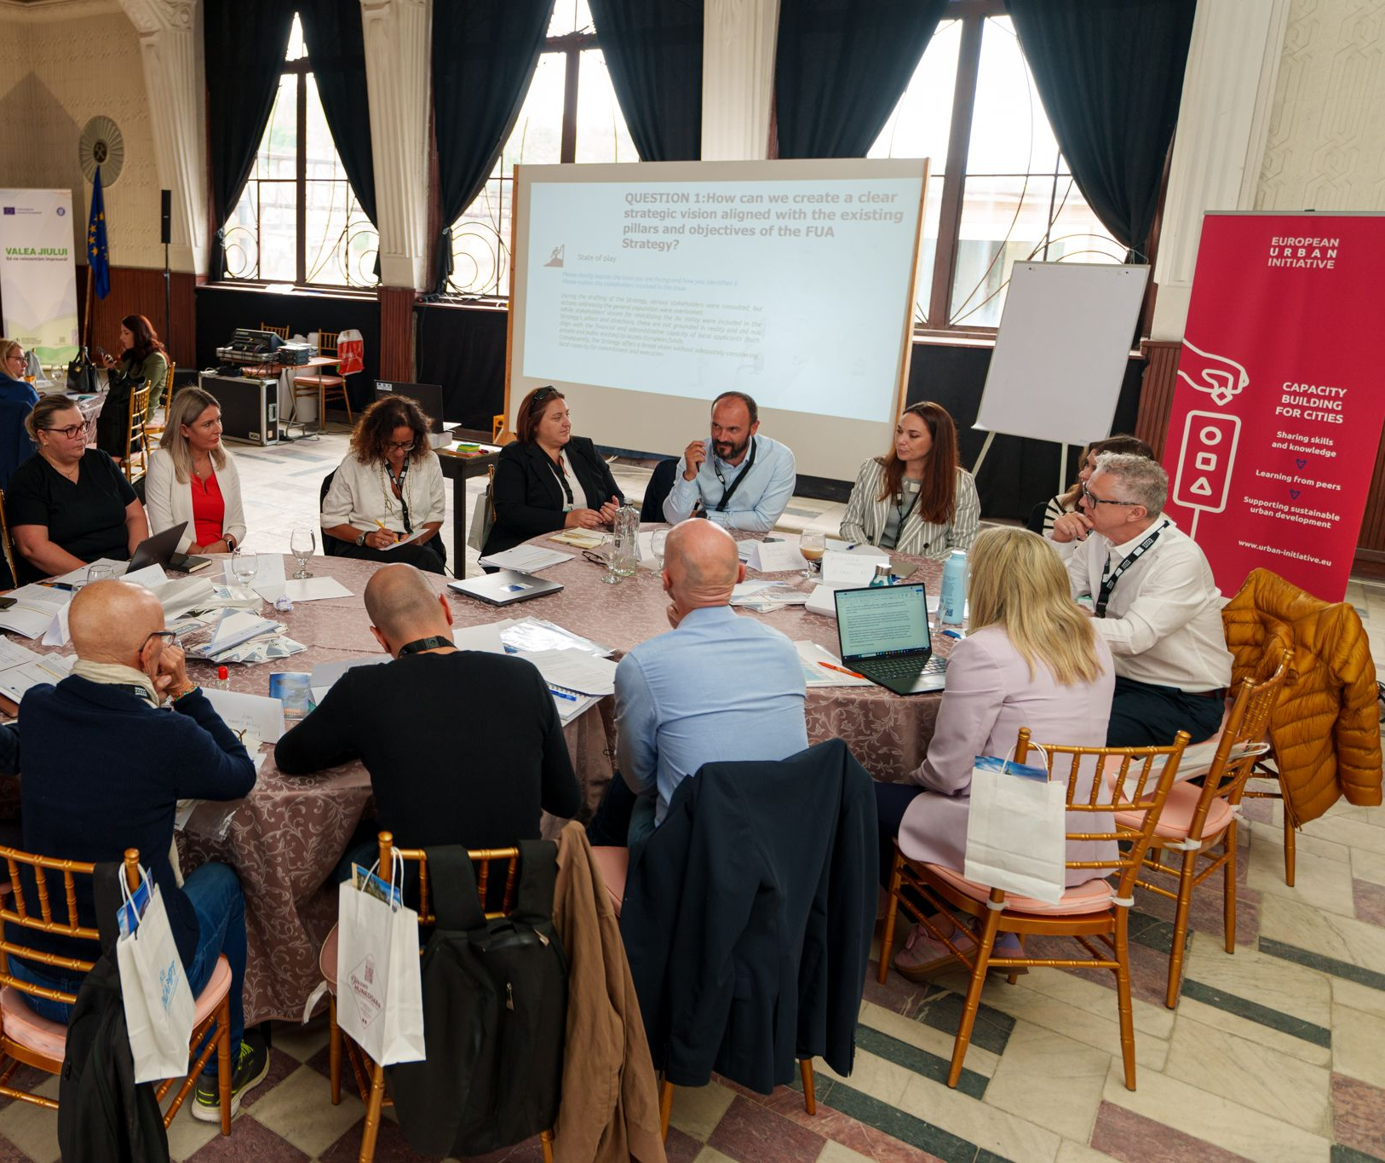
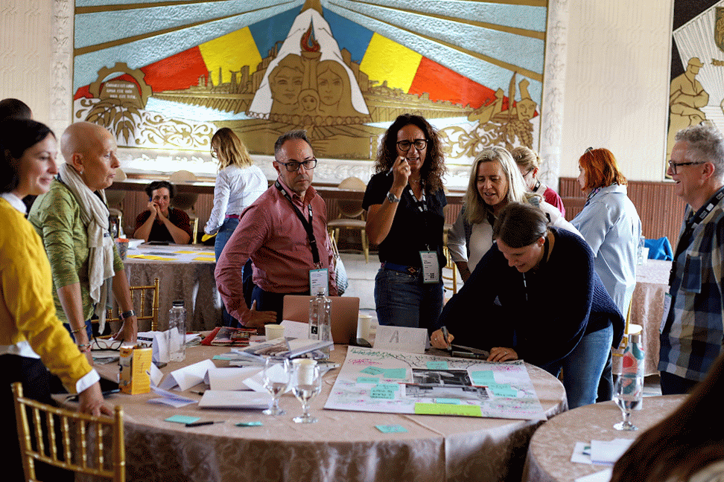
What is an EUI Peer Review?

Slide 20

Peer Reviews
Cities come together for 2-day event to solve challenges related to SUD strategies (those financed through art.11 ERDF)
Each PR: usually 3 cities under review & 15 peer reviewers
Cities Under Review: EU urban authorities on Article 11 list (www.urban-initiative.eu/article-11-cities)
Peer Reviewers: Any EU urban authority interested in integrated, place-based approaches to SUD
Fixed methodology and implementation of 4 to 6 months
Support from a team of experts throughout the process
Travel costs for all, staff costs for peer reviewers
4 peer reviews held so far (EL, PT, PL, RO), 2 upcoming (CY, IT)
Call open for 2025 peer reviews
Apply by 13 November!
Notes:
With the ongoing call, you can apply tomorrow and start your implementation in 2024!

Slide 21
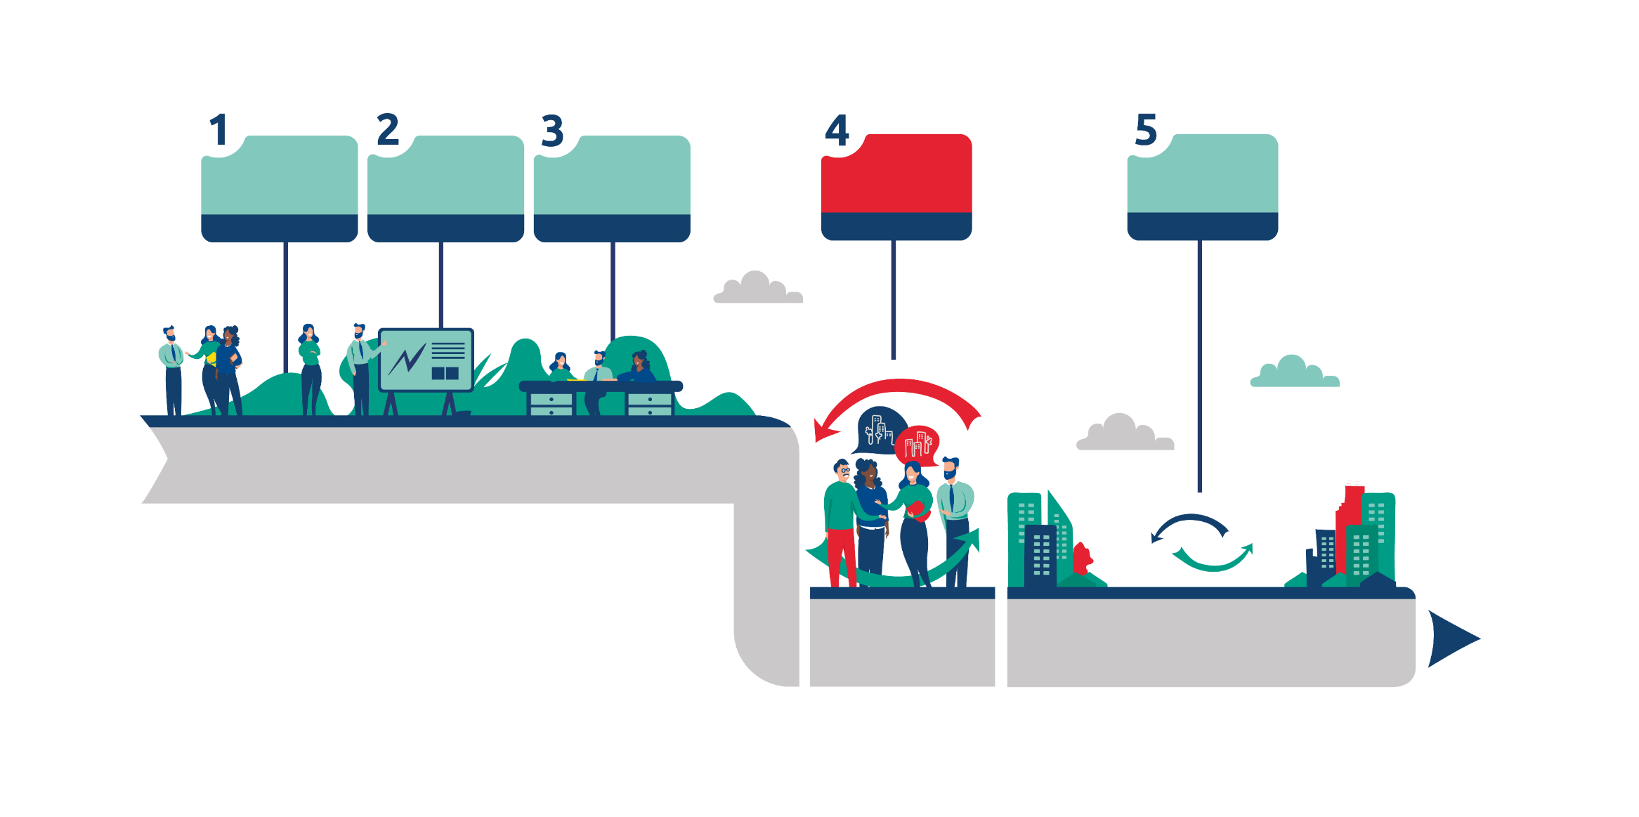
What happens in an EUI Peer Review?
An activity in five steps
Confirming the scope
Matchmaking
Content preparation
Peer review event
Follow-up activities
2 weeks
4 weeks
8 weeks
2 days
6 months
Challenges confirmed
Dates & location
Cities under review & peers grouped
Background paper
Online meetings
List of useful cases from peers
2-day in-person event
Report received
Support for application to city-to-city exchange
Follow-up meeting

Slide 22
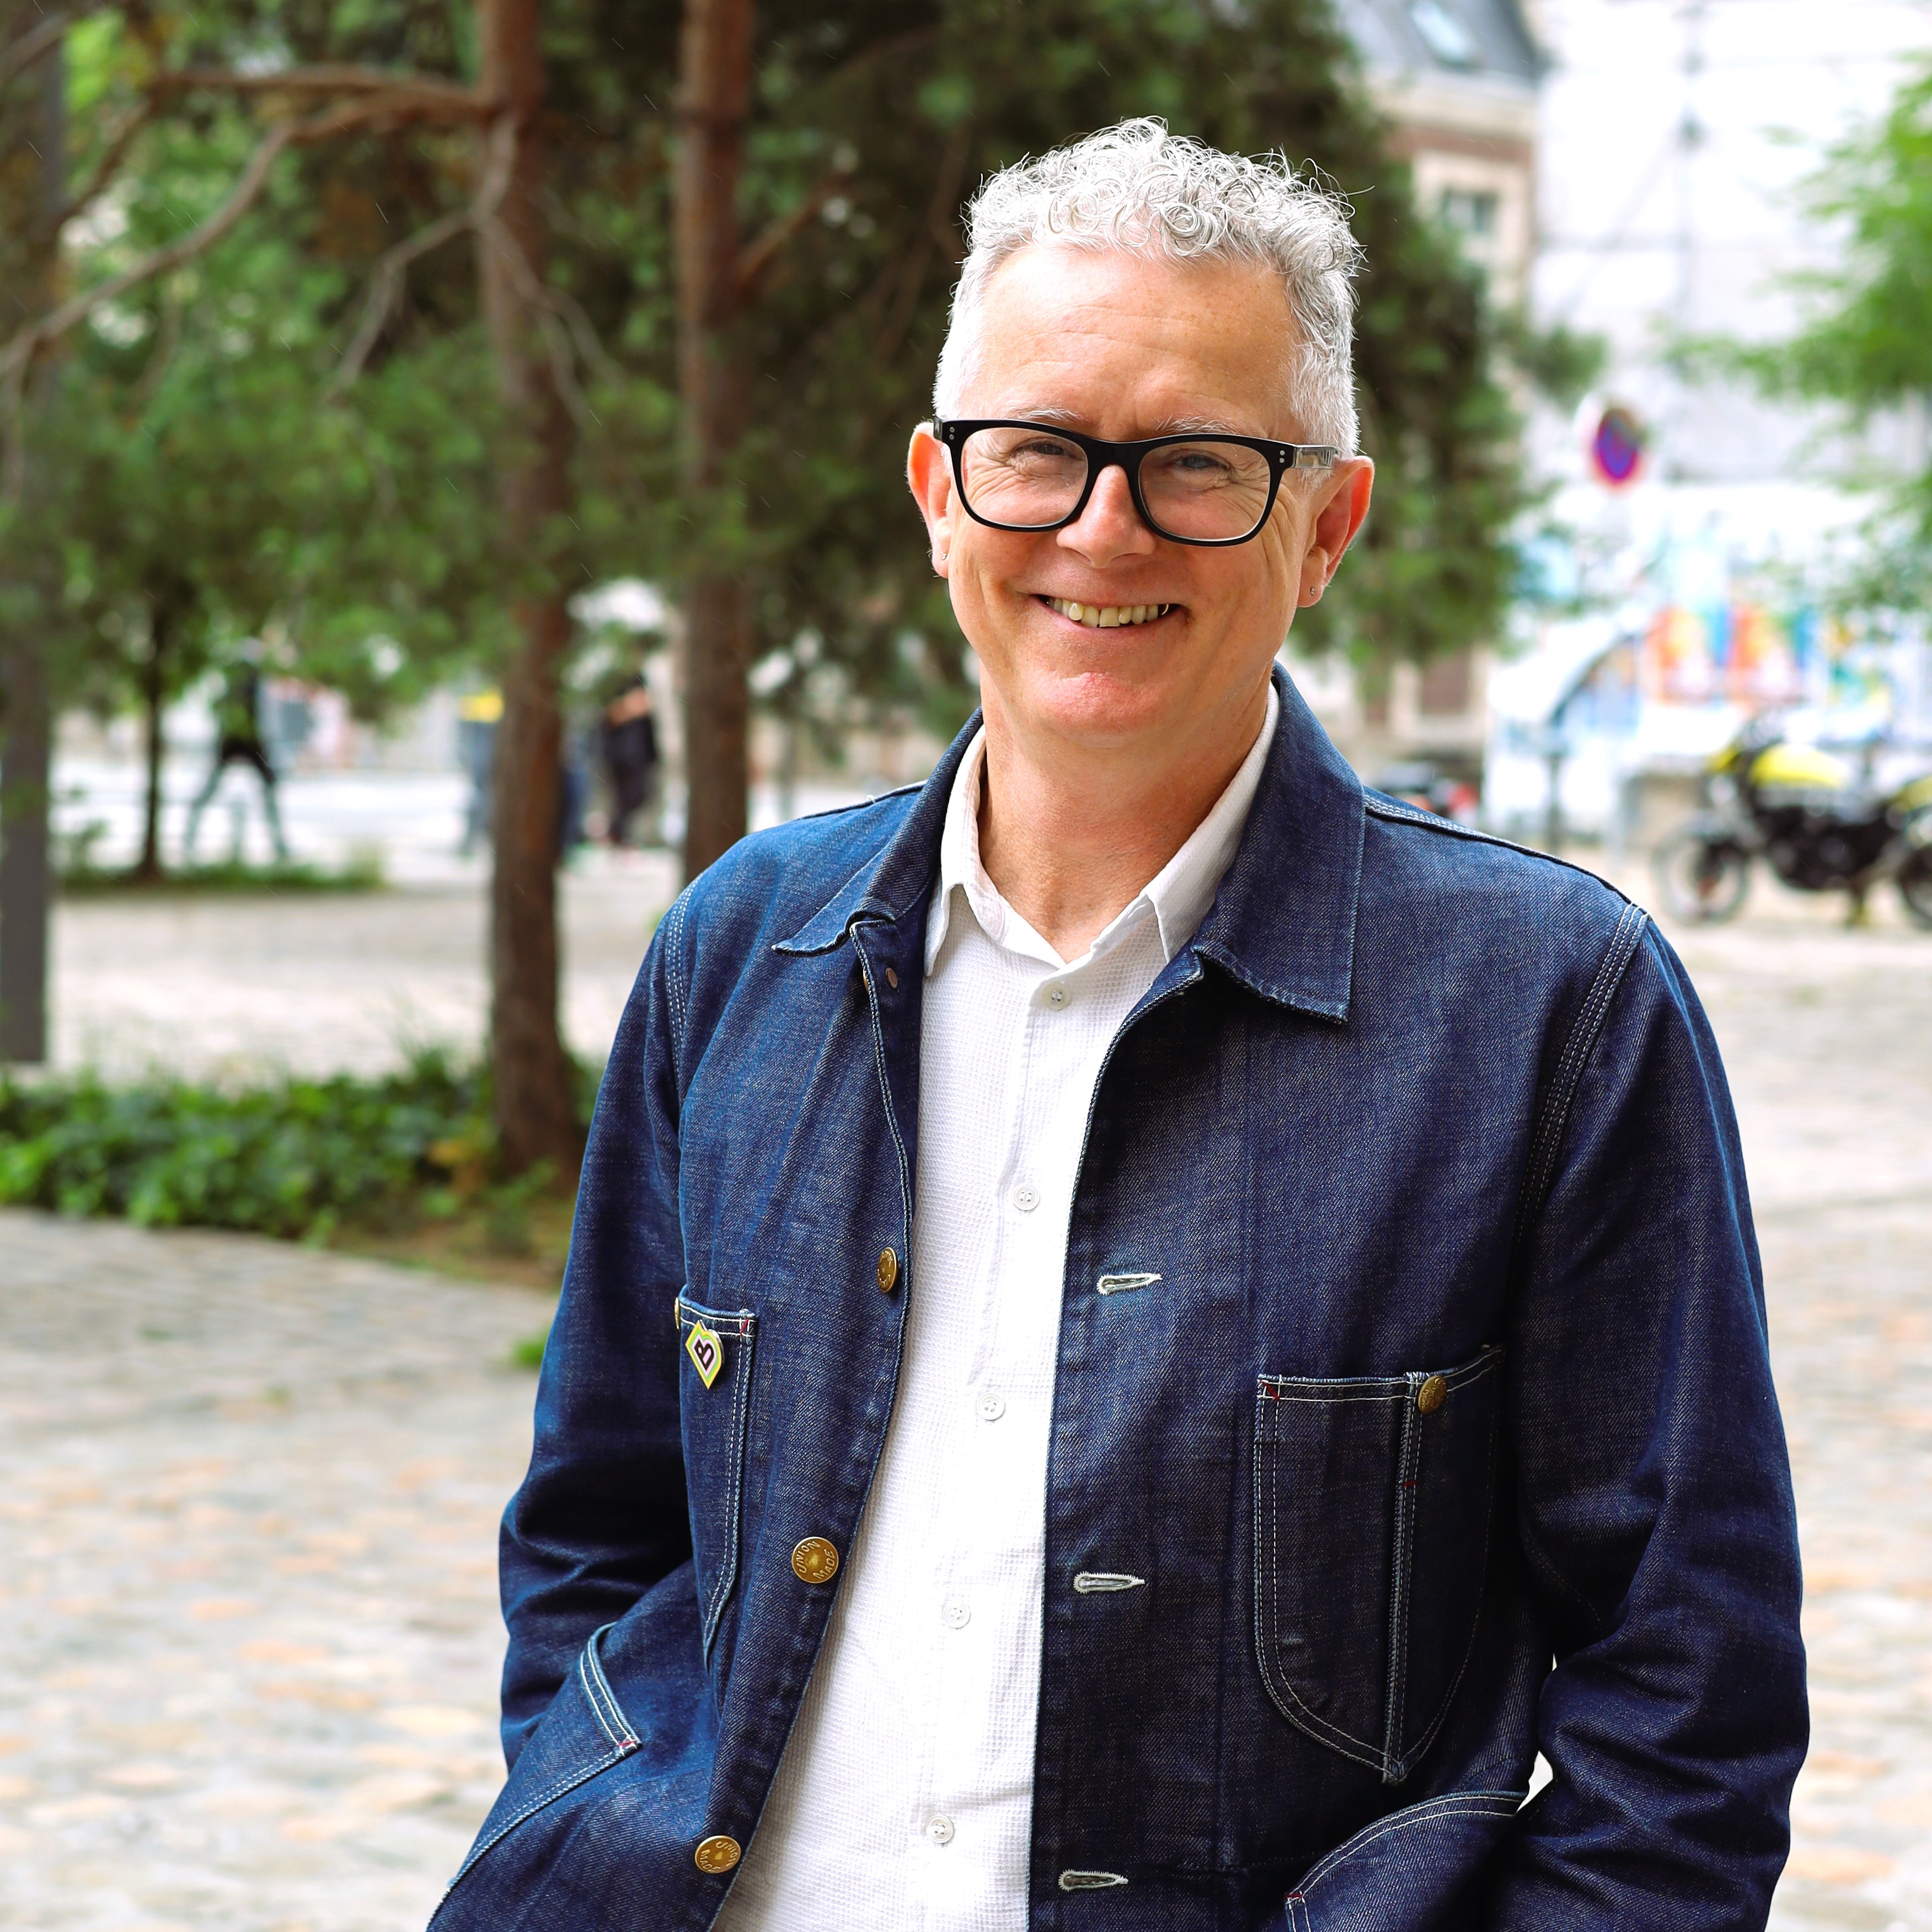
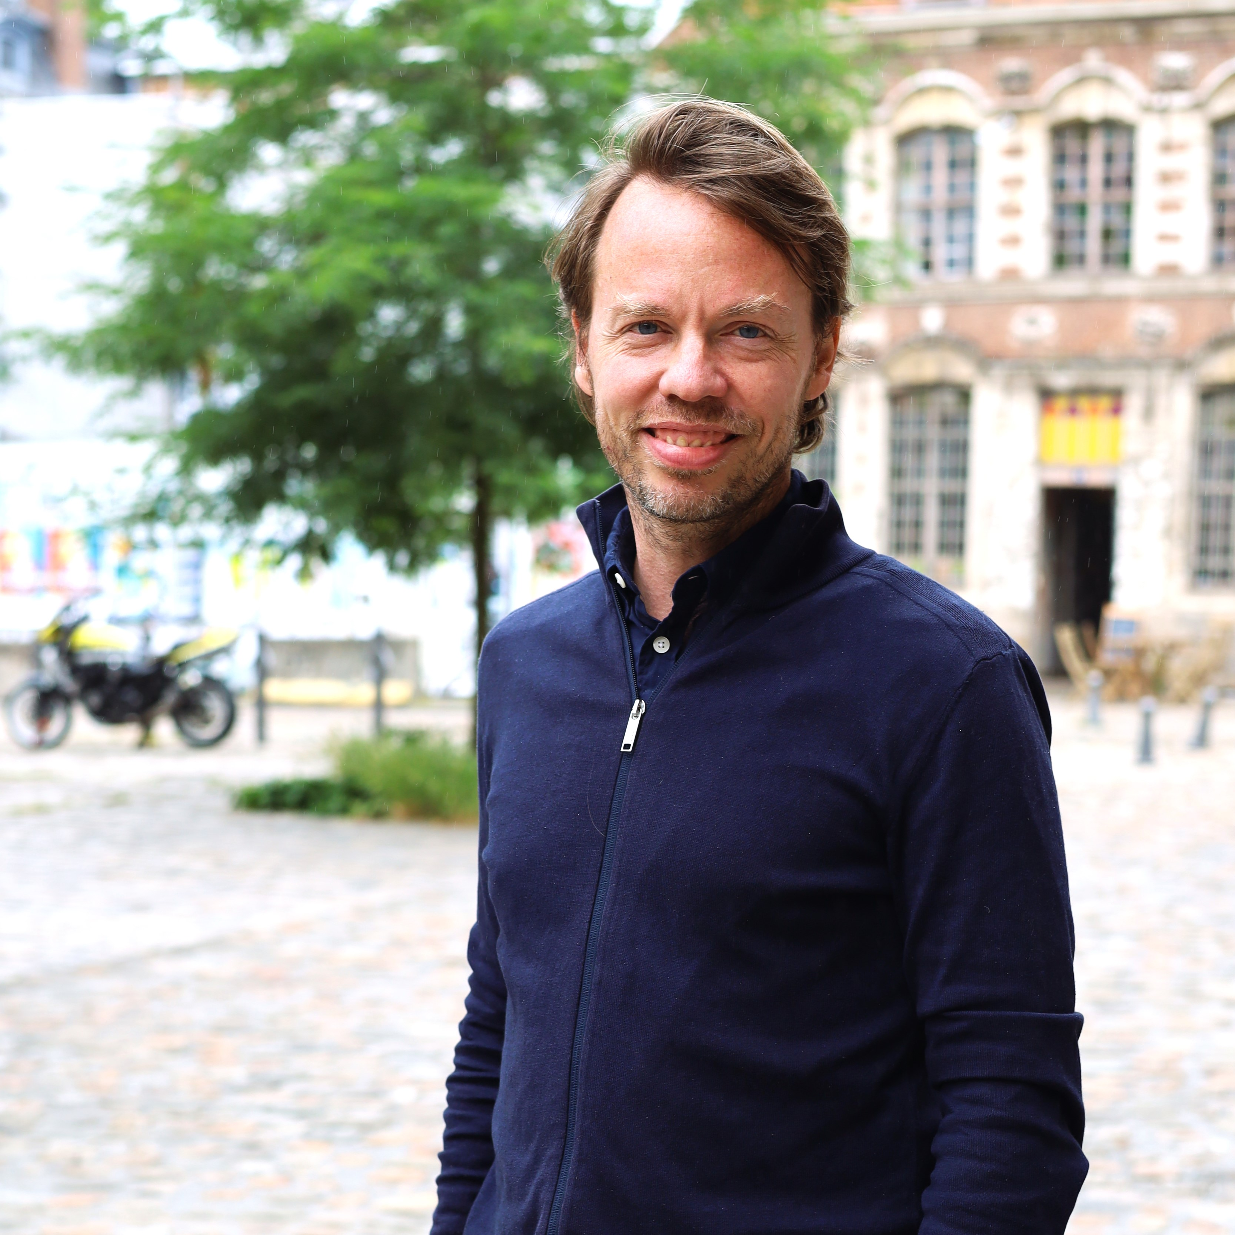

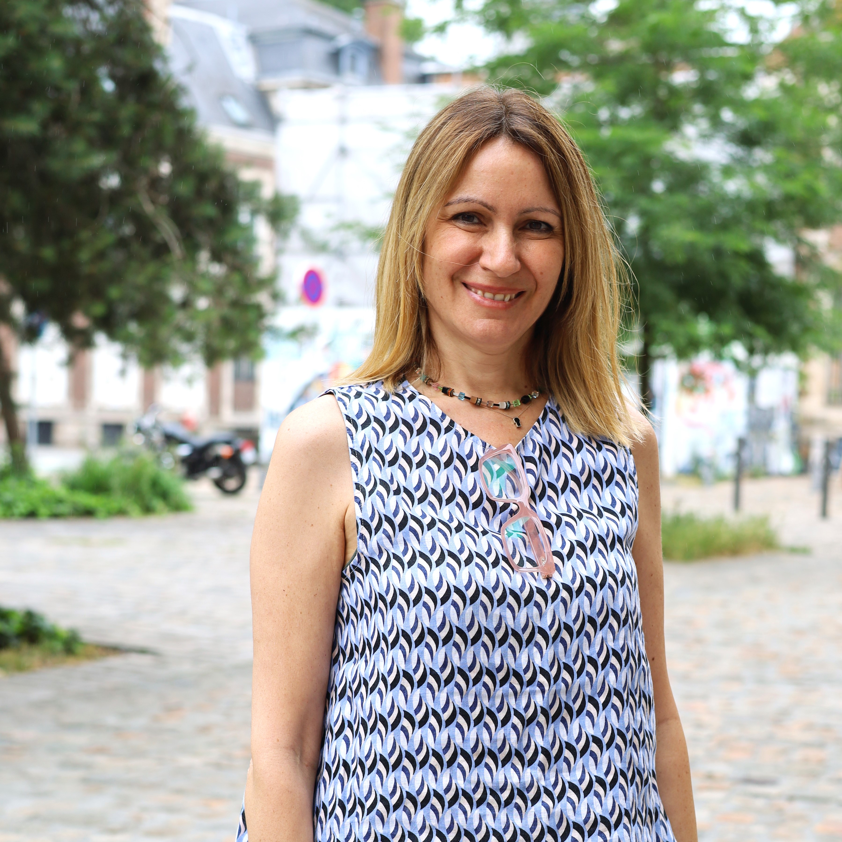
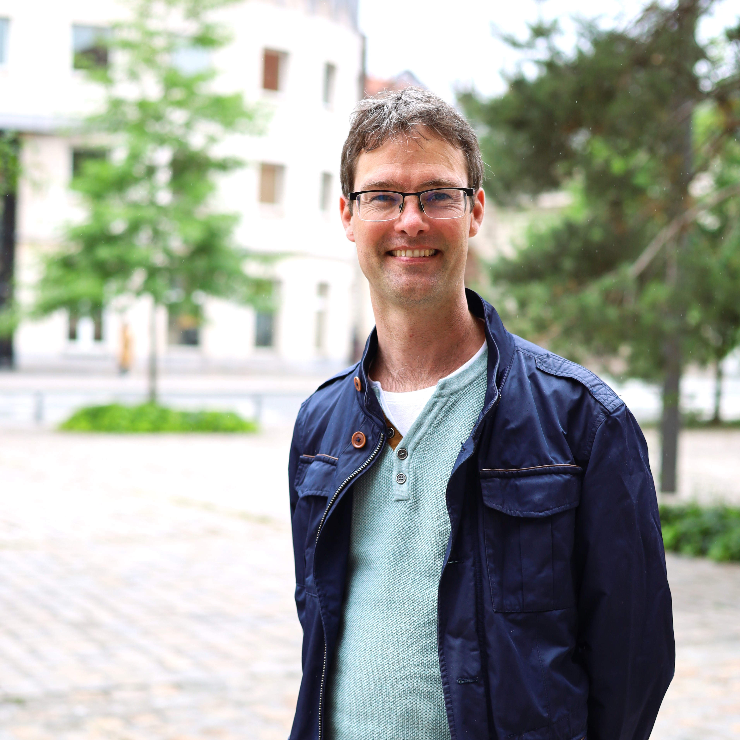
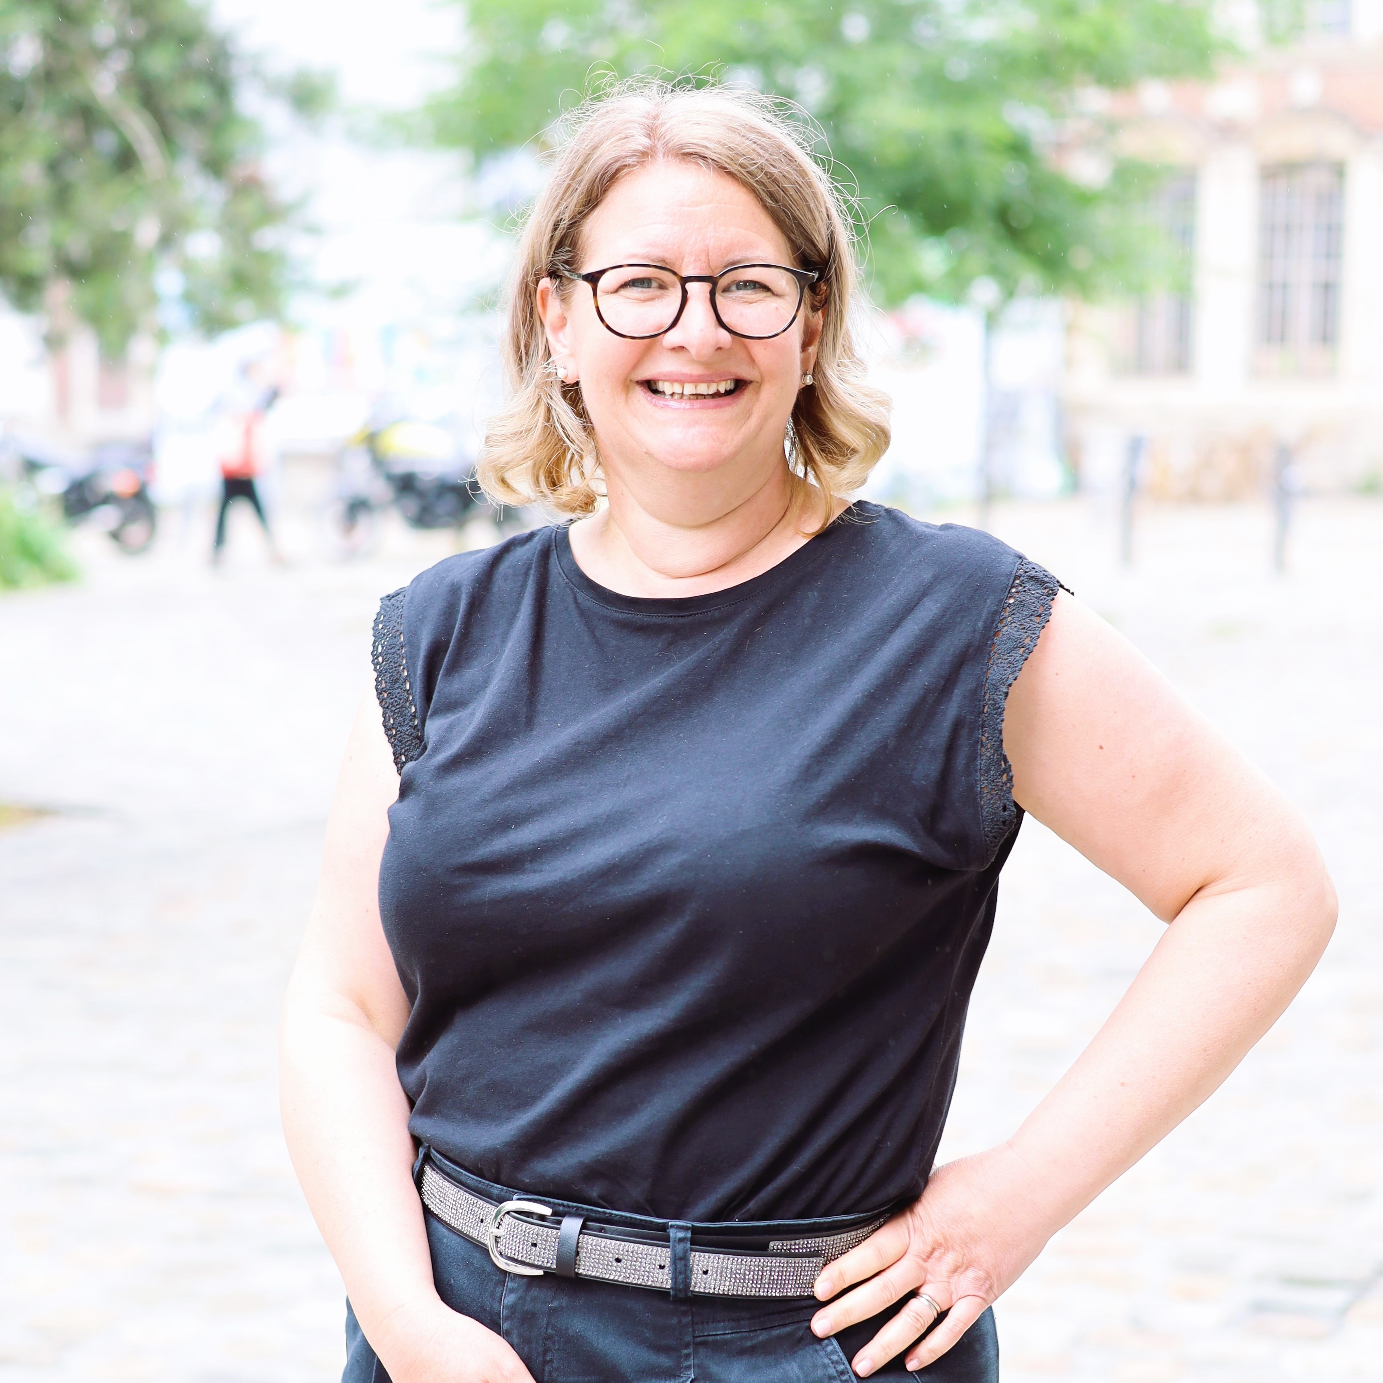
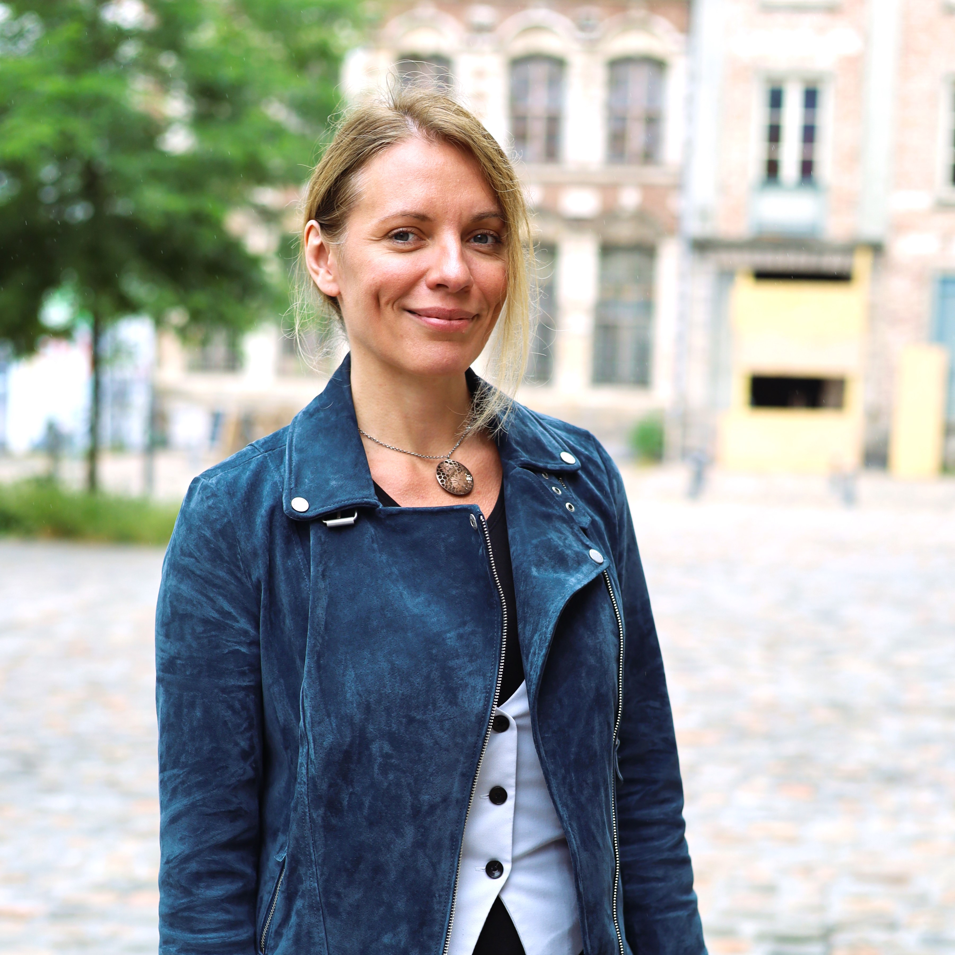
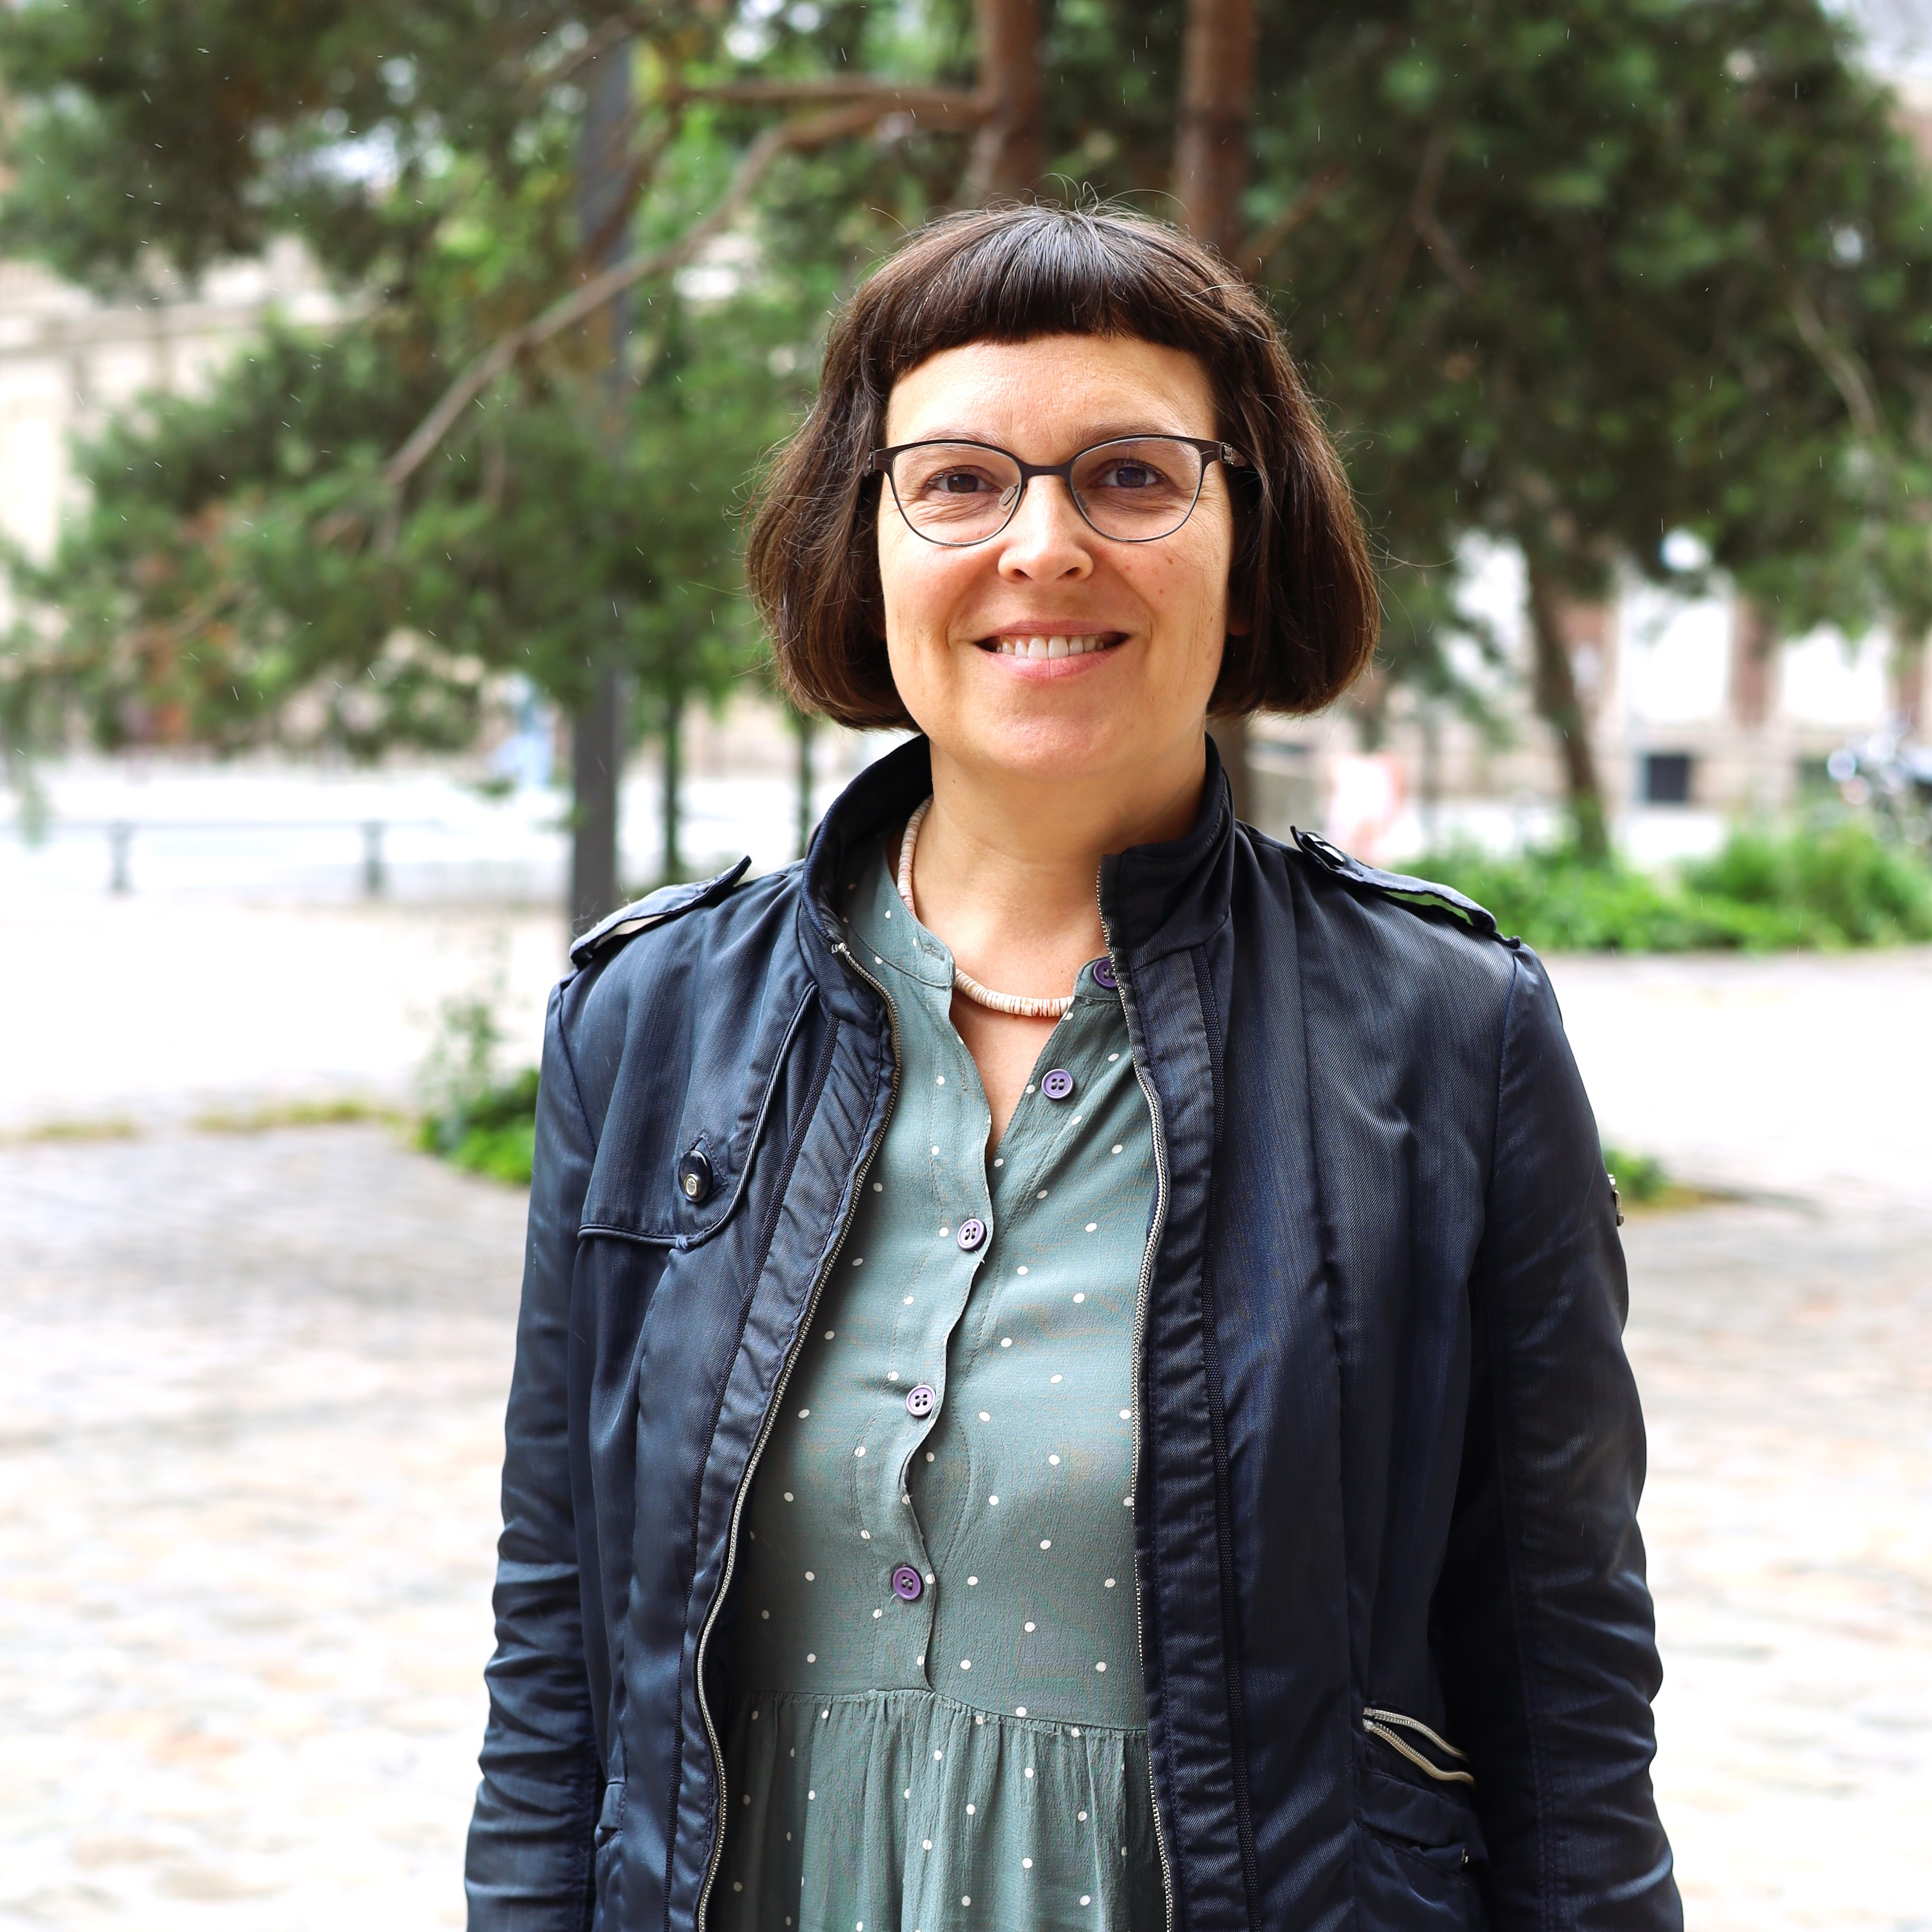
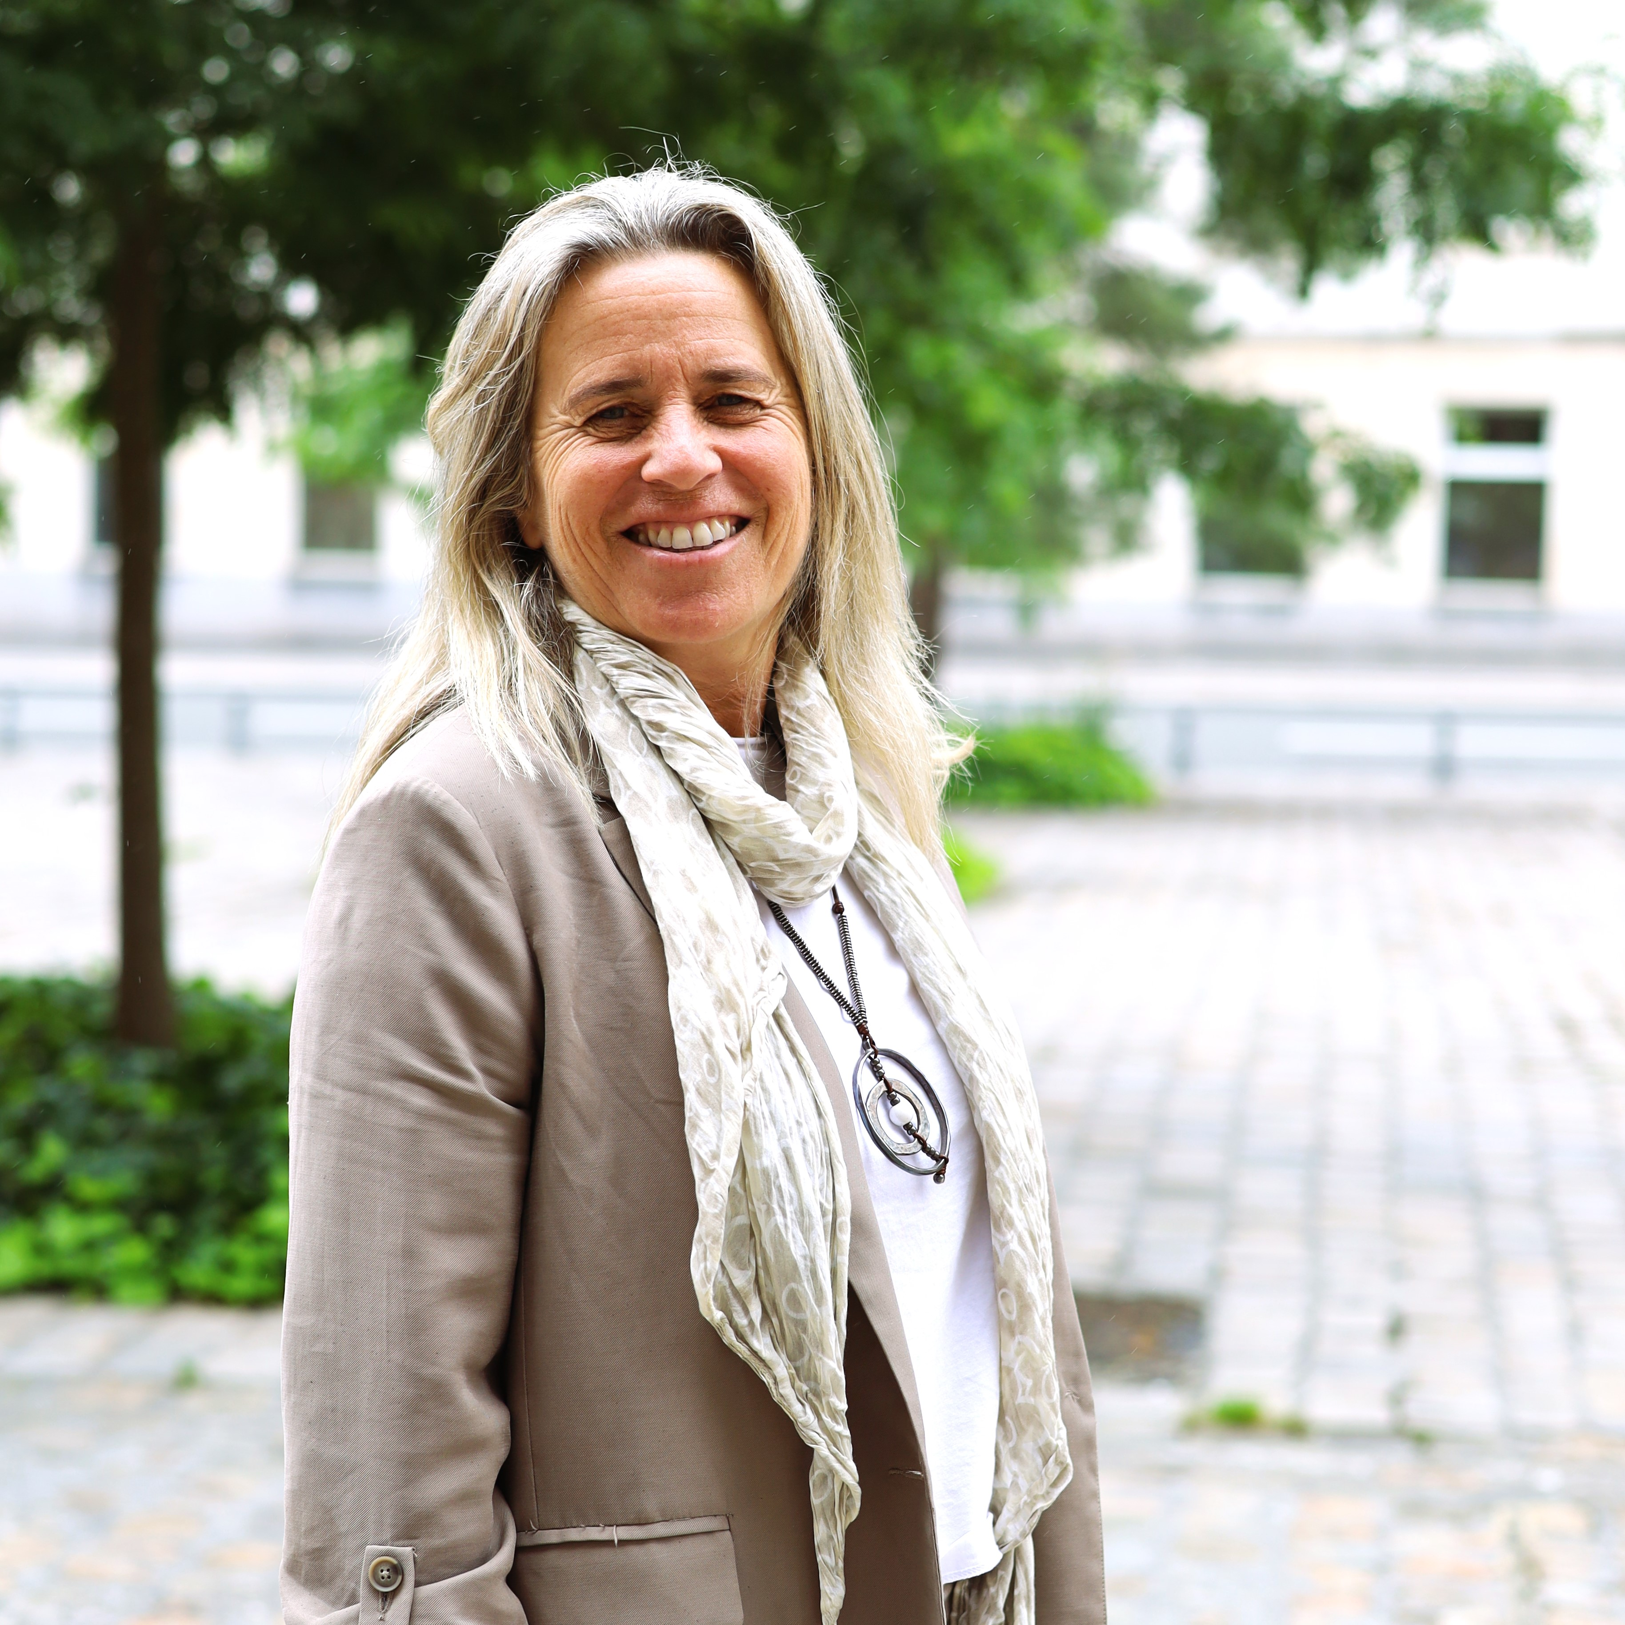

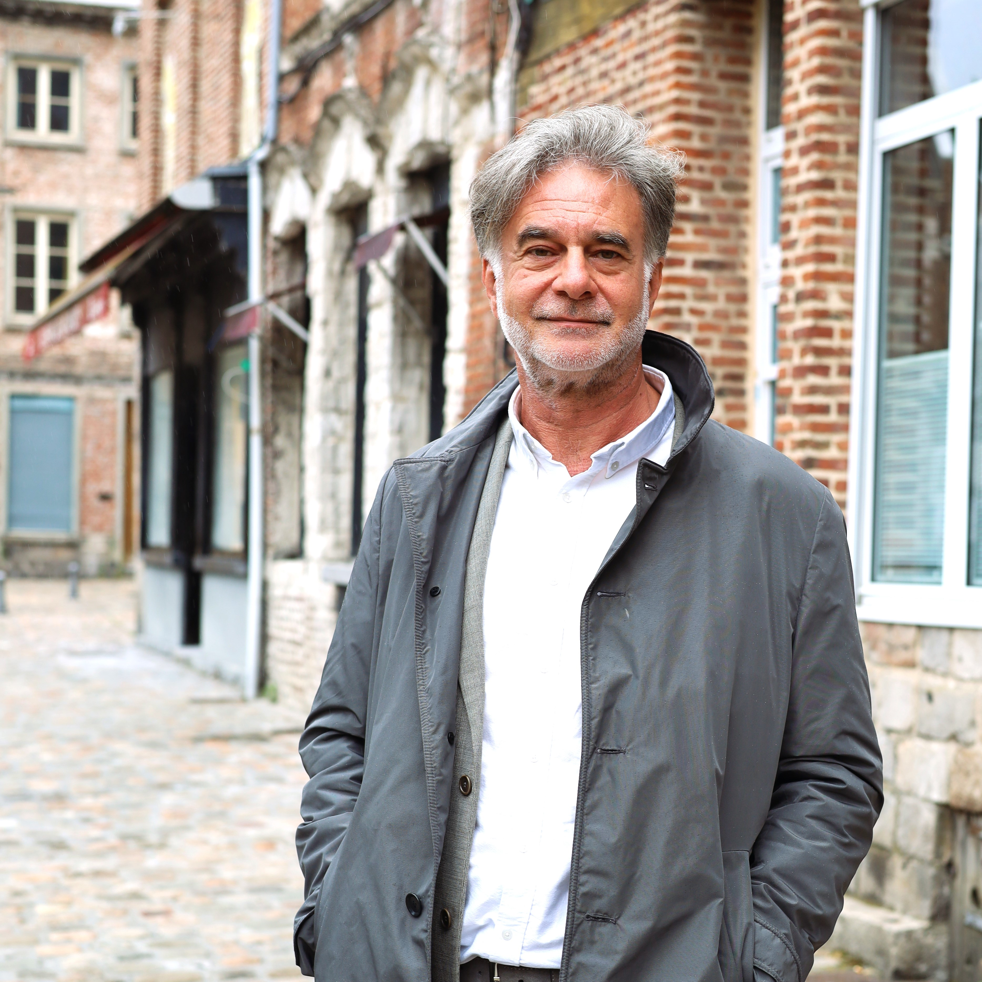
Introducing the Peer Review Experts
Levente Polyak
Peer Review Expert
Sandra Rainero
Peer Review Expert
Eddy Adams
Peer Review Expert
Martijn De Bruijn
Peer Review Expert
Eleni Feleki
Peer Review Expert
Petra Grgasović
Peer Review Expert
Adele Bucella
Expert & Coordinator
Sandra Marin
Peer Review Expert
Martina Pertoldi
Peer Review Expert
Eurico Neves
Peer Review Expert
Sally Kneeshaw
Peer Review Expert

Slide 23

What’s in it for Cities under Review?
1
A structured process to help you address specific needs in developing, implementing or monitoring your SUD strategy.
Specific, tailored feedback, reflections, and inspiration from Peer Reviewers to address challenges and improve your strategy
Constant expert support, guidance and advice from the team of approved EUI experts and the EUI Secretariat.
2
3
Notes:
Check the testimonies from past cities under review.

Slide 24

I would like to apply as City under Review
What are my challenges?
Key resource for cities under review:
Potential CUR identify three challenges to address in the PR
Must be related to design / implementation of their SUD strategy (Article 11 strategy)
Check six building blocks of Handbook for SUD strategies and SAT4SUD self-assessment tool to identify relevant topics.
You can refine the challenges described in the application form during the preparation stage.
Notes:
Applicants for cities under review are asked to identify three challenges in the Application Form. It’s important to highlight that the challenges are further detailed in the implementation of the activity. At application stage, nothing you put needs to be final – questions are more for us to get a first and quick understanding of the challenges. The challenges are linked to the Handbook for SUD strategies. We will definitely need your help in translating the concepts in normal language.

Slide 25

What’s in it for Peer Reviewers?
1
Peer Reviewers learn from, as well as inspire, the City under Review – the learning goes both ways.
Learn from the other Peer Reviewers, hear about a range of inspiring practices and approaches from cities across Europe.
By being engaged in this process, Peer Reviewers critically reflect on their own successes and remaining challenges.
2
3
Notes:
Check the testimonies from past cities under review.

Slide 26
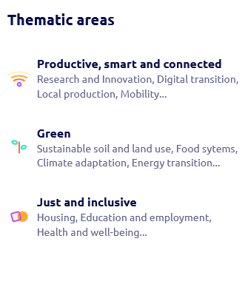
I would like to apply as Peer Reviewer
What is my expertise?
Potential peer reviewers identify their operational and thematic fields of expertise.
Operational expertise is based on the six building blocks of Handbook for SUD strategies.
Thematic expertise in based on the Portico taxonomy of thematic areas.
Key resources for peer reviewers
Notes:
Potential peer reviewers are asked to identify their expertise, both operationally and thematically. We will also need your help in making sure the concepts are clear.

Slide 27
What support does EUI provide?
Apply, and we take care of the rest!
1
2
3
Expertise
Logistics
Funding
Two experts support Cities under Review with every step
Host cities: we organise event and cover all costs
Participants: You book travel & accommodation which EUI reimburses after the event.
You can claim financial support:
After event
Based on standardised costs
Up to 4 people for City under Review
Up to 2 people, for Peer Reviewer

Slide 28
How does the funding work?
A lump sum paid to urban authority (except hosts)
1
2
2
Travel cost
Per diem
Staff costs
Fixed unit cost defined by EC based on distance between place of departure & host city
Fixed daily rate defined by EC per MS for accommodation, subsistence & local travel
Up to 4 days payable
€ 350 per day
Up to 5 days payable
Only for Peer Reviewers

Slide 29
Call for EUI Peer Reviews - Key Details
1
Dates: 1 October – 13 November 2024, 12:00 CET
Eligible authorities:
Cities Under Review: EU urban authority on Article 11 list (www.urban-initiative.eu/article-11-cities)
Peer Reviewers: Any EU urban authority interested in integrated, place-based approaches to SUD
2
3
How to apply:
Submit application via EUI website. Prepare information with courtesy application form:
For either/both roles: Motivation, participating staff, endorsement of institution
Cities Under Review: Status of SUD strategy, 3 challenges, staff involvement in SUD strategy
Peer Reviewers: Thematic and operational expertise related to SUD strategies
4
Timeline for next steps:
30 Nov Earliest dates for results of call, notification of all applicants
End-Dec Decision on dates and locations for peer reviews
Jan 2025 Composition of peer review groups based on matchmaking and agreement
Feb-June 2025 Implementation of peer reviews resulting from this call (3 or 4 expected)
Notes:
How will this work? We will have two rounds, each functioning the same way. You will first hear about Schaerbeek’s and Bilbao’s cases – in seven minutes. We will then break into two groups – in the plenary Schaerbeek and in the room next door, Bilbao. You will work on the challenges, first redefining the problem, then providing insights and recommendations. We will then all gather back in the plenary for collective feedback.

Slide 30
You are pre-allocated to language rooms
11:00 – Participants move to break-out rooms
11:45 – All return to plenary for closing messages
Didn’t arrive in the right room?
Write your language in chat box, we will move you
Participants from DK, LU & MT:
  Stay with us in plenary for Q&A!
  UCP will follow up to answer your questions
Time for break-out rooms
Notes:
Thank you, Romain and Anne, for these lovely welcoming words. If you felt inspired or intrigued, I have good news for you: we will hear more about the Hauts-de-France multi-level governance model in innovation later today – so stay tuned!

Slide 31
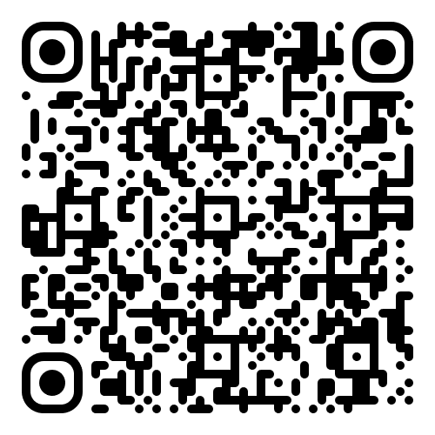
Recap: how to apply, what support is available
  Get support
  Application Pack: Read Guidance for Peer Reviews and Courtesy Application Form.
  Article 11: check eligibility at www.urban-initiative.eu/article-11-cities
    You are article 11, but your city isn’t listed? Talk to UCP, upload proof with application.
  Bilateral consultations: if you have specific questions, book a 1-1 meeting with PS
  Email support: Send your queries via capacitybuilding@urban-initiative.eu.
Call open for 2025 peer reviews
Apply by 13 November, 12:00 CET

Slide 32
Thank you for your participation!

