Slide 1
EUI-innovative actions call 3
Topic “Technology in cities”
Applicant seminar
23 May 2024

Slide 2

EUI-INNOVATIVE ACTIONS CALL 3
Technology in cities
Cohesion policy programmes
2021-2027
SUD
Strategies
EUI
Call 3
  EUR 40 billion of cohesion policy to support digitalization in 2021-2027
  EUR 15 billion SUD implementing integrated strategies through the Specific objectives selected for this call.
EUI-innovative actions Call 3
Make the right connections to support your project ideas on the « Technology in cities » topic!
Cohesion policy supporting the digital transition 2021-2027 | Data | European Structural and Investment Funds (europa.eu)

Slide 3
EUI-INNOVATIVE ACTIONS CALL 3
Technology in cities
Prompts for urban authorities:
Ensuring better and adapted public services by optimizing public service delivery through innovative technological transformation (cost reduction, automation, acceleration, and simplification of administrative procedures).
Consolidating the local governance, ensuring an effective participatory democracy and stimulate innovation and competitiveness by involving more local people, businesses, universities in the planning and design, with the aim to co-design and co-create the local solutions. The partnership with Universities and businesses should be developed to create and enhance innovation and smart specialization dynamics in the local economy.
Mastering the digital transformation, local data collection and sharing while ensuring the highest standards for data privacy by innovative way of collect, use, store, and share sub-city-level data with increased granularity to provide better services for citizens and businesses.
Perfecting the Spatial planning, land use and industrial zoning by using technologies in the strategic and spatial planning, for ensuring harmonious and optimal urban and peri-urban development.
Prompts are indicative
Combination is welcomed (integrated projects)
EUI-IA strategic assessment criteria also matter

Slide 4
EUI-INNOVATIVE ACTIONS CALL 3
Technology in cities
Prompts for urban authorities:
Ensuring better services, digital and physical accessibility, and inclusion of persons with disabilities and older population by increasing their active participation in the local governance system and by collecting and analysing data on the local specific needs and experiences, in order to create/adjust local policy. Specific focus on measures for labour market inclusion, lifelong learning, and retaining talent.
Safe, secure and resilient cities by redesigning urban spaces for the citizens to be less exposed to climate change and other threats based on vulnerability assessment and scenarios, by proposing new innovative services, infrastructure and equipment contributing also to the resilience of critical infrastructures and public spaces.
  Strengthening prevention and mitigation of natural and man-made disasters
  Ensuring food security in urban and functional areas
  Cybersecurity
Prompts are indicative
Combination is welcomed (integrated projects)
EUI-IA strategic assessment criteria also matter

Slide 5
EUI-INNOVATIVE ACTIONS CALL 3
Technology in cities
Link your proposal with the « Cohesion policy target »
The list of options is long, be selective and specify HOW your proposal will contribute to the objectives of your relevant Programme !
Specific objective 1.1 for a more competitive and smarter Europe by “developing and enhancing research and innovation capacities and the uptake of advanced technologies”.
Specific objective 1.2 for a more competitive and smarter Europe by “reaping the benefits of digitisation for citizens, companies, research organisations and public authorities”.
Specific objective 1.4 for a more competitive and smarter Europe by “developing skills for smart specialisation, industrial transition and entrepreneurship”.
Specific objective 1.5 for a more competitive and smarter Europe by “enhancing digital connectivity”.
Specific objective 2.4 for a greener Europe by “promoting climate change adaptation and disaster risk prevention and resilience, taking into account eco-system based approaches”.
Specific objective 4.1 for a more social and inclusive Europe by “enhancing the effectiveness and inclusiveness of labour markets and access to quality employment through developing social infrastructure and promoting social economy”.
Specific objective 4.2 for a more social and inclusive Europe by “improving equal access to inclusive and quality services in education, training and lifelong learning through developing accessible infrastructure, including by fostering resilience for distance and on-line education and training”.
Specific objective 4.3 for a more social and inclusive Europe by “promoting the socioeconomic inclusion of marginalised communities, low-income households and disadvantaged groups, including people with special needs, through integrated actions, including housing and social services".
Specific objective 5.1 for a Europe closer to citizens by “fostering the integrated and inclusive social, economic and environmental development, culture, natural heritage, sustainable tourism and security in urban areas”.
EUR 15 billion for SUD in 121 programmes with investments planned under the 9th specific objectives.
References: ERDF Regulation – Article 3

Slide 6
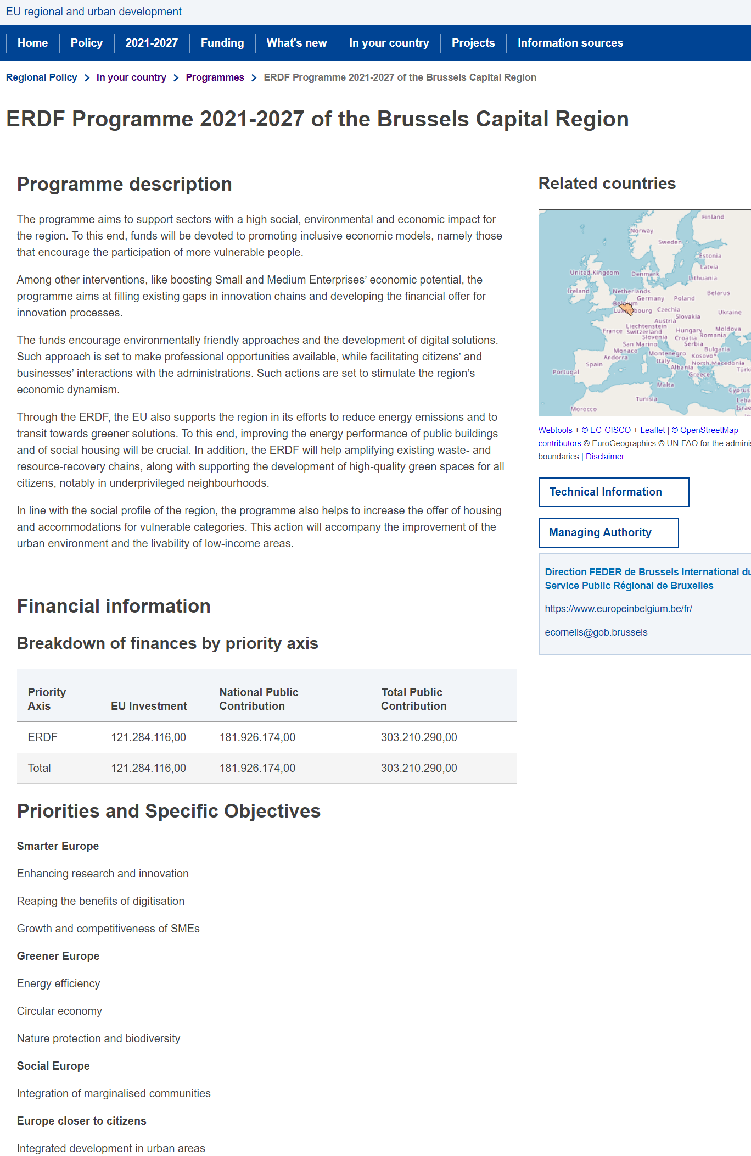
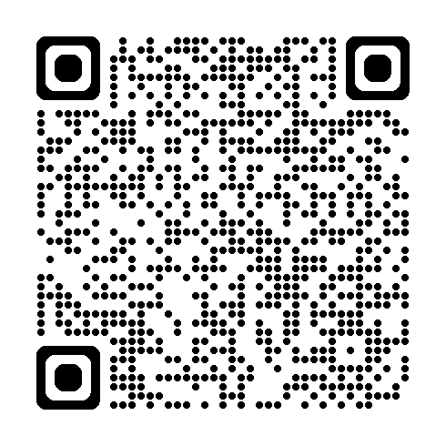
EUI-INNOVATIVE ACTIONS CALL 3
Technology in cities
Information on Cohesion policy in your country?
  National single portals: National single portals - European Commission (europa.eu)
  Inforegio – summary of programmes:
  Inforegio - Programmes (europa.eu)
Example: Brussels Capital Region ERDF programme 2021-27

Slide 7
EUI-INNOVATIVE ACTIONS CALL 3
Technology in cities
A list of indicators inspired from Cohesion policy to capture some of the multiple dimensions of a technological « upgrade »
Output indicators (examples):
New products and services created (measurement unit: new products/services).
People supported (trained, upskilled, accompanied or assisted); (measurement unit: persons)
Population covered by projects in the framework of integrated actions for socio-economic inclusion of marginalised communities, low-income households and disadvantaged groups (measurement unit: persons).
Result indicators (exemples):
Users of new and upgraded digital services, products and processes (measurement unit: users/year).
Jobs created in supported entities (measurement unit: annual FTEs)
Annual users of new or modernised health and/or social care facilities (measurement unit: users/year).
…NOT binding but to be used when relevant to complete your project proposals’ specific indicators

Slide 8
‘Technology in cities’
Examples of relevant knowledge sources
Ninth report on economic, social and territorial cohesion
Inforegio - Ninth Report on Economic, Social and Territorial Cohesion (europa.eu)
European Commission Report “The future of cities: opportunities, challenges and way forward”
the-future-of-cities_online.pdf
Urban Agenda for EU - Partnership on Digital Transition
Digital Transition | UAEU (urban-initiative.eu)
Urban Innovative Actions – Digital Transition
Digital transition | UIA - Urban Innovative Actions (uia-initiative.eu)
Urban Data Platform Plus (dashboards, strategies, reports and tools to analyse urban and territorial trends – JRC-REGIO).
Urban Data Platform Plus (europa.eu)
A Europe fit for the digital age
A Europe fit for the digital age - European Commission (europa.eu); Excellence and trust in artificial intelligence - European Commission (europa.eu)
The New European Innovation Agenda
The New European Innovation Agenda - European Commission (europa.eu)
The Digital Europe Programme
The Digital Europe Programme | Shaping Europe’s digital future (europa.eu)
Programme summaries by country and managing authority contact details
Inforegio - Programmes (europa.eu)

Slide 9
Thank you for your attention!
More information at:
Technology in cities | EUI (urban-initiative.eu)

