Slide 1
Infossession :
URBACT Good Practices &
EUI City-to-City Exchanges
21 May 2024

Slide 2

AGENDA
  URBACT & European Urban Initiative
  URBACT Good Practices Call
  EUI City-to-City Exchanges Call

Slide 3


URBACT & European Urban Initiative
Launched in 2002
Launched in 2022
Networks
Innovative actions
Capacity-Building
Capacity-Building
Communication
Knowledge-sharing
Communication Knowledge-sharing
Close collaboration
&
common national contact point

Slide 4


Call for Good Practices
15 April-30 June
2024

Slide 5
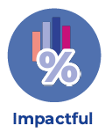




What are we looking for?
A successful urban good practice implemented in a European city that is:
Notes:
No limit set in how many will be approved.

Slide 6
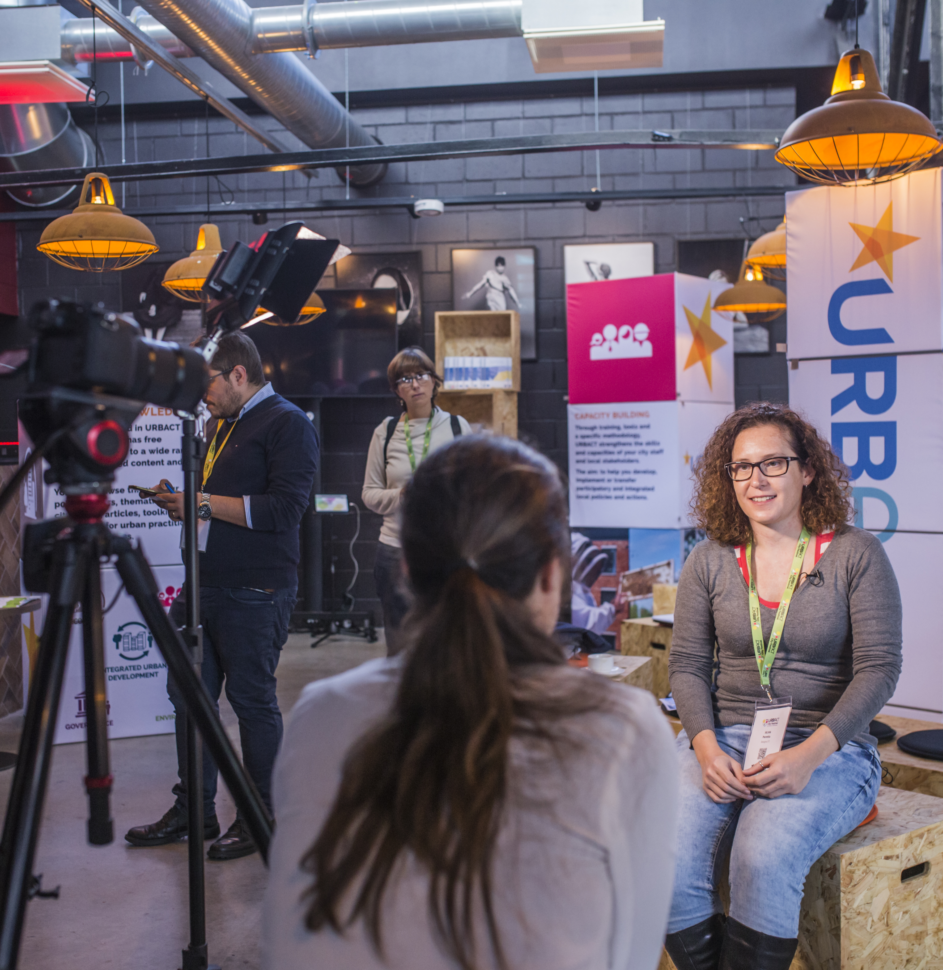
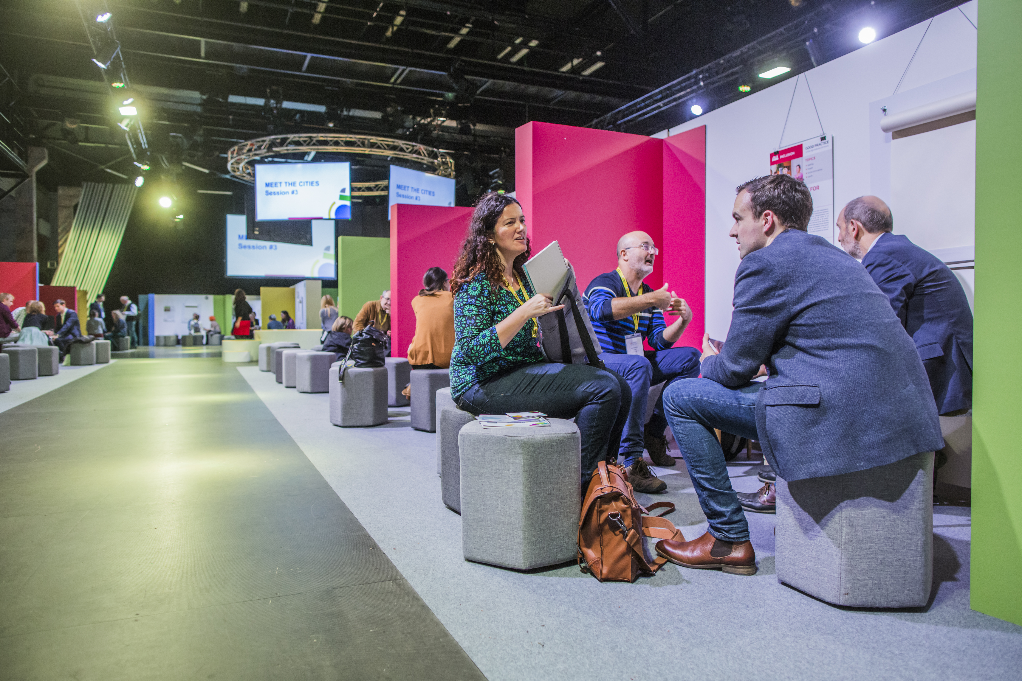
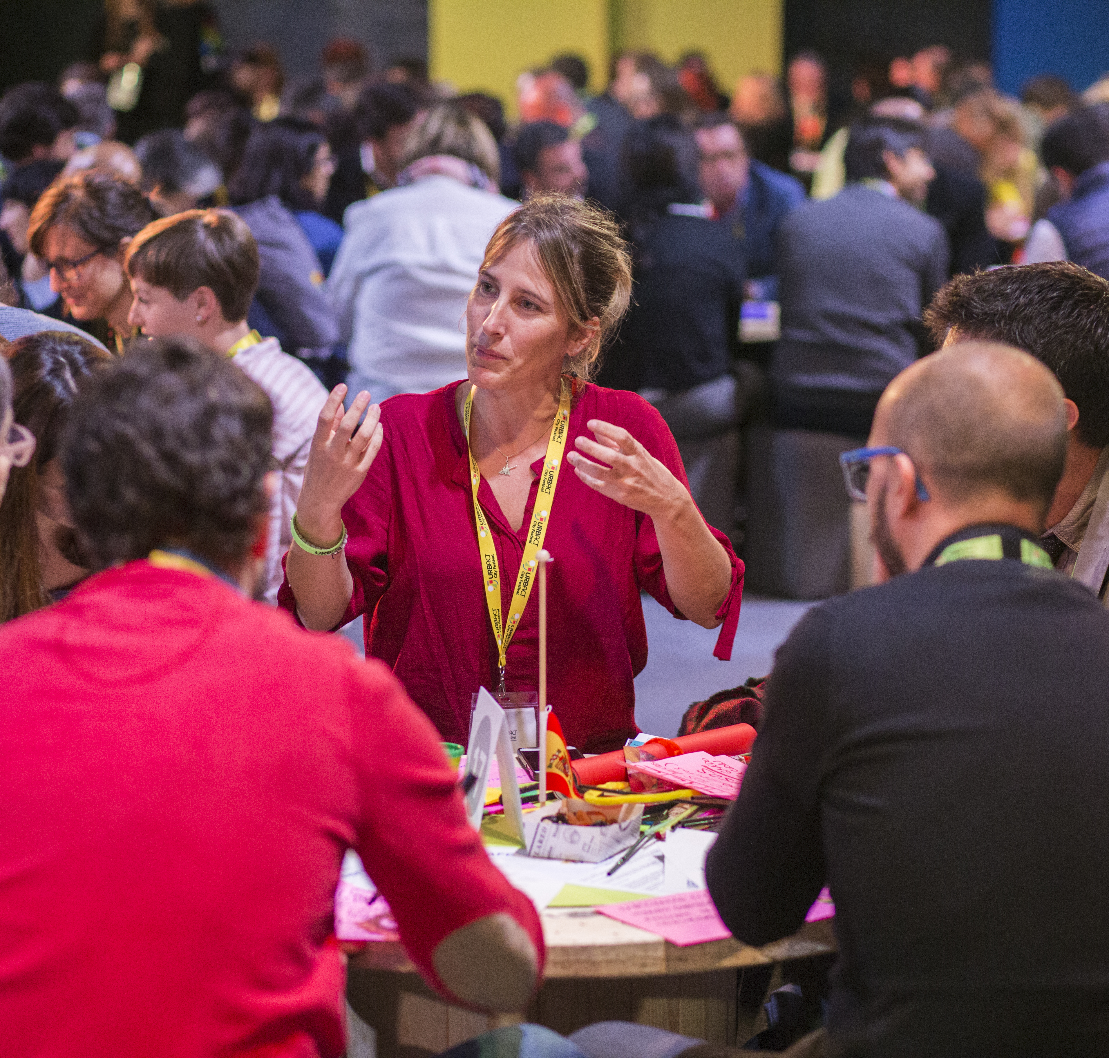
Photos: URBACT City Festival, Tallinn, 2017
Why apply?
Put your city in
the spot light
Showcase your Good Practice at the URBACT City Festival
8-10 April 2025, Wroclaw (PL)
Get the option to transfer your practice through an URBACT Transfer Network
Notes:
A series of communication and visibility activities:
-Online: URBACT website/social media/ European Commission’s channels/ Portico platform to name few
-In person: URBACT City Festival, EU Cities Forums, national events organised by National URBACT Points
Also a possibility to improve your practice if you participate if you chose to become a Lead Partner of an URBACT Transfer Network. Plus, the assessment panel of the practices will give feedback on the applications received.
URBACT Transfer Networks are a great opportunity to transfer and improve your practice for 2,5 years with the help of URBACT experts, with testing new actions at local level. In the past, a Transfer Network included from 5 to 8 partners and had a budget of 600 000 euros. A significant amount of this budget goes to the Lead Partner for hiring staff to manage the networks, for testing actions at local level and for local experts.

Slide 7
Who is eligible?
Cities, municipalities, towns
Infra-municipal tiers of government such as city districts and boroughs, in case where they are represented
Metropolitan authorities and organised agglomerations
Local agencies defined as public or semi-public organisations set up by a city, partially or fully owned by the city authority, responsible for the design and implementation of specific policies
No limitations in terms of size and population in order to apply to this call for Good Practices
Institutions from:
27 EU Members States
Partner States (Switzerland and Norway)
IPA countries (Albania, Bosnia and Herzegovina, Montenegro, North Macedonia and Serbia)
Ukraine and Moldova
Notes:
For any kind of city, no limitations in terms of size of population.
Any city can apply, regardless of how the practice was developed and implemented. It does not have to be a practice that was developed under URBACT.

Slide 8
Thematic coverage
Any policy area that has to do with sustainable urban developement
Economic development, social inclusion, green transition, energy transition, digital transition, gender equality, cultural heritage, migration, urban renewal, and others!

Slide 9
Criteria for the selection of Good Practices
Relevance at European Level
Fit with principles of integrated and participatory sustainable urban development
Impact at local level
4. Transferability
Criteria equally important and equally weighed:
25 points/
criterion

Slide 10
Criteria for the selection of Good Practices
Relevance at European Level
Why do you think this practice is relevant for other European cities? How the practice serves the EU Cohesion Policy 2021-2027 and its objectives, or the Sustainable Development Goals, or topics of the partnerships of the Urban Agenda for the EU.

Slide 11
Criteria for the selection of Good Practices
2. Fit with principles of integrated and participatory urban development
How does the practice use an integrated approach to tackling urban challenges (tackling at least environmental, economic, social dimensions at the same time)?
What evidence is there of a participatory approach in project development and implementation? Which stakeholders are involved and how do they work together?
Does the practice address gender equality? Does the practice involve digital technologies? Does the practice address green transition? If so, how?

Slide 12
Criteria for the selection of Good Practices
3. Impact at local level
Demonstrated positive impact on an urban area or on the entire city
What impact has the practice made at local level? Please provide details about the impact, added value (what needs/problems the practice addressed), results achieved, number or percentage of people having benefitted from the practice, evidence about the situation before the practice and after the practice implementation.
How is the practice documented?

Slide 13
Criteria for the selection of Good Practices
4. Transferability
Conditions of the practice easily applicable to other cities
Is the practice linked to any specific national governance/legislative context? Please explain if/how this impacts on the potential of transfer to other cities
Is there scope to amend the practice to suit other city contexts?
What do you think it is needed for the practice to be transferred to other cities?
Have you already transferred your practice in a way or another?

Slide 14


Timeline of the call

Slide 15
Submission procedure
To submit your Good Practice:
Fill in an online questionnaire in English by 30 June 2024 at 14:00 CET*
Link to the form on urbact.eu/get-involved
*An applicant can submit more that one proposal of Good Practice. However, the cities with several awarded good practices willing to take the role of the Lead partner in a Transfer network will have to choose one of their awarded good practice and apply for a single Transfer Network.

Slide 16
Experience from URBACT Good Practices selected in 2017
1st URBACT Call for Good Practices ran from December 2016 to March 2017
270 applications received
- 264 eligible
- 97 received the URBACT Good Practice label
(from 25 EU countries)
-23 of them transferred to 188 European cities through URBACT Transfer Networks (from 2018 to 2022)
Notes:
From the 97 proposed Good Practices, 31 cities had never been involved in URBACT before, which means 32% of the total cities having received the URBACT Good Practice label.

Slide 17
Useful resources
Terms of Reference: urbact.eu/get-involved
2017 selected Good Practices: urbact.eu/good-practices
URBACT Transfer Networks: urbact.eu/networks

Slide 18
Next online info sessions!
23 May 10:00-11:00 CET: What's in it for my city? Focus on visibility & URBACT City Festival of 8-10 April 2025, Wroclaw (PL)
20 June 10:00-11:00 CET: What happens next? Insights on the Call for Transfer Networks.
Details: urbact.eu/get-involved
Contact: goodpractices@urbact.eu

Slide 19

Questions?

Slide 20

EUI City-to-City Exchanges
continuously open

Slide 21


What is a City-to-city exchange?
Brings together a city facing a specific problem related to sustainable urban development (‘the applicant’)
And another 1-2 cities from a different EU Member State with expertise to help tackle this challenge (‘the peer’)
Simple application form, quickly implemented visit (between 2 and 5 days)
Depends entirely on city needs and the challenge they wish to put forward!
Open to all cities (in category DEGURBA 1 or 2)
Ongoing Call – Apply when you need.
More: https://www.urban-initiative.eu/capacity-building/pilot-call-c2c-exchanges

Slide 22
City-to-City Exchanges: what type of support do we provide?
Funding to support applicants and peers:
Type of cost Applicant City Peer City
Travel, accommodation & subsistence Up to 4 people Up to 2 people
Daily rate covering staff time No Up to 2 people
Expertise: we can appoint a moderator to facilitate exchange and learning process
Peer identification: we can facilitate contact with urban authorities
around Europe

Slide 23
City-to-City Exchanges in 2023 – Pilot Phase
Pilot phase: 4 April 2023 - 17 November 2023
Results:
43 applications, with approximately 90 cities engaged as applicants or peers. Evaluation ongoing currently.
Approximately 90% are small or medium-size cities
Approximately 75% are cities located in less-developed or in-transition regions
2 applicants started already implementing activities
Due to the high interest demonstrated by cities, we decided to open the call on a continuous basis.

Slide 24
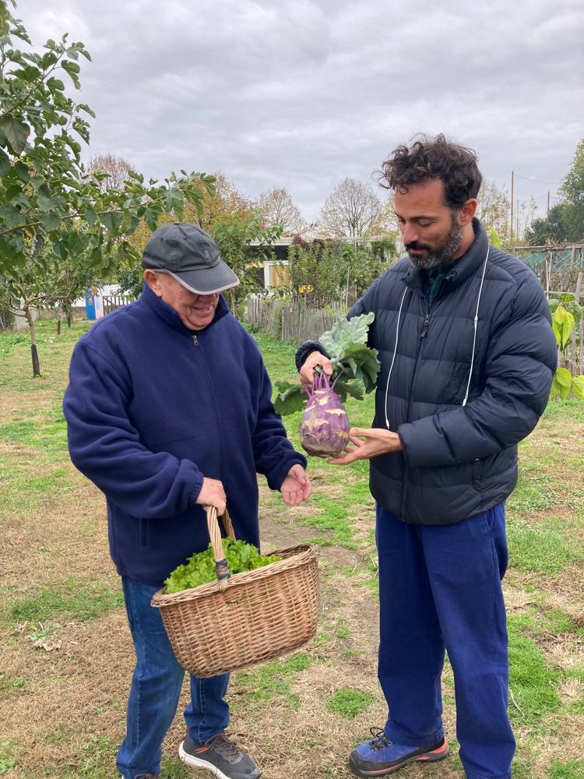
City-to-City Exchanges in 2024
Approval and Implementation of the C2C applications received in 2023.
Call open on a continuous basis – Cities can apply when they need/want!
Evaluations conducted on a rolling basis.
Revision of guidelines & simplification of application.
Bilateral consultations always available at this link
Peer introduction request form always available at this link

Slide 25
Thanks for your attention !
Get in touch with us
Fabian Massart (Fabian.massart@uliege.be)
Joachim Vercruysse (joachim.vercruysse@ugent.be)
Raissa Mohamed Robleh (rmohamedrobleh@sprb.brussels)
www.urban-initiative.eu www.urbact.eu

