Slide 1

Peer Review
Online Info Session
Welcome!
We will start at 10:30 CEST.
Are you a bit early?
Let us know in the chat which city you are from.
Grab a tea or a cup of coffee and get ready!
Notes:
Waiting room slide

Slide 2
Peer Review
Online Info Session
Notes:
Header slide

Slide 3
1
Welcome
2
All you need to know about Peer Reviews
Cities under Review in the spotlight: experiences from Pleszew (PL) and Maia (PT)
3
Agenda
Peer Reviewers in the spotlight: experiences from Vicenza (IT) and Pavlos Melas (EL)
4
10:30 - 12:00
5
FAQs
6
Wrap-up and closure words from European Commission, DG REGIO

Slide 4
Collective exercise
To whom do you go to seek advice when you face a professional challenge?
Answer in one sentence in the chat.

Slide 5
1. How many times did you attend an EUI event before?
First time
Twice
Three times
Four times
Five or more times
Poll

Slide 6
2. How well do you know the EUI Peer Reviews?
Poll
It’s totally new for me
I have heard the bells ringing and I am curious
I know the basics but tell me more
I know a lot but miss crucial information
I know pretty much everything
I already participated in a Peer Review

Slide 7
WHAT IS THE EUI?
Coherent support for cities

Slide 8



3 SERVICE PILLARS FOR EU CITIES +
identify and test innovative, transferable and scalable solutions to sustainable urban development problems of particular relevance at EU level
building cities’ capacity for sustainable urban development
communicating, disseminating knowledge from implemented projects and further building on the lessons learnt and their experience
FUNDING FOR INNOVATIVE PILOT PROJECTS
SUPPORT & STRENGHTEN CITIES' CAPACITIES
URBAN KNOWLEDGE AT ONE REFERENCE POINT:
PORTICO

Slide 9
Peer Reviews
Everything you need to know

Slide 10
What is a Peer Review?

Slide 11

What is a Peer Review?
WHAT: a capacity building activity to support European cities to improve the design and implementation of your Sustainable Urban Development strategies
HOW (method): throughout exchange and joint work with peers around Europe
WHO, 2 possible roles: City under Review and/or Peer Reviewer
Main milestone: 2-day event that brings together several Cities under Review, each with their group of 6 Peer Reviewers
It’s a process, goes beyond the actual event
More details: About EUI Peer Reviews | EUI (urban-initiative.eu)
Notes:
A peer review is a two-day event that brings together cities under review and peers (i.e., fellow urban practitioners). The cities under review are benchmarking their SUD strategies and getting insights, recommendations on their SUD strategies from peers.
The aim is to improve the capacity of cities under review in designing and implementing SUD Strategy. The main focus on the activity is SUD strategies, as defined by Cohesion Policy and article 11 of the current Regulation, that means as integrated, participatory, place-based strategies.
We are following a fixed methodology that is implemented in approx. 8-10 months.

Slide 12
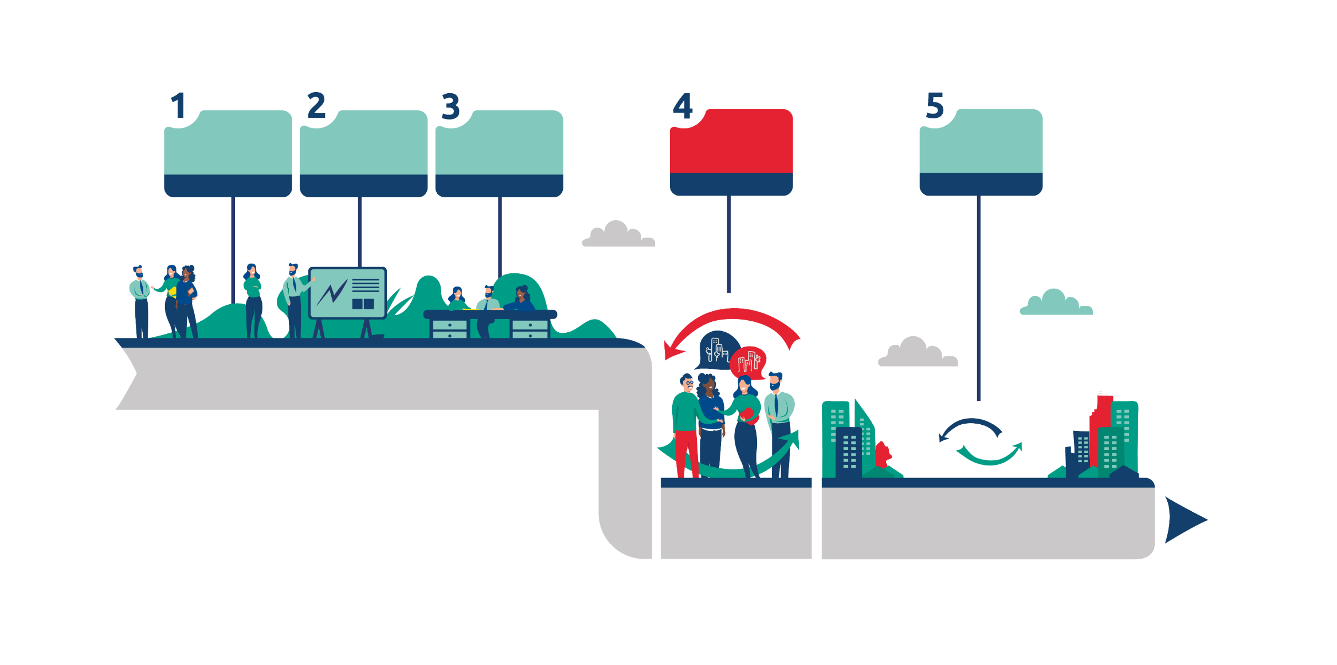
What do you concretely do in an EUI Peer Review?
An activity in five steps
Confirming the scope
Matchmaking
Content preparation
Peer review event
Follow-up activities
2 weeks
4 weeks
8 weeks
2 days
6 months
Challenges confirmed
Dates & location
Cities under review & peers grouped
Background paper
Online meetings
List of use cases from peers
2-day in-person event
Report received
Support for application to city-to-city exchange
Follow-up meeting
Notes:
Peer Reviews follows a particular process adapted from a methodology developed by the Joint Research Centre (JRC) of the European Commission

Slide 13
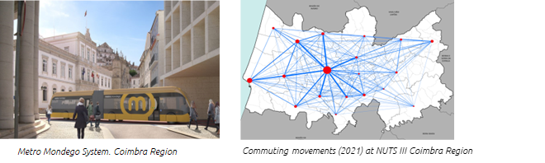


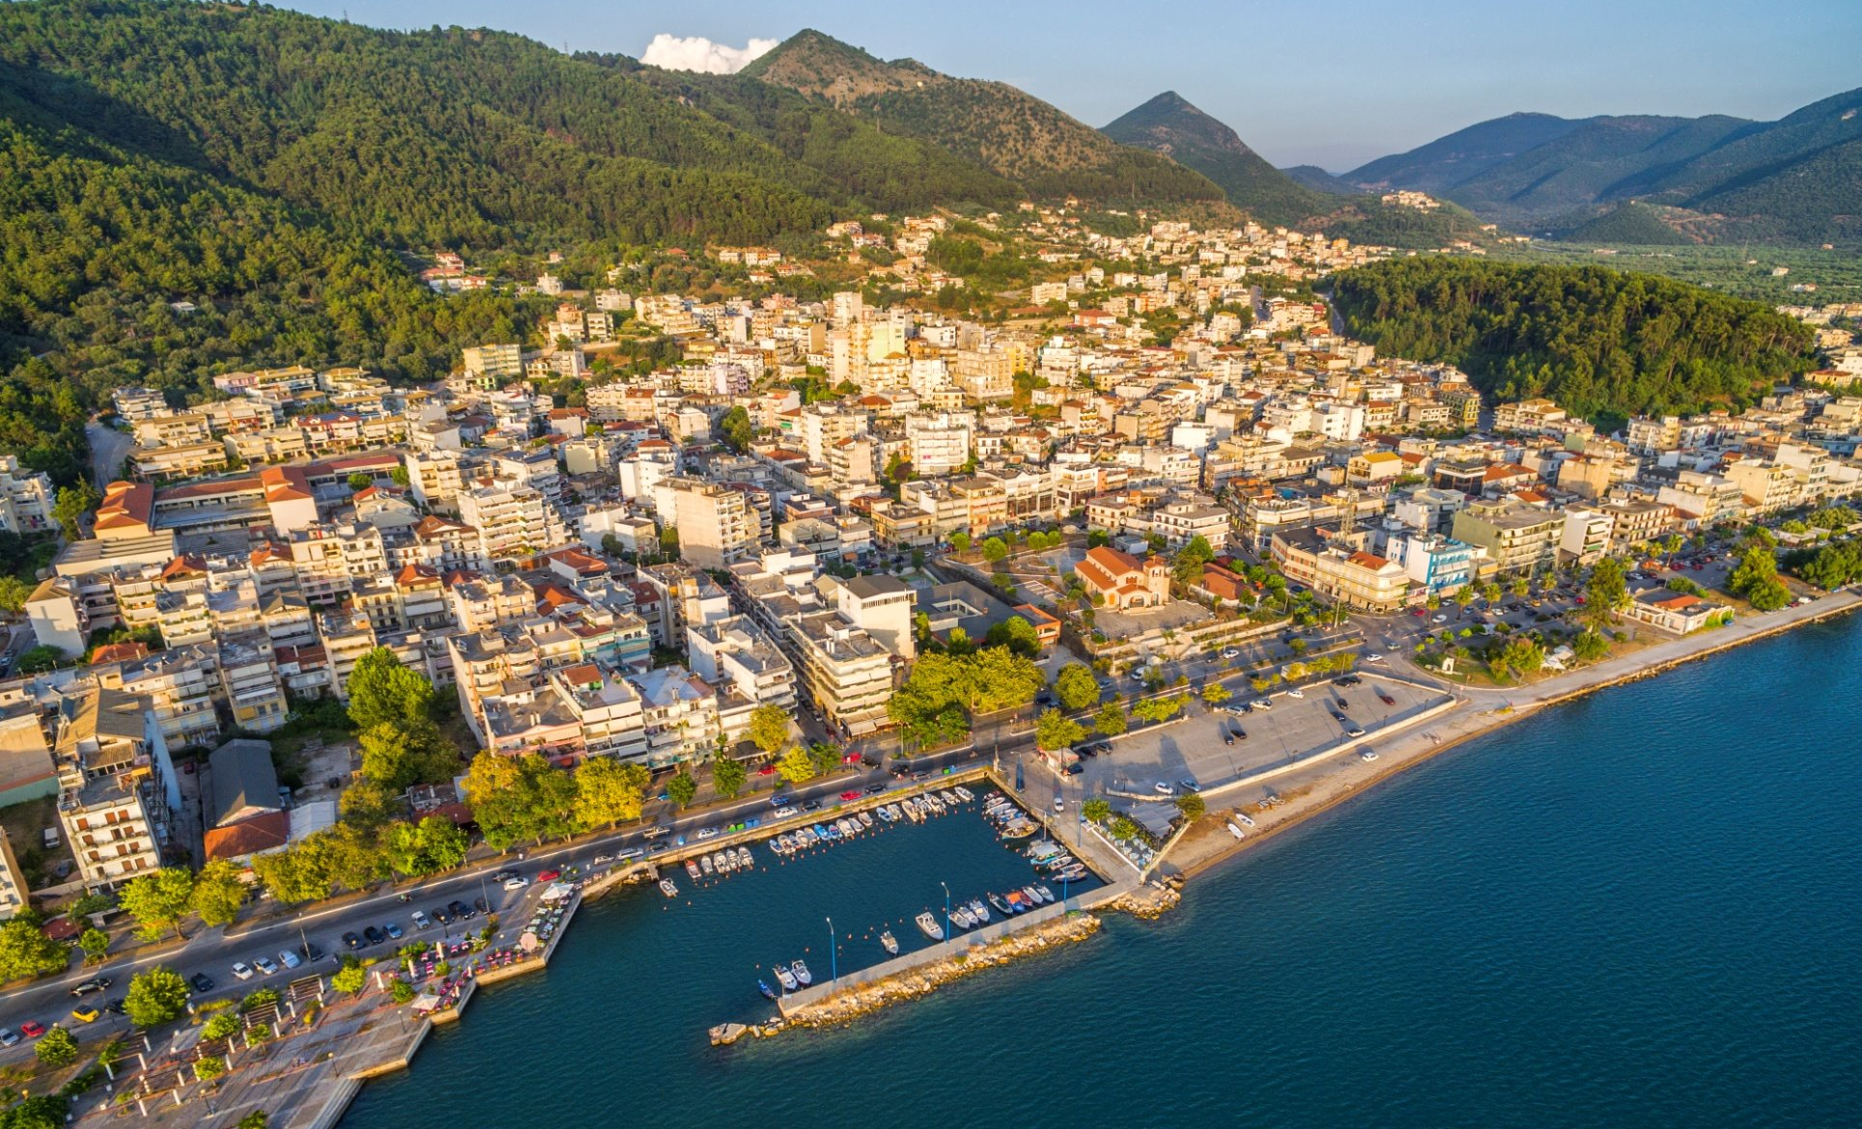
The Peer Review Universe
Venice, IT
Bistrita, RO
Piraeus, EL
Coimbra
Kalisz, PL
Murcia, ES
Plszew, PL
Montemurlo, IT
Drama, EL
Piraeus, EL
Addressing a Common question at the event
West Athens
Igoumenitsa
Kavala, EL
Lodz, PL
Genoa, IT
Padova, IT
Pavlos Melas, EL
Lorquí, ES
Vila Franca de Xira, PT
Alba Iulia, RO
Notes:
Peer Review event in Coimbra, PT

Slide 14
What type of support does EUI provide?
Apply, and we take care of the rest!
1
2
3
Expertise
Logistics
Funding
2 Peer Review Experts will support Cities under Review in every step of the activity.
We take care of the whole organisation and cover all costs!
Participants: You only have to book your travel & accommodation.
You can claim financial support:
After the event,
Based on standardised costs,
For up to 4 people if you are a City under Review,
For up to 2 people, if you are a Peer Reviewer.

Slide 15
How can you get involved?

Slide 16

Call for Peer Reviews
The call for Peer Reviews is open until 30th of April 12:00 CET
You can apply to be a City under Review, a Peer Reviewer, or both!
To learn more about the call:
  Check the page of the call on the EUI website
  Read the Guidance for applicants
  Book a 30-min online call with one of the capacity building officers

Slide 17


2024 Peer Reviews timeline
End of June: decision on dates and location of Peer Review events & final composition of peer review groups
30 April: Call closes, deadline for applications
12 March: Call open
9 April 10:30 -12:00
Peer Reviews online info session
After 14 May: announcement of call results
Autumn – winter 2024: 3 Peer Review events

Slide 18
Any questions?

Slide 19
Cities under Review
in the spotlight

Slide 20
Peer Reviewers
in the spotlight

Slide 21
Which role are you most interested in?
Poll
City under Review
Peer Reviewer
Both
I don’t know yet

Slide 22
FAQs
Ask us anything
With Paul & Zoé

Slide 23
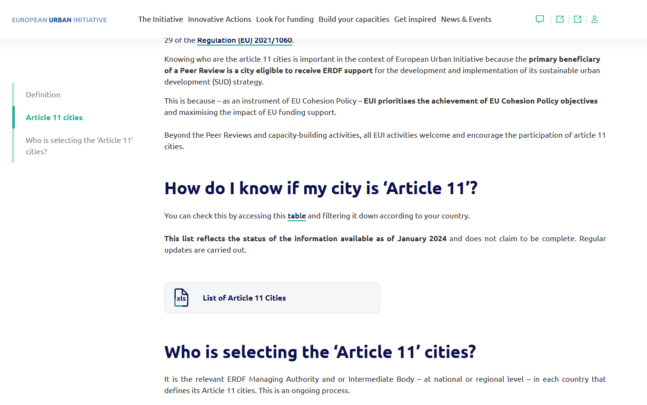

Slide 24
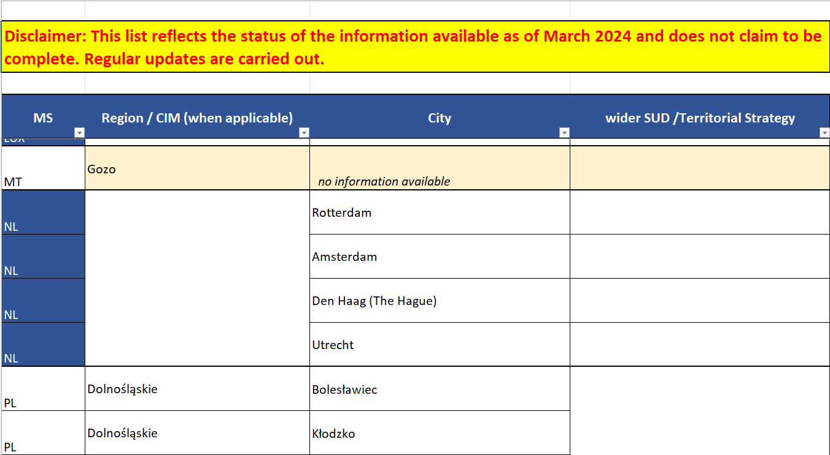

Slide 25
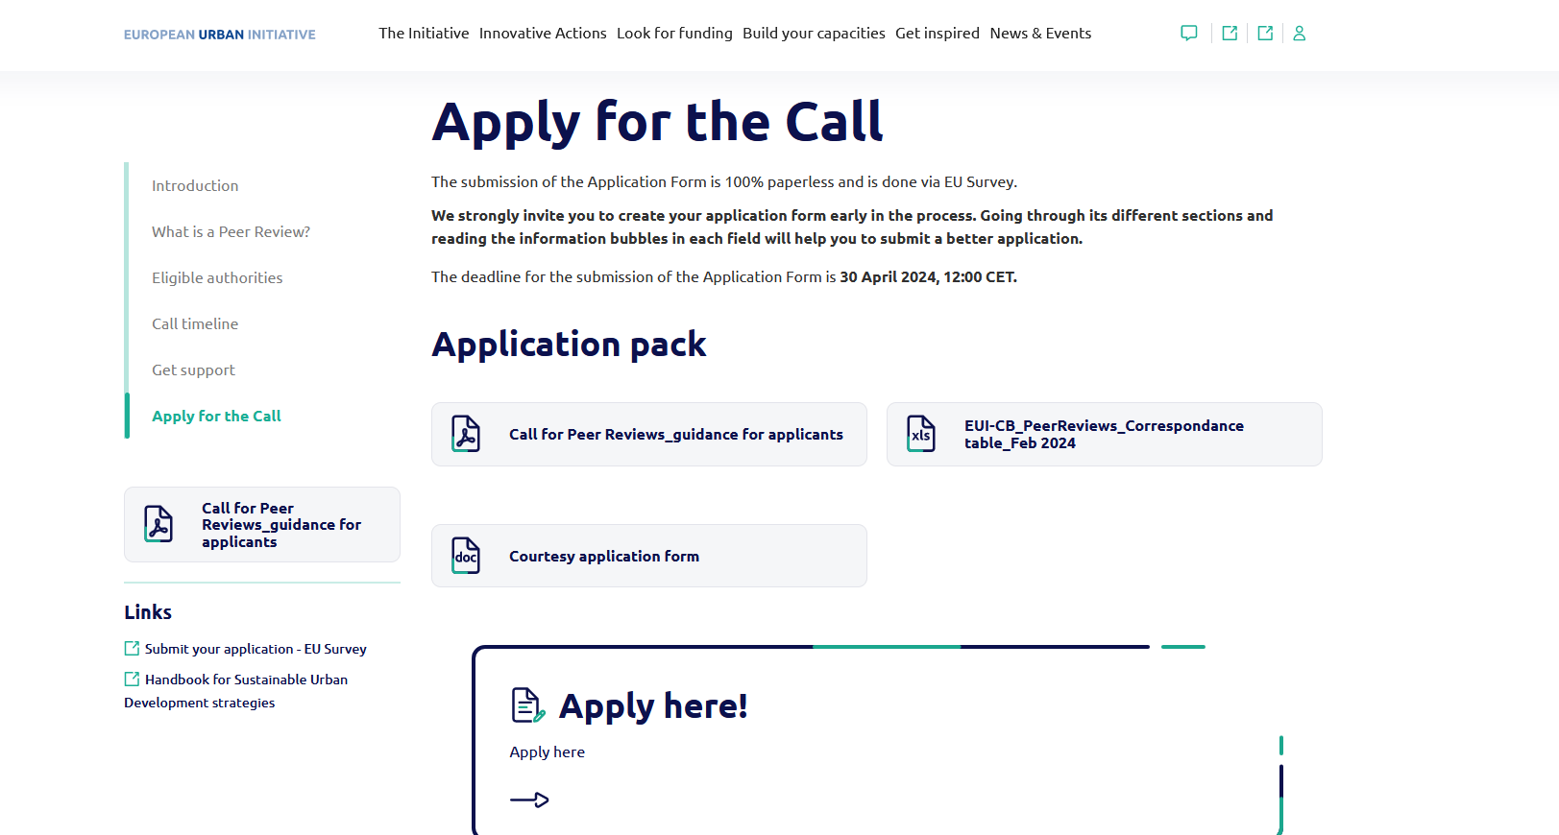

Slide 26
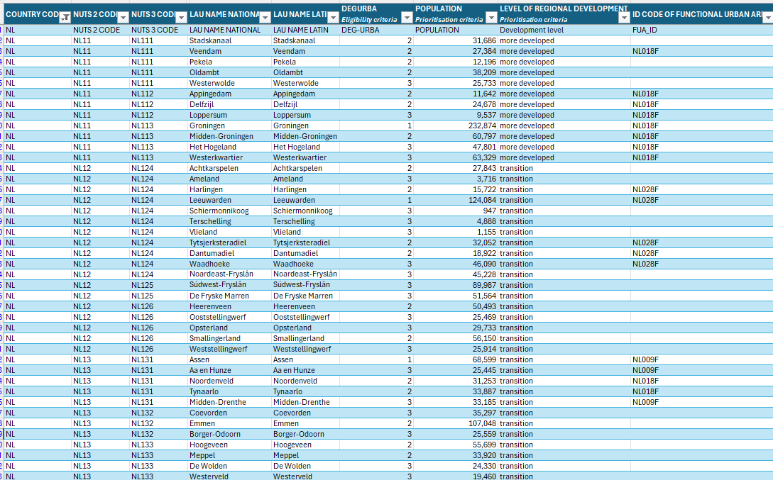

Slide 27
Closing words
With European Commission

Slide 28
4. How close are you to submit a Peer Review application?
Poll
I don't know if it's something for us
We are considering this
We started filling-in the application form
Very close! We are about to push the ‘submit’ button

Slide 29
5. Did this event meet your expectations?
Poll
Yes, very much so!
To a certain extent
It could have been better
No, not really

Slide 30
Wrap-up

Slide 31

EUI capacity building offer: trio of activities
Call open: 12 March – 30 April 2024
3 Peer Reviews to start second half of 2024
Open non-stop
32 Exchanges approved so far
5 training events in 2024: Finland, Ireland, Latvia, Sweden, Croatia – Greece (TBC)

Slide 32
Upcoming European Urban Initiative opportunities
Upcoming events:
Info session , Innovative Actions Third Call : 6 May 2024 -> register now
EU City Lab on Food #2: 29-30 May 2024 in Liège -> Join us
Leveraging Innovation Ecosystems for Sustainable Cities: 29-30 May 2024 in Tampere, Finland -> Check out the event page
Current and upcoming calls:
Call for City-to-City Exchanges –> visit the call page
Cities Forum 2025, call for host city –> apply to be host
Call for Innovative Actions in May-September –> visit the call page

Slide 33
Thank you for your attention!

Slide 34
Thank you for joining us!
You will receive an e-mail shortly with all follow-up.
For any questions on capacity building activities contact us at:
capacitybuilding[at]urban-initiative.eu

