Slide 1
Reshaping policy, unleashing talents, shifting minds for the Green Transition
STUDY VISITS PRESENTATION
8-9 November 2023 - Tourcoing (Lille Metropole) France

Slide 2
Terrabundo – REV 3
Witness the application of the circular economy at the Terrabundo and former industrial site AGFA GEVAERT. Terrabundo is an office building, coworking space and events venue, part of the REV3 initiative and supported by ERDF funds. The building is C2C-accredited and highly energy-efficient. The nearby former industrial site AGFA GEVAERT was regenerated into a business district promoting food quality and circular economy projects.
During the site visit, participants will learn more about the project as a regional development accelerator serving businesses. There will be particular emphasis on the eco-construction, the circular nature as well as the location’s’ hub function for the green transition.

Slide 3
Information
Departure from venue: 14.15
Duration: approx. 1,5 hours (excluding transfer time)
Location: 1 rue Christian Maille, 59710 Ennevelin
Departure from the La Chaufferie -Tourcoing
Transportation mode: Bus
End of visit: 18.00, the bus will drop you off in the Centre of Lille; dinner will start at 19.30

Slide 4
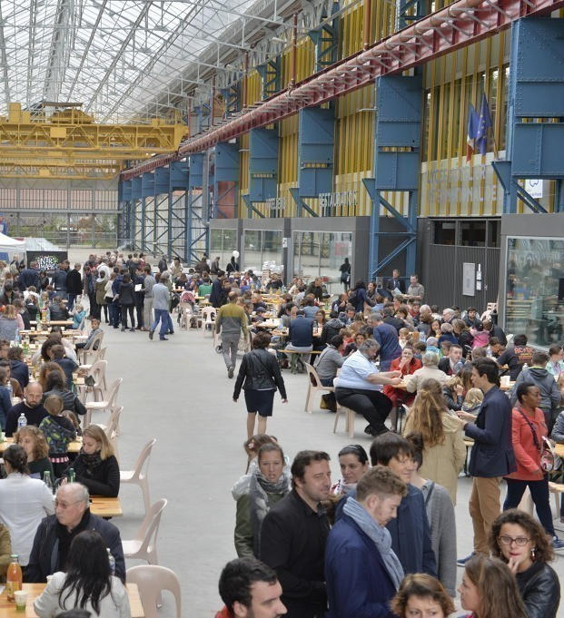
Fives – Chaud Bouillon
“Chaud Bouillon !”, a former plant turned in a place promoting social inclusion through food
4 complementary spaces: the foodcourt, the shared kitchen, the urban farm and the professional kitchen.
A project part of a larger transformation : the creation of an eco-district associating 1000 housings, including social housings, public amenities (parc, swimming pool…), hotel and design schools, activities, shops and convenience stores.

Slide 5
Information
Departure from venue: 14.15
Duration: approx. 1,5 hours (excluding transfer time)
Location: Chaud Bouillon, 70 Pass. de l'Internationale, Lille
Departure from the La Chaufferie -Tourcoing
Transportation mode: Bus
End of visit: 17.30, the bus will drop you off in the Centre of Lille; dinner will start at 19.30

Slide 6
Loos en Gohelle
Discover a small town in the heart of the Nord-Pas de Calais mining basin, which has become a model of resilience!
A story of a territorial reconversion over a 30 year period. Including social, economic and environmental investment, with a special feature - citizen participation.
The visit will explain the transition journey piloted by Loos en Gohelle through key visible achievements such as the solar church and fablab supporting pilot technologies in energy transition and sustainable buildings.

Slide 7
Information
Departure from venue: 14.15
Duration: approx. 2 hours (excluding transfer time)
Location: Loos-en-Gohelle, France
Departure from the La Chaufferie -Tourcoing
Transportation mode: Bus
End of visit: 18.00, the bus will drop you off in the Centre of Lille; dinner will start at 19.30

